Slide 1
THE DEEP WORK STARTER KIT
Rebuilding Attention in a Distracted College World
by Phuong Dinh
MsC Marriage and Family Therapy’ 26
Notes:
Hello everyone,
My name is Phuong, and I’m one of the Academic Coaches here at the Kortschak Center. As part of our ongoing commitment
to supporting students’ academic success, I’ll be leading a workshop on Deep Work for more meaningful learning.
In this workshop, we’ll explore Deep Work as a practical tool for rebuilding our attention span and minimize distractions.
Together, we’ll talk about why focused attention matters, what gets in the way of it and how you can develop strategies to
work more intentionally and effectively.

Slide 2
Learning Outcomes
Understand the concept of cognitive fragmentation and its effects
Recognize personal attention levels and learning habits
Create strategies to sustain focus during study sessions
Notes:
These will be our learning outcomes for today’s workshop.
First, we will develop an understanding of cognitive fragmentation and how it affects our ability to engage in deep work.
Second, we will reflect on and recognize our personal attention patterns and learning habits.
Lastly, we will focus on creating practical strategies and routines that help us sustain focus during deep-work study sessions.

Slide 3
What is DEEP WORK?
WHY IT MATTERS?
A focus, distraction- free time
Staying on one task long enough to understand, remember and complete it.
“Lock-in mode": one task, full attention, zero noise
Learning improves when attention is sustained, not split
Reduces mental fatigue and burnout
Leads to higher-quality work (reading, writing, comprehension)
Quality of focus > hours spent studying
Notes:
Let's jump into defining Deep Work.
It is essential describing the state of focus and free of distraction. For a lot of us as student, it could often be the ability to stay working on one task
Learning happens when attention is sustained, not split to make connections, understand ideas and store information in memory.
Lower mental fatigue and burnouts whileimproving performance. When focus isn’tconstantly interrupted, studying feels moreintentional and supports higher quality of worklike reading, writing and comprehension .
Time spent ≠ learning gained, quality ofattention matters more than numbers ofstudying hours

Slide 4
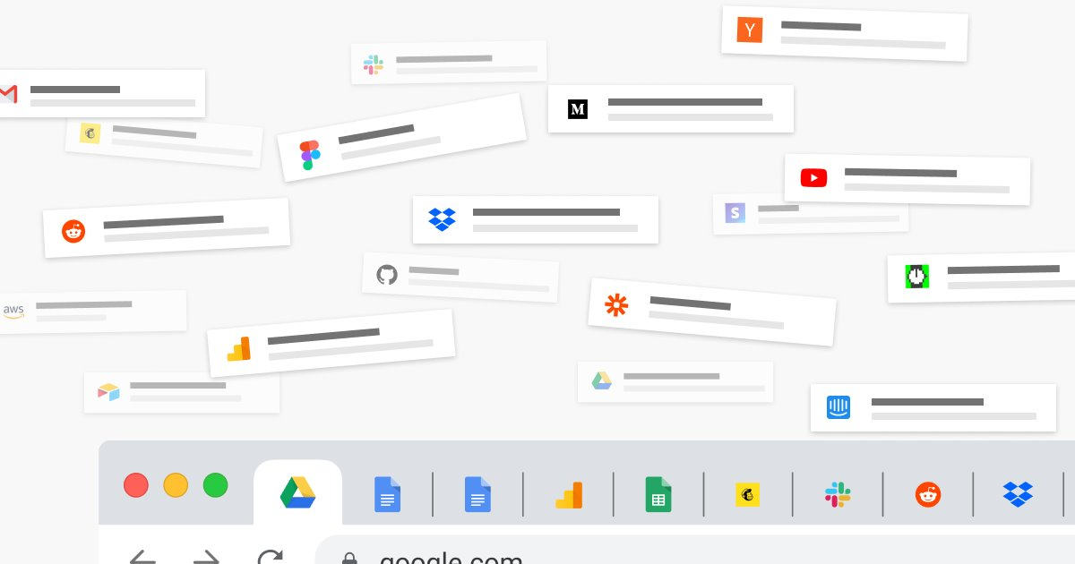
WHY DOES OUR FOCUS BREAK DOWN?
COGNTIVE FRAGMENTATION
A mental state where attention becomes scattered due to constant digital interruptions and information overload, making it difficult to sustain focus or build cohesive understanding.
Notes:
Our focus is often affected by something we call cognitive fragmentation.
Imagine your brain works like a web browser with 20 or 30 tabs open. Some of those tabs are important, some you forgot
about, and a few are playing music somewhere in the background. Even when you’re trying to focus on just one task, all of
those open tabs are still using mental energy. That’s what cognitive fragmentation feels like.
Another example is task switching. Every time you switch from studying to checking your phone or opening another app, your
brain has to restart. That restart time adds up, which is why studying can feel harder and more exhausting than it actually
needs to be.

Slide 5
WHY DOES OUR FOCUS BREAK DOWN?
COMMON SIGNS of COGNTIVE FRAGMENTATION
Jumping between tabs, apps, and tasks
Rereading the same paragraph without understanding
Feeling mentally scattered or overwhelmed, "brain fog"
Strong urges to “just check” your phone
Notes:
These are some common signs of cognitive fragmentation that many students and most of us—experience.
For example, you might notice yourself jumping back and forth between tabs, apps or different assignments, even when you meant to focus on just one thing.
You may also find yourself rereading the same paragraph, or even the same sentence, several times and still not quite understanding what it’s saying.
Feeling mentally scattered, overwhelmed, or experiencing what we often call “brain fog” is another common sign. This usually happens when our brains are overloaded with information and constant sensory stimulation.
And finally, there’s that strong urge to check your phone while working, "just to see something quickly" . Even those short moments can interrupt your focus and make it harder to get back into deep, meaningful work.

Slide 6
IDENTIFY YOUR SOURCES OF DISTRACTIONS
Which apps interrupt me most and why?
When do I find myself having the urge to check my notifications?
Did you look at your phone “just to check one thing” and resurfaced 15 minutes later?
What tasks require the most focus for me?
Am I switching between assignments mid- study session?
Did I start my study session without a clear plan?
Are my surroundings noisy?
Am I studying in a place that I tend to use for relaxing and wind down?
Notes:
This slide is about becoming more aware of where our distractions actually come from. The goal here isn’t to judge ourselves but to notice patterns.
Start by thinking about which apps tend to interrupt you the most and why. Is it notifications, boredom, stress, or habit?
Pay attention to when you feel the urge to check your phone. Does it happen when a task feels difficult, boring, or unclear?
Often, we check our phones with the intention of just a quick look, but time slips by faster than we realize. Those few seconds can easily turn into 10 or 15 minutes, disrupting our focus.
It’s also helpful to notice which tasks require the most focus for you and whether you’re switching between assignments in the middle of a study session. Task switching can feel productive, but it often breaks concentration.
Think about how you start your study sessions. Beginning without a clear plan can make it easier to get distracted.
Finally, consider your environment. Is the space noisy? Or is it a place you usually associate with relaxing or winding down? Our surroundings play a big role in how focused we’re able to be.

Slide 7
INTRODUCE YOU TO THE DEEP WORK CHECKLIST
So, what is a Deep Work Checklist ?
A practical tool to use before you start studying
Helps reduce distractions before they happen
Supports focused work through intention, not willpower
​
Notes:
We’ve spent time talking about how cognitive fragmentation breaks our focus. Now we’re shifting to solutions. The Deep Work Checklist is a simple tool you can use before you study to set yourself up for success, without relying on motivation alone

Slide 8
BUILD YOUR DEEP WORK RITUAL / CHECKLIST
1. My Focus Block
How long will this deep work session be?
20 minutes – I’m rebuilding focus
40 minutes – I can stay with one task
60 minutes – I already have strong focus habits
( ) minutes
Why I chose this length:
Start time: __________
End time: __________
Notes:
This slide is about building your own deep work ritual, starting with your focus block. There’s no “right” length here, the goal is to choose something realistic for you.
First, think about how long you can honestly stay focused on one task right now.
If you’re rebuilding your attention, 20 minutes is a great place to start.
If you can usually stay with one task a bit longer, 40 minutes might feel right.
If you already have strong focus habits, you might choose 60 minutes.
You can also write in a custom time if none of these options fit you.
Next, take a moment to think about why you chose that length. Maybe you know you lose focus after a certain amount of time, or maybe you’re working your way up slowly. That awareness is part of building better focus habits.
Finally, choose a clear start and end time for your session. Having a defined time block helps your brain know when to focus and when it’s okay to take a break.

Slide 9
BUILD YOUR DEEP WORK RITUAL/ CHECKLIST
2. My Deep Work Zone
Where will I do this work?
Location: ________________________
What makes this place work for focus?
Notes:
This part of the checklist is about identifying your Deep Work Zone or the place where you’ll do your focused work.
Start by choosing a specific location. This could be a library, a study room, a desk at home, or any space where you’re less
likely to be interrupted.
Next, think about what makes this place work for your focus. Is it quiet? Are there fewer distractions? Does your brain
associate this space with getting work done rather than relaxing or scrolling? Be aware of other factors lighting, noise level and whether your phone is within reach can all affect your ability to stay focused.
The goal is to be intentional about where you study not just what you study.

Slide 10
BUILD YOUR DEEP WORK RITUAL/ CHECKLIST
3. Environment Check
Before I start, I will:
Clear my desk/workspace
Gather all materials I need
Close extra tabs (limit: ___ tabs)
Put my phone:
out of reach
in another room
face down
Notes:
This step is about setting up your environment before you begin, so distractions don’t interrupt you once you’re already
Focused.
First, take a moment to clear your desk or workspace. You don’t need it to be perfect, remove anything that might pull
your attention away from the task you’re working on.
Next, gather all the materials you’ll need for this session. That way, you don’t have to get up or switch tasks once you’ve
Started.
Then, look at your screen and close any extra tabs you don’t need. You can even set a personal limit for yourself. Fewer tabs
mean less mental clutter.
Finally, decide what to do with your phone. This is an important one. You might choose to put it out of reach, leave it face
down, put on DND, turn if completely and even place it in another room, whatever helps reduce the urge to check it.
The goal of this environment check is to remove as many distractions as possible ahead of time, so your focus doesn’t have to
rely on constant mental effort once you begin working.

Slide 11
BUILD YOUR DEEP-WORK RITUAL (CONT)
4. One Clear Intention (Most Important)
What is the one task I will work on?
If I finish early, I will continue by:
Notes:
This step is about setting one clear intention for your deep work session and it’s the most important part of the checklist.
Before you start, ask yourself: What is the one task I will work on during this session?
Try avoiding being vague rather be specific and clear with the task one specific, clear task such as reading a certain number of
pages, outlining a paragraph or solving two sets of problems.
Having one clear intention helps your brain know exactly what it’s supposed to focus on which makes it easier to stay
engaged and avoid distractions.
Next, think about what you’ll do if you finish early. This is your backup plan. It keeps you from being on your phone or
another task once the main goal is done.
This step helps turn deep work into a structured, intentional session rather than an open-ended one.

Slide 12
BUILD YOUR DEEP-WORK RITUAL (CONT)
5. Distraction Plan
What usually pulls my attention away?
My top distraction: ____________________________
What I’ll do when the urge hits: ⬜ Ignore it for 60 seconds ⬜ Write it down and return to the task ⬜ Take one deep breath and refocus
⬜ Others: __________________
Notes:
The 5th step is about planning for distractions before they show up. Distractions are normal, the goal is to respond to them intentionally.
First, think about what usually pulls your attention away. It might be your phone, notifications, outside noise, a difficult part of the task or even your own thoughts.
Next, choose what you’ll do when that urge hits. Having a simple response plan helps you stay in control without needing to
make a decision in the moment.
You might choose to ignore the urge for 60 seconds, write the thought down and return to the task, or take one deep breath
and refocus. You can also add your own strategy if something else works better for you.

Slide 13
BUILD YOUR DEEP-WORK RITUAL (CONT)
6. After the Session
What did I complete?
What distracted me most?
One thing I’ll adjust next time:
Notes:
This final step is about reflection, not evaluation. The goal is to learn from the session, take a moment to notice what you completed. Even small progress counts and helps build confidence.
Next, think about what distracted you the most. This isn’t about blame but for awareness. Knowing what showed up helps you plan better next time.
Finally, choose one small thing you’ll adjust for your next deep work session. It could be changing your environment, shortening your focus block or adjusting your distraction plan.

Slide 14
BUILD YOUR DEEP-WORK RITUAL (BONUS!)
Track the Experience (optional)
(After each session, rate the following on a 1–5 scale:
Clarity How clear was my thinking and understanding?
1 ⬜ ⬜ ⬜ ⬜ ⬜ 5
Productivity How much meaningful progress did I make?
1 ⬜ ⬜ ⬜ ⬜ ⬜ 5
Stress Level How stressed did I feel during the session?
1 ⬜ ⬜ ⬜ ⬜ ⬜ 5 (Lower is better)
Sense of Accomplishment How satisfied did I feel afterward?
1 ⬜ ⬜ ⬜ ⬜ ⬜ 5
MAKE IT A WEEKLY CHALLENGE
Schedule two 60-minute deep work sessions per week
Pick times you can actually protect (not “ideal” times)
Treat them like appointments with yourself
Notes:
This is a bonus track at the end of your study session to reflect on the overall experience. As a way to boost productivity, you can also make into a weekly challenge of doing 2 60 minutes deep work sessions following this guidelines.

Slide 15
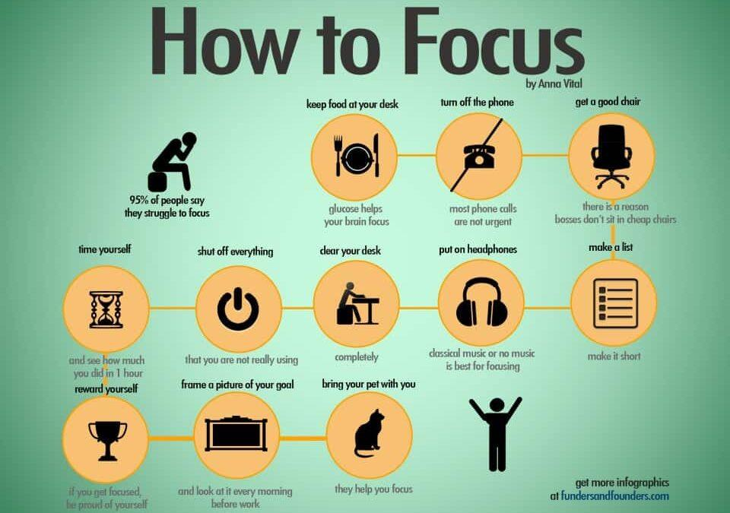
Technology rules for deep work ritual (recommended)
Turn off all notifications
Use Focus Mode / Do Not Disturb
Silence group chats
Block/deleting distracting apps if needed
Keep ≤ 3 tabs open
Notes:
This slide focuses on technology rules that can support deep work.
First, turning off notifications is one of the most effective ways to protect your focus. Even silent notifications can pull
attention away, so fewer alerts mean fewer interruptions.
Using Focus Mode or Do Not Disturb can be especially helpful during deep work sessions. These tools let you temporarily
pause notifications while still allowing important contacts or apps through if needed. Silencing group chats is another big one.
Group messages tend to create constant interruptions, even when the messages aren’t urgent.
If certain apps are especially distracting, consider blocking or deleting them during study periods. This doesn’t have to be
Permanent, just enough to reduce temptation while you’re trying to focus.
Finally, try to limit the number of tabs you keep open. Keeping three or fewer tabs reduces visual and mental clutter and
makes it easier to stay on one task.
The goal here isn’t to eliminate technology but to set clear boundaries so your devices support deep work instead of
interrupting it.

Slide 16
DURING YOUR DEEP WORK SESSION: DO
Start even if you don’t feel focused yet
Expect restlessness in the first few minutes
Gently bring your attention back when it drifts
Write down distractions to handle later
Stay with the same task for the full block
Take a real break when the timer ends
Notes:
Deep work isn’t about forcing yourself to concentrate for hours. It’s about setting up the right conditions, one session at a time. Start small, stay consistent and let focus build naturally.
As we wrap up, this slide is a reminder of what deep work looks like.
You don’t need to feel focused before you start. Focus often comes after you begin. It’s normal to feel restless or uncomfortable in the first few minutes, that’s your brain adjusting.
When your attention drifts, gently bring it back without judgment. Getting distracted doesn’t mean you’re doing it wrong, it’s part of the process.
If a thought or distraction comes up, write it down and return to your task.
Stay with the same task for the full time block, even if it feels challenging.
And when the timer ends, take a real break. Rest is part of deep work, not a reward for it.

Slide 17
DURING YOUR DEEP WORK SESSION: DON'T
Wait for motivation or the “right mood”
Switch tasks mid-block
Check notifications “just for a second”
Multitask or keep extra tabs open
Judge yourself for losing focus
Notes:
Lastly, this is here to normalize what often gets in the way of deep work and to remind you what not to expect from yourself.
Don’t wait for motivation or the “right mood” to start. Deep work usually creates motivation, not the other way around.
Try not to switch tasks in the middle of a focus block. Even when it feels productive, task switching breaks your attention and
makes it harder to re-engage.
Avoid checking notifications “just for a second.” Those small interruptions often take more time and energy than we realize.
Multitasking or keeping extra tabs open may feel efficient, but it actually increases mental load and reduces the quality of
your work.
And most importantly, don’t judge yourself for losing focus. Distraction is part of being human. What matters is gently
noticing it and returning to the task.

Slide 18
REFERENCES
Calderwood, C., Ackerman, P. L., &amp; Conklin, E. M. (2014). What else do college students “do” while studying? an investigation of multitasking - sciencedirect. Sciencedirect https://www.sciencedirect.com/science/article/abs/pii/S0360131514000384
Cao, J., Luo, J., Zhou, J., &amp; Jiang, Y. (2024). Attention switching through text dissimilarity: A
cognition research on fragmented reading behavior. Frontiers.https://www.frontiersin.org/journals/human-
neuroscience/articles/10.3389/fnhum.2024.1402746/full
Graben , K., Doering , B. K., &amp; Barke, A. (2022). Receiving push-notifications from smartphone
games reduces students learning performance in a brief lecture: An experimental study -
sciencedirect. Sciencedirect .https://www.sciencedirect.com/science/article/pii/S2451958822000045

