Slide 1
Self-care in 8 Dimensions of Wellness
USC Kortschak Center For Learning and Creativity
Yizhen Jane Wang
Notes:
Hi everyone! My name is Yizhen Jane Wang, an academic coach at KCLC. I’ll introduce the 8 dimensions of wellness and share practical tips and examples you can try out. ​

Slide 2
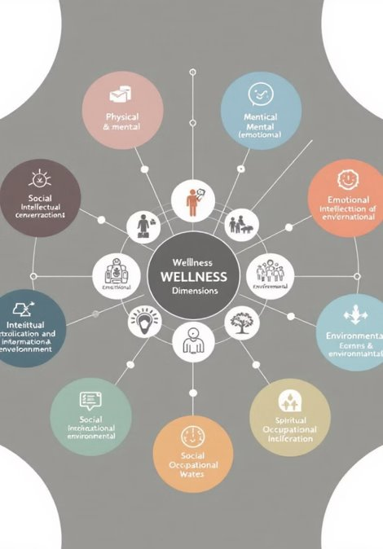
Self-Care in 8 Dimensions of Wellness
Self-care: Activities to maintain well-being​
Wellness: Active process for a fulfilling life
Notes:
Here’s a question to start us off: When was the last time you intentionally did something just for yourself? For example, maybe you went on a walk, listened to music, or even took a nap.​
If it’s been a while, don’t worry—by the end of this presentation, you’ll have some new ideas to make self-care a regular part of your routine.​
​
This topic is important for college students because balancing academics, relationships, and personal well-being can be overwhelming. But here’s the good news: self-care isn’t about perfection, it’s about small, intentional steps that help us live fulfilling lives. Wellness is an active process—it's about making choices that align with your values and promote well-being. Imagine wellness as an evolving journey.​

Slide 3
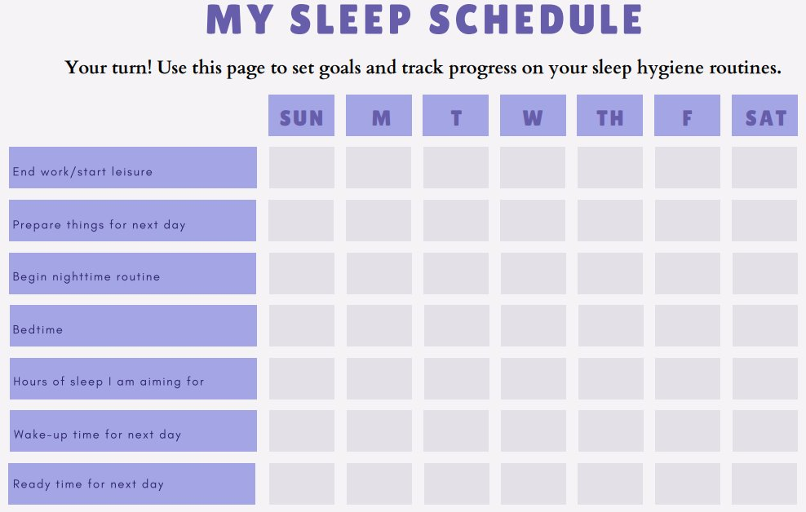
Physical Wellness
Care for your body: nutrition, exercise, sleep
Time Management: schedule activity, meals, sleep
Self-Care Actions:
30 mins activity, 5x/week
5 servings fruits/veggies daily
Sleep 7-8 hours/night
Notes:
Let’s start with physical wellness. This is probably the one most of us think of first. Physical wellness is all about taking care of your body—things like exercise, eating well, and getting enough sleep. I know it sounds simple, but to be honest, it’s not always easy. Especially when you’re juggling deadlines, classes, and maybe even a part-time job. Research has shown that individuals who engage in at least 30 minutes of moderate physical activity five times a week report improved focus and reduced stress levels. Additionally, establishing consistent sleep routines has been linked to better academic performance and emotional regulation.​
Here’s a tip: Start small. You don’t need to hit the gym for two hours every day. Even a 10-minute walk between study sessions can do wonders. Another great habit is building a consistent sleep schedule. Try to aim for 7–8 hours of sleep every night—your brain and body will be refreshed.​
​

Slide 4
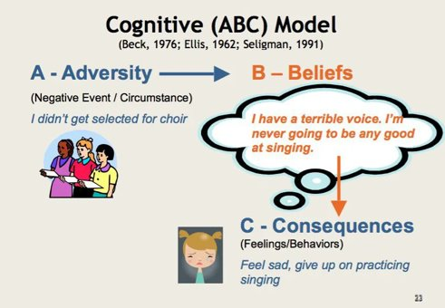
Intellectual Wellness
Continuous learning and creativity
Self-Regulation: Plan, monitor, and evaluate
Actions:
  A-B-C thinking
  Engage in puzzles, reading, learning
Notes:
Next, we have intellectual wellness, which is all about keeping your mind active and curious. This doesn’t just mean studying harder—it’s about learning for the growth and creativity. Have you ever taken a break from academics to learn something fun, like trying a puzzle or exploring a random topic online? That counts!​
One strategy you can try is the A-B-C thinking model. Studies highlight the effectiveness of strategies like breaking tasks into smaller steps and using tools such as the A-B-C thinking model. This model—identifying the activating event, beliefs, and consequences—has been demonstrated to help students manage stress and improve decision-making skills during high-pressure situations. For example, if you’re stressing over a big project, break it down. Identify the Activating event (like the project deadline), your Beliefs about it (like “I’ll never finish this”), and the Consequences of those beliefs. Then, reframe those beliefs into something more constructive, like, “If I take it one step at a time, I can handle this.”​
​

Slide 5
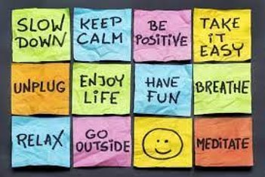
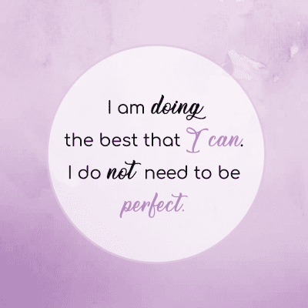
Emotional Wellness
Express/manage emotions effectively
Managing Emotions: positive self-talk
Actions:
  Mindfulness for negative self-talk
  Seek help for overwhelming emotions
Notes:
Now let’s talk about emotional wellness. This is all about recognizing, expressing, and managing your emotions. Emotional wellness is the ability to manage and express emotions effectively. This dimension plays a crucial role in handling stress and maintaining a positive outlook.We all have tough days—maybe you failed a quiz or had an awkward conversation with a friend. Emotional wellness is about how you bounce back from those moments.​
One of the best tools for this is mindfulness. Have you ever tried just pausing and taking three deep breaths when you’re feeling overwhelmed? It sounds simple, but it can really help. For example mindfulness techniques, such as focusing on the present moment or practicing deep breathing, can significantly reduce anxiety. Replacing negative self-talk with positive affirmations has also been shown to enhance self-esteem and emotional stability.​
​
​

Slide 6
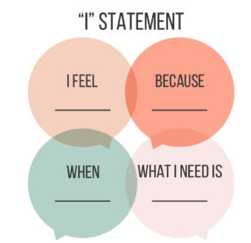
Social Wellness
1. Build supportive relationships
2.Self-Care Actions:
Use “I” Messages for communication
Maintain social support network
3. Effective communications:
Respectful Language
Cool-down breaks
Focus on present issues
Notes:
Social wellness is all about building strong, supportive relationships and communicating effectively. To do this, it’s important to understand three approaches: elemented arguments, assertive communication, and effective communication.
An elemented argument is a logical, evidence-based way of making a point. It often used in debates or academic settings. While it’s useful for structured discussions, it can come across as too formal or confrontational in personal conversations.
Assertive communication, on the other hand, strikes a balance. It allows you to express your needs clearly while still respecting the other person. For example, instead of saying, “You never listen,” you might say “I feel unheard when I’m interrupted.” This keeps the conversation focused and constructive.
Lastly, effective communication, which brings it all together by adding empathy and active listening. Things like maintaining eye contact, paraphrasing what the other person says, and avoiding distractions can make a big difference.​
To strengthen social wellness, practice using “I” statements to express your thoughts without blaming others. Active listening is also key. Really focus on what the other person is saying instead of just thinking about your response. And try to avoid common distractions like interrupting or bringing up old issues during arguments.​
​
​

Slide 7
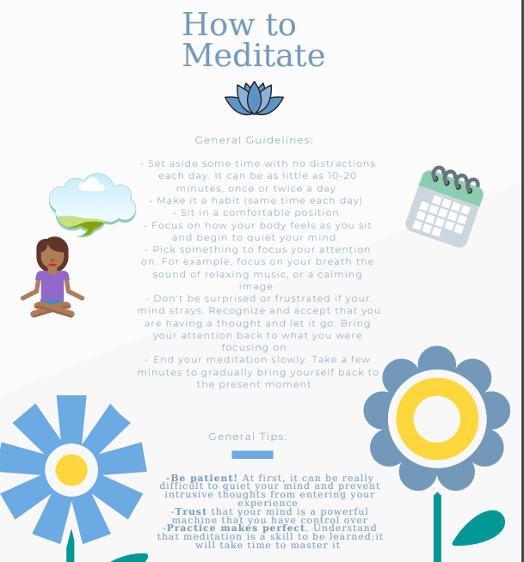
Spiritual Wellness
Find purpose, align actions with values
Connecting goals with values
Self-Care Actions:
reflect./meditate daily
Explore personal beliefs and respect others.
Notes:
Spiritual wellness is about finding meaning, purpose, and alignment between your values and actions. It doesn’t necessarily have to involve religion. It’s about connecting with what makes your life meaningful and grounding yourself in those principles. Spiritual wellness helps provide a sense of direction, especially during stressful or uncertain times, and it can foster resilience and peace of mind.​
One way to improve spiritual wellness is through daily reflection. This could be as simple as taking five minutes at the end of your day to ask yourself: What went well today? What am I grateful for? Journaling your thoughts or keeping a gratitude log can help you gain clarity about your values and recognize the positive aspects of your life. Meditation is another powerful tool helping you focus on the present moment and let go of distractions or negative thoughts.​
Combine your goals with your values is another essential aspect of spiritual wellness. For instance, if you value helping others, you might set a long-term goal of volunteering or pursuing a career in a field that allows you to make a positive impact. When your actions reflect your core values, it becomes easier to stay motivated and fulfilled.​

Slide 8
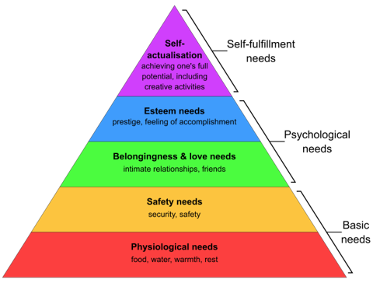
Occupational Wellness
Fulfillment: work aligns with values/passions
Actions:
  SMART career goals
  Seek/respond to feedback for growth
Notes:
Occupational wellness focuses on finding fulfillment by aligning your work or studies with your values, goals, and passions. The Productivity Pyramid helps guide this process. At the base are your values—your "why," which gives meaning to your work.
Next are your long-term and intermediate goals—your "what," such as completing a degree or learning a new skill.
Daily tasks—the "how"—are the small actions you take, like studying or preparing for an exam, while urgent tasks at the top are time-sensitive but should still connect to your goals.​
To foster occupational wellness, use SMART goals to break down large project into manageable steps and ensure your actions connect with your values. Individuals who connect daily tasks to long-term goals experience greater satisfaction and productivity. For example, a student pursuing a career in sustainability might attend a career fair to explore opportunities, linking immediate actions to future goals. Occupational wellness is about prioritizing what matters most and taking meaningful steps toward a fulfilling path.

Slide 9
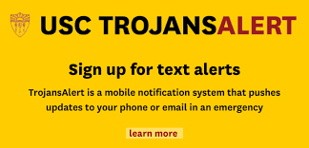
Environmental Wellness
Be aware of your environment, align actions with sustainability
Connecting habits with environmental impact
Self-Care Actions:
Spend time with nature to recharge
Reduce, reuse, recycle to minimize waste
Conserve energy and water in daily routines
Notes:
Environmental wellness focuses on creating safe, supportive, and sustainable environments that contribute to your overall well-being. This includes personal safety, maintaining comfortable and organized spaces, and reducing your environmental impact through sustainable practices.​
Personal safety is a fundamental aspect of environmental wellness. At USC, resources like TrojansAlert provide real-time emergency notifications to keep students informed during critical situations.
Similarly, the LiveSafe Mobile App allows users to report suspicious activity, access virtual SafeWalks, and communicate with emergency responders, ensuring greater safety on campus.​
Your immediate surroundings also play a significant role in environmental wellness. A clean and organized living or study space can reduce stress and enhance productivity. Adding personal touches to your environment, such as plants, photos, or items that bring joy, can create a more comforting and positive atmosphere.
Sustainability is another essential element of environmental wellness. Small actions, such as recycling and reducing waste, not only help protect the planet but also instill a sense of responsibility and mindfulness. Spending time outdoors in natural settings can further improve your mental health and strengthen your connection to the environment.​
​

Slide 10
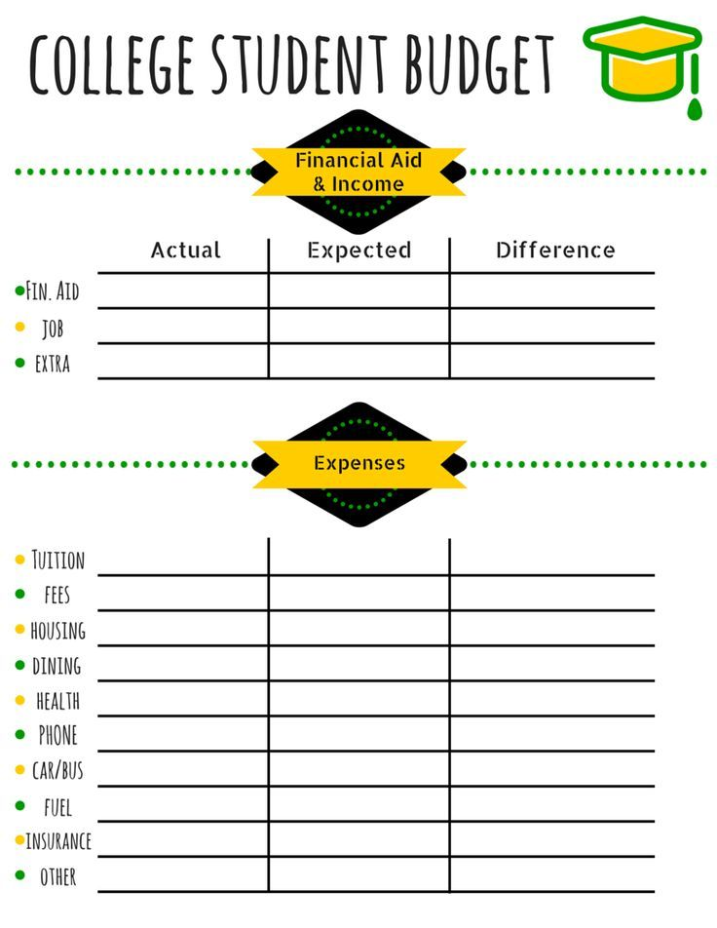
Financial Wellness
Manage your finances, align spending with long-term goals
Connecting financial habits with security and stability
Self-Care Actions:
Budget monthly to prioritize needs and savings
Track spending to avoid overspending
Set financial goals to reduce stress and build confidence
Notes:
Financial wellness involves managing resources effectively to reduce stress, build stability, and spending with long-term goals. A key aspect is distinguishing between needs—essentials like tuition, rent, and food—and wants, such as dining out or luxury items. Prioritizing needs over wants is important for maintaining financial balance.​
Preparation for emergencies, such as wildfires or natural disasters, is also vital. Building an emergency fund to cover essential expenses can provide security during unexpected crises.USC offers resources like the Financial Aid Office for loans, grants, and scholarships and the Emergency Assistance Fund for unexpected hardships.
Budgeting workshops and financial coaching are also available to help students manage finances effectively.​
Practical tips include creating a budget, setting financial goals, and using tools like apps to track expenses. Sustainable habits, such as meal prepping and using public transportation, can help save money while supporting long-term financial wellness. Proactive financial planning reduces stress and ensures greater stability and security.​
​

Slide 11
USC Resources
Department of Public Safety. USC Trojan Alert . USC Department of Public Safety. Retrieved from https://dps.usc.edu/services/trojans-alerts/
Financial Aid Office. Financial Aid Office. USC. https://financialaid.usc.edu/
Kortschak Center for Learning and Creativity.Tool and Resources. https://kortschakcenter.usc.edu/
Kortschak Center for Learning and Creativity.Self Care Handouts. https://kortschakcenter.usc.edu/self-care-handouts/
Kortschak Center for Learning and Creativity. Stress Management Handouts. https://kortschakcenter.usc.edu/stress-management-handouts/
Office of Student Accessibility Services (OSAS). USC Office of Student Accessibility Services. Retrieved March 5, 2025, from https://osas.usc.edu/
Student Basic Needs. Student Basic Needs. USC. Retrieved February 28, 2025, from https://studentbasicneeds.usc.edu/
USC Student Health – Counseling and Mental Health. https://careers.usc.edu/organizations/usc-student-health-counseling-and-mental-health/
Notes:
To wrap up, wellness is a dynamic, ongoing process that involves making intentional choices to care for yourself in all areas of life. The 8 Dimensions of Wellness are interconnected and contribute to your overall well-being. Start with one dimension—maybe improving your sleep routine, setting a financial goal, or building stronger social connections—and let that progress motivate you to tackle other areas over time.
USC offers a wide range of resources to support your wellness journey, from the Kortschak Center for Learning and Creativity to financial aid, safety tools like TrojansAlert, and various campus wellness programs. Make use of these tools to empower yourself and take control of your well-being.
Ultimately, the choices you make today shape your future. Here are some USC resources I would like to share with you.

Slide 12
Reference
College budget template. Pinterest. https://www.pinterest.com/pin/123456789/​
Centers Health Care.. Is your sleep hygiene as good as it should be? Centers Health Care. Retrieved January 26, 2025, from https://centershealthcare.com/media/is-your-sleep-hygiene-​as-good-as-it-should-be/​
Lemon, N. (2025). Prioritising wellbeing and self-care in higher education: How we can do things differently to disrupt silence. Routledge.​
Macrovector. Concept of healthy lifestyle and fitness physical modern flat vector icons [Illustration]. Dreamstime. https://www.dreamstime.com/illustration/physical-wellness.html​
Melnyk, B. M., & Neale, S. (2018). 9 dimensions of wellness: Evidence-based tactics for optimizing your health and well-being. The Ohio State University.​
Positive Psychology.com. Albert Ellis' ABC Model in CBT Theory. Positive Psychology.com. Retrieved January 26, 2025, from https://positivepsychology.com/albert-ellis-abc-model-rebt-cbt/​
Seli, H. (2023). Procrastination elimination strategies. In Motivation and learning strategies for college success: A focus on self-regulated learning. Taylor & Francis.​
South Dade News Leader. (2021, October 26). October is emotional wellness month [Photograph]. South Dade News Leader. https://www.southdadenewsleader.com/lifestyle/october-is​-emotional-wellness-month/article_150c7770-3669-11ec-ba9a-a3c9c6f64344.html​
Zentner, K., Bradford, B., & Van Ingen, B. (2023). Student wellness in higher education: A focus on social, physical, and financial wellness. The International Journal of Learning in Higher Education.​
Zohair, N., Javed, M., Rahat, M., Mumtaz, H., Sher, A., Raza, Z., Qayyum, S., & Ahmad, S. (2020). Dimensions of wellness: A multidimensional concept. BMC Journal of Medical Science, 1(2), 39-46.​
Notes:
As you focus on self-care and intentional action, you’re building a stronger foundation for success—not just academically, but personally and professionally. Wellness is a journey, and every small step you take brings you closer to becoming the best version of yourself. Thank you!​
​

