Slide 1
INCREASE YOUR SELF-AWARENESS TO MANAGE STRESS AND GROW YOUR INTROSPECTION
Jordan Gant
Notes:
I am Jordan Gant, an Academic Coach, and this presentation will review the importance of increasing your self-awareness of the emotional and physical response to stressors to grow your introspection. You will learn ways to decompress and reconnect to a more grounded state.

Slide 2
What is Introspection?
The process of exploring what is going on in our minds and bodies
Being in the present, allows us to experience our existence with less judgment and more insight
(Eyal, 2023)
Notes:
Introspection is the process of exploring what is going on in our minds and bodies.
Introspection gives us the opportunity to evaluate ourselves, our thoughts, and challenges more effectively and with more clarity. This is a chance to reassess how we should respond and feel when faced with our perceived challenges.
Being in the present allows us to experience our existence with less judgment and more insight
This will help us in identifying our responses to stressors, people, and situations in our environments, including identifying triggers and causes of stress
Once we gain more awareness through introspection, we are more likely to develop more effective coping skills, that allow us to feel more competent and in more control of our behavior.
When we are aware of how we respond to stressors in our mind and body, it helps us understand how we tend to resolve our stress.

Slide 3
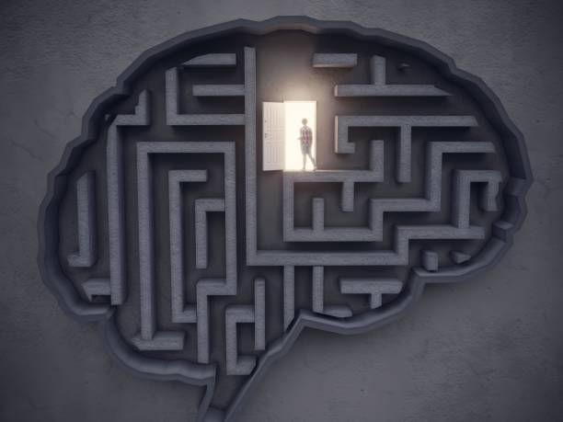
Reflection is a Key Element of Introspection
We can only evaluate and reevaluate our thoughts when we reflect upon our experiences.
(Hixon & Swann, 1993)
Notes:
Reflection is a necessary element of introspection as it helps us to be aware of the automatic thoughts that we have and how we respond to stressful events.
We are reflecting when we carefully consider what we are feeling and how we are thinking
We cannot be introspective if we are not reflecting. We can only evaluate and reevaluate our thoughts when we reflect.

Slide 4
Developing our Reflection Skills
Developing our reflection skills can be done in multiple ways:
Reflect on a stressful situation
Recognize how your body is feeling in response
Recognize your immediate thoughts
What behavior will you engage in to calm yourself?
Notes:
Developing our reflection skills can be done in multiple ways. To make it easy for you to follow along, I have outlined a simple four step process that can help in developing your reflection skills. Again, we do this because reflection is a key element of introspection. Feel free to pause this video and ask yourself these questions:
Reflect on a stressful situation
Recognize how your body is feeling in response
Recognize your immediate thoughts
What behavior will you engage in to calm yourself?
An example of this may be taking a test. When it time for me to take the exam, I may notice that my body feels tense. I am feeling stressed and anxious. My thoughts turn negative to think I will fail the test. I notice this in my mind and body, and relax I need to calm down to be able to focus on the test. To calm myself, I can engage in breathing exercises. I notice my body is not as tense and I am not feeling as stressed. I can reflect on my past success with tests. I notice my anxiety is lessening. I can challenge my negative thoughts, and replace them with more realistic thoughts. I can consider the amount of time I studied and recognize that I have prepared for the test as best as I could.

Slide 5
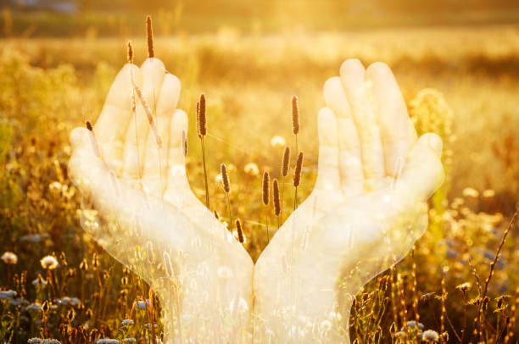
Additional Ideas to Encourage Introspection: Gratitude
Dedicate time for reflecting on gratitude
Make it social
(Armenta et al., 2022)
Notes:
Now that we have reviewed the definition and discussed reflection, let's look at how to actually encourage introspection.
Gratitude: When we are thankful, we attract more of what we desire. This is because, when we feel good, we perform better.
We perform better and make gains as a result of our more positive outlook.
Specific ways you can practice gratitude:
Dedicate specific time in your day to name and reflect on the things you are grateful for
Make it social, call a friend and tell them you are grateful for them or discuss all that you are grateful for in your life
Gratitude is associated with greater overall well-being and perceived social support (Armenta et al., 2022)

Slide 6
Ideas to Encourage Introspection: Affirmations
Practice positive self-talk
Affirmations
(Buhle et al., 2013)
Notes:
Another important element of introspection is recognizing self-talk so we can replace negative ones with positive and affirming language. To do this we must pay close attention to how we are talking to ourselves. For example, if you find yourself using negative or limiting self-talk try to pause and reframe it. This is called cognitive reappraisal (Buhle et al., 2013).
Affirmations are positive words/phrases to encourage yourself. We can recognize through using affirmations and focusing more on our strengths as opposed to our challenges, we can create these more optimistic beliefs that encourage us and make us feel good.
Affirmation example: "My mind's ability to learn and remember is increasing every day" or " I'm capable of being a great student and I will ask for help when I need it"

Slide 7
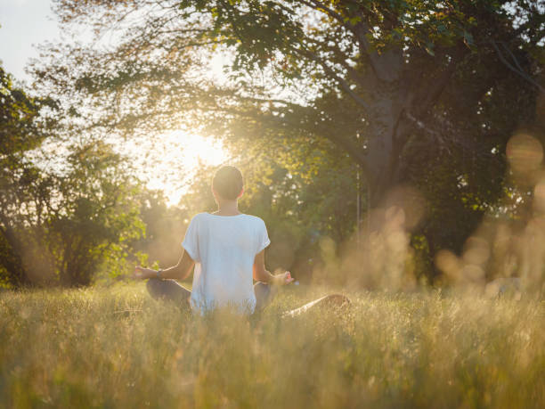
Additional Ideas to Encourage Introspection: Meditation
Breathing meditations
Chanting
Prayers
Notes:
According to the Merriam-Webster dictionary, meditation is a mental exercise for the purpose of reaching a heightened level of spiritual awareness.
Meditation can take many forms: Breathing exercises, chanting, prayer, and other practices in the present moment can give us more time to process stressors and challenges to encourage more effective choices and behavior while adapting to changes. There is no minimum limit on how long meditation can be. It is best to start with 1-2 minutes and build up from there. Something as simple as closing your eyes and taking a deep breath can be meditation.
Students can find these types of meditation on YouTube, the Calm App, or asking a spiritual advisor for guidance. Whichever you decide, you can start slow and build from there and see if it helps with stressors.

Slide 8
Ideas to Encourage Introspection: Journaling
Journaling:
On empowering topics
On stressful topics
Notes:
Journaling allows you to pause and check in about how you are feeling, how you would like to feel, and any growth you have seen when facing stressors.
Journaling is an easy process-you can use an app, a notebook, or even a sheet of paper. If you use paper, you will also need a pen or pencil. Journaling can also be for any amount of time, 5-15 minutes is plenty of time. It is up to you!
While journaling you can ask yourself questions, such as: what have I done well today? What am I looking forward to? What am I most proud of? What I am grateful for? Of course, you might also journal to help you alleviate stress. Write how certain events make you feel and strategies to relieve stress can be helpful.
For example, if you always experience high levels of stress prior to a certain class, journaling can help provide introspection and help you identify and explore what may trigger the stress for this class. Spending a few minutes before class or after class may help you with the stress you are feeling.

Slide 9
Final Thoughts on Promoting Introspection
Accept that change is constant and necessary for growth
When we accept change, we are able to reflect more effectively
When we reflect, we are more likely to understand what is happening inside of us
Notes:
As some final thoughts:
Exploring introspection is a trial and error process so give yourself grace as you learn to recognize what you are feeling and trying new strategies. It may take a few times to find what will work for you.
Accept that change is constant and necessary for growth and working on introspection and it's techniques can help minimize stresses and anxieties around changing
You can look at challenges and change as an opportunity to develop your coping skills. Even when we have feared change in the past, we can shift our thoughts and expectations surrounding challenges and obstacles for better outcomes and personal growth.
When we accept change, we are able to reflect more effectively. We can tune into what is happening inside of us
Try some new strategies discussed to be able to practice introspection and remember it will take time! Be open minded and keep practicing.

Slide 10
REFERENCES
Armenta, C. N., Fritz, M. M., Walsh, L. C., & Lyubomirsky, S. (2022). Satisfied yet striving: Gratitude Fosters Life Satisfaction and improvement motivation in youth. Emotion, 22(5), 1004–1016. https://doi.org/10.1037/emo0000896
Buhle, J. T., Silvers, J. A., Wager, T. D., Lopez, R., Onyemekwu, C., Kober, H., Weber, J., & Ochsner, K. N. (2013). Cognitive reappraisal of emotion: A meta-analysis of human neuroimaging studies. Cerebral Cortex, 24(11), 2981–2990. https://doi.org/10.1093/cercor/bht154
Eyal, N. (2023a, June 23). Here are the 4 simple introspection steps that will boost self awareness. Nir and Far. https://www.nirandfar.com/introspection/
Hixon, J. G., & Swann, W. B. (1993). When does introspection bear fruit? self-reflection, self-insight, and interpersonal choices. Journal of Personality and Social Psychology, 64(1), 35–43. https://doi.org/10.1037//0022-3514.64.1.35
Notes:
I hope this workshop helps you better understand how introspection allows us to reflect and consider healthy habits! Fight on!

