Slide 1
Transitioning from High School to College Academics
Navigating the beginning of your college journey
By Caraline Rossini
Notes:
Hi, I am Caraline Rossini and I am an academic coach at the Kortschak Center for Learning and Creativity. Today, our topic is about the stressful transition from high school to college. Having been in your shoes, my goal with this workshop is to support incoming college freshman as they begin their college journey.

Slide 2
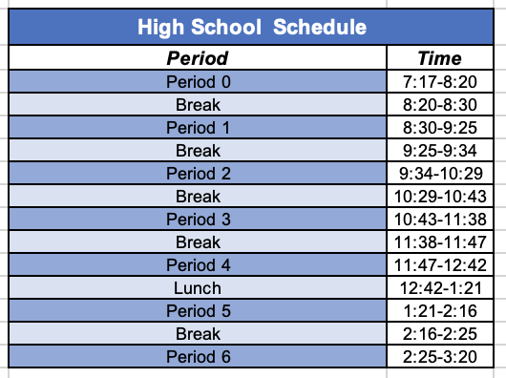
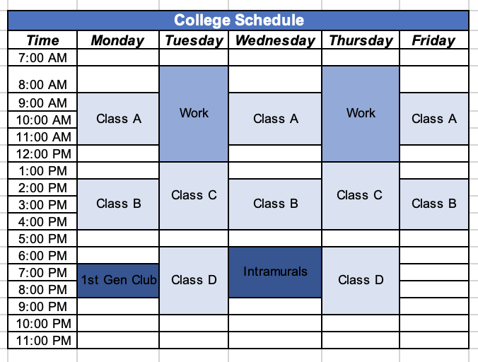
Different Schedule- K-12 vs Higher Education
(San Clemente High School Bell Calendar, 2022)
Notes:
One challenge students face starting college is that their schedule is quite different compared to when they were in high school. Most high school students have a strict schedule, requiring them to be on campus from early morning until late afternoon. In contrast, college schedules are often less structured. While initially, this seems to be a good thing, it can lead students to believe they have more unstructured time than they actually do (Gibney et al., 2010). This can be an issue because students may not realize that they must set aside time to complete their assignments and study. As a result, many students end up overscheduling themselves with nonacademic activities, and ultimately fail to set aside time for their academics.

Slide 3
Figuring out your schedule
Independent learning in college (Gibney et al., 2010).
Use Unstructured time to:
Study
Complete assignments
Prepare for upcoming lectures
Prepare for exams
Notes:
Unlike high school, college put a big emphasis on independent learning (Gibney et al., 2010). According to Meyer et al., (2008), independent learning is the process where external factors like instructors creating an environment for students to utilize information and communication technology, and internal factors like emphasizing student development of skills like problem-solving, attention, memory, identifying feelings, and understanding the learning process.
A big part of the adjustment from high school to college will be understanding your schedule and planning accordingly. Let's look at this more closely. As we discussed, the appearance of unstructured time can cause procrastination issues. Instead, this ”unstructured time” should be used to study, complete assignments, prepare for upcoming lectures, preparing for exams, and completing other tasks. When reflecting on the unstructured time in your schedule, ask yourself "What do I need to complete today? What do I need to complete tomorrow? What is due in the next week?"

Slide 4
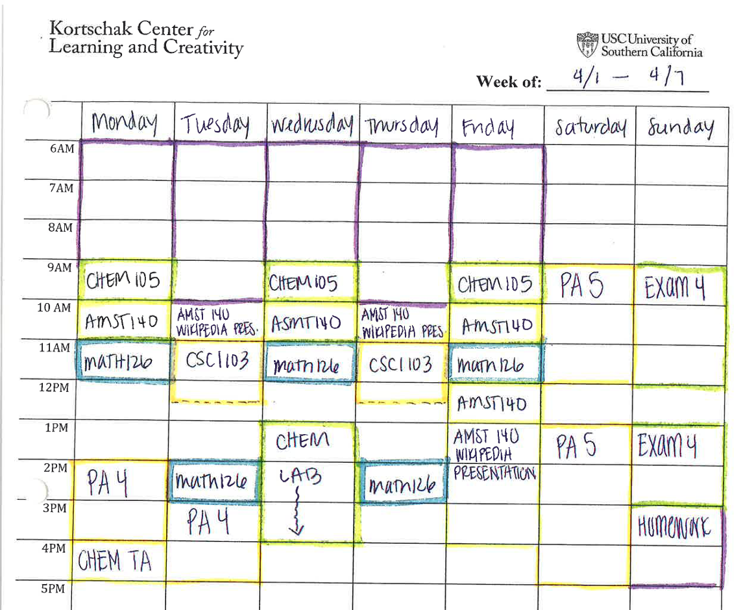
Tips for creating an organized schedule
Use a planner
Plan for tomorrow
Put your daily schedule in your phone calendar
Weekly Schedule Handout
Notes:
To create an organized schedule that allows you to complete assignments and engage in self-care activities, think about doing the following. Try using an electronic planner to keep track of upcoming assignments, exams, and other tasks. You can also use the calendar on your phone to schedule time to study, attend classes, and other academic-related tasks that need to be completed (set event alerts as reminders). Plan ahead for the tomorrow’s schedule so you know what to expect. To build a personalized schedule that will help you succeed, take into account when you are most productive. Let's say I am a morning person. Based on that information, I would schedule my homework and study time in the morning because I focus best at that time.
Build your schedule around other appointments/tasks you have that day. Let's say that I work on campus in the afternoons but I live about an hour away. To get there on time, I could drive to campus early, and spend the time before my shift completing assignments in the library. An example of an organized schedule can be seen in our weekly schedule handout which is available on the KCLC website. If you are interested in learning more about scheduling strategies, be sure to check out our 'Time Management' workshop located on our website kortschakcenter.usc.edu under the 'Tools and Resources' tab and select "Time Management".

Slide 5
How to Study
High school
receive a study guide & more hands-on support.
College
may not get a study guide; emphasis on students' studying independently.
Techniques:
Prepare in advance.
Attend office hours.
Create a study guide.
Schedule study segments (Seli, 2023).
Notes:
When it comes to studying, there are several differences between what this process looks like in high school vs. college. In high school, students usually receive a study guide and information from their instructor as to what they will be tested on. Teachers provide guidance and hands-on support to students to prepare them for taking exams in college.
In college, students will need to do the bulk of their studying independently. For example, students usually do not receive a study guide, and must do their own research to determine what they will be tested on. Professors expect their students to actively participate in their learning and to advocate for themselves if they need help.
Begin preparing for the exam 1-2 weeks in advance, so you have time to study and complete current coursework. Attend your professor/TA's office hours and ask questions about confusing concepts and inquire about the content that the exam will cover. You can also create your own study guide and have all the information you'll be tested on in one place. Plan ahead when you will be studying for the exam during the week. Doing this allows you to have protected time in your schedule to focus on preparing for your upcoming exam.
Additionally, the Kortschak Center also offers workshops on time management, stress management, test taking strategies, and how to flourish through finals. You may want to reflect and ask yourself: what environment do I study best in? Not sure? Try studying in different locations like the library, coffee shops, or outside.

Slide 6
Campus Involvement
Be intentional with your social life
Explore clubs & other social gatherings
Focus on one or two clubs to start
Take advantage of your time in college
Explore interests
Connect with professors
Notes:
Be intentional with your social life on campus. Explore the clubs and other social gatherings your college/university offers. This helps you find people with similar interests outside your major and gen ed classes. Don’t over commit yourself. Make sure you're thinking realistically about how many clubs you can commit to on top of your academic and self-care commitments. In fact, maybe start by committing to one or two clubs and reevaluate your experience at the end of the semester.
Take advantage of your time in college, it goes by fast and it’s important that you make the most of your experience.
Explore your interests and connect with professors. Get to know your professors and share with them who you are. You never know, your professor could help you get into graduate school. Mine sure did! Conduct informational interviews with professionals in careers that interest you.

Slide 7
Fear of Missing Out (FOMO)
FOMO has caused college freshman to lose sleep (Adams et al., 2016).
Engage in time management skills (Adams et al., 2016).
To avoid sleep debt, get 7-9 hrs. of sleep/night (Hirshkowitz et al., 2015).
Positive self-talk
You can only do so much.
Say to yourself: "I'm doing as much as I can handle and that's enough".
Notes:
Due to there being so many social events on campus, students can experience FOMO, or the fear of missing out. This has been found to negatively impact college students, specifically freshman, to lose sleep “Participants reported both in person and virtual pressures to stay awake and engage with peers…some participants did not want to go to sleep and miss social interactions” (Adams et al., 2016, p. 345). To solve this, students must not focus on other’s opinions of how they spend their time and instead utilize time management skills (Adams et al., 2016, p. 345).
The last thing you want is to accrue sleep debt, which is defined as, “The cumulative hours of sleep that one is not getting” (Pratt, 2022, p. 2). Positive self-talk is also important when it comes to FOMO. We need to remind ourselves that while there are many opportunities on campus, you can't do everything. It's important to remind yourself and say aloud, "I'm doing as much as I can handle, and that's enough".

Slide 8
Managing Seasons of Change
Normalize stress, anxiety, and homesickness.
Make sure you are taking care of yourself (Thurber & Walton, 2012).
Give yourself grace and space during seasons of change.
Notes:
During seasons of change, it's normal to experience stress, anxiety, and homesickness. I know that I did when I transitioned from high school to college. To combat homesickness, we need to normalize the discussion of being homesick around others. Other tactics we can use to get through homesickness can be to schedule a regular time to call your family and think about the positive aspects of being away from home (Thumber & Walton, 2012). As you go through this transition, it's important that you engage in self-care activities. Make sure you are taking care of yourself, get enough sleep, and eat healthy (Thumber & Walton, 2012).
Give yourself GRACE and SPACE during seasons of change. Grace meaning not holding yourself to extremely high expectations when adjusting to a new phase of life. Space meaning allowing yourself to fully embrace the change you're encountering and taking the time you need to get adjusted. Reflection question: How can I best support/care for myself during seasons of change (ex: get good sleep, reward myself with a candy bar at the end of the week)?

Slide 9
Things to remember about this transition
It’s normal to feel overwhelmed & homesick (Thurber & Walton, 2012).
You don’t need to have everything figured out.
There is no ”perfect” way to do college.
You are not alone.
Notes:
Finally, there are several things to keep in mind about this transition. First, it's normal to feel overwhelmed. The process of high school is drastically different from the college process. You don’t need to have everything figured out. Allow yourself to settle into college and explore different subjects. You don’t need to know what you want to do with your life upon starting college.
There's no 'perfect way' to do college. College is an individual experience where you are on your own journey. This may be difficult to understand at first since it's contrary to high school where there is a lot of comparison between you and your peers. Instead of comparing how someone else studies, find ways that work best for you. It's important that you figure out the techniques and study skills that best support your learning style.
Know that you are not alone in this transition. I encourage you to talk about your experience with your friends and know that you have support resources available to you. If you live in on-campus housing, reach out to your RA and discuss the challenges you may be facing. Access campus counseling services for additional support in your transition. We at KCLC are also always here to help you in achieve academic success.

Slide 10
References
Adams, S. K., Williford, D. N., Vaccaro, A., Kisler, T. S., Francis, A., & Newman, B. M. (2016). The young and the restless: Socializing trumps sleep, fear of missing out, and technological distractions in first-year college students. International Journal of Adolescence and Youth, 22(3), 337–348. https://doi.org/10.1080/02673843.2016.1181557
Gibney, A., Moore, N., Murphy, F., & O’Sullivan, S. (2010). The first semester of university life; ‘will I be able to manage it at all?’ Higher Education, 62(3), 351–366. https://doi.org/10.1007/s10734-010-9392-9
Hirshkowitz, M., Whiton, K., Albert, S. M., Alessi, C. A., Bruni, O., Don Carlos, L. L., Hazen, N., Herman, J. H., Katz, E. S., Gozal, D., Neubauer, D. N., O’Donnell, A. E., Ohayon, M. M., Peever, J. H., Rawding, R., Sachdeva, R., Setters, B., Vitiello, M. V., Ware, J. C., & Hillard, P. J. A. (2015). National Sleep Foundation’s sleep time duration recommendations: methodology and results summary. Sleep Health, 1(1), 40–43. https://doi.org/10.1016/j.sleh.2014.12.010
Pratt, R. J. (2022). The Impact of Sleep on Athletic Performance: A Review of the Literature [Honors Thesis]. University of South Dakota. https://red.library.usd.edu/honors-thesis/245/
San Clemente High School Bell Calendar. (2022, November 28). San Clemente High School. Retrieved February 7, 2024, from https://sctritons.capousd.org/documents/SCHS-Bell-Schedule-Calendar-Fall-22-23-Updated-11-28-2022.pdf
Seli, H. (2023). Motivation and Learning Strategies for College Success (7th ed.). Taylor & Francis.
Thurber, C. A., & Walton, E. A. (2012). Homesickness and adjustment in university students. Journal of American College Health, 60(5), 415–419. https://doi.org/10.1080/07448481.2012.673520
Notes:
Here are my references. Thank you for listening, please visit the Kortschak Center in person, or check out our website (kortschakcenter.usc.edu) for more tips on time management, organization and/or study skills.

