Slide 1
How To Create/Change A Habit
Kortschak Center for Learning and Creativity
Academic Coach: Heidi (Yutong) Hui
Notes:
Hello, I am Heidi, an academic coach at the Kortschak Center and in this presentation we will focus on how to change/ create a habit.

Slide 2
What is a Habit?
A habit is a behavior that starts as a choice, and then becomes an unconscious pattern.
Habits influence our daily life
Habit often takes place in a habit loop
Notes:
Before we officially start how to change or create a habit, we first need to understand what a habit is.
Let’s think about the next questions together. What did you do first when you woke up in the morning? Did you brush your teeth before you wipe your face? Did you hop in a shower, scrolling your phone to check the news, or make yourself a cup of coffee to freshen yourself up?
In fact, things we think we're choosing to do are habits. A habit is a behavior that starts with a choice, and then becomes an unconscious pattern. The meals we order, whether we save or spend money on a certain product, how often people exercise and so on. Habits can have enormous influence on our daily life, our health, productivity, financial security, and happiness. Scientists find out that habits often take place in a habit loop. And once you understand the loop you can change or create the habits.

Slide 3
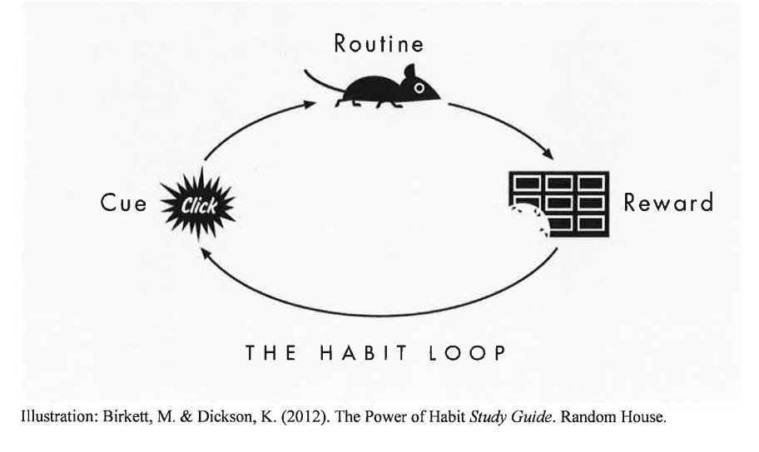
Habit Loop (Duhigg, 2012)
3 Basic Steps of Habit Loop:
When I see my CUE,
I will do my ROUTINE
to get a REWARD
Notes:
Every habit – no matter how simple or complex – has the same pattern, a habit loop. It's start from a cue, a trigger that tells your brain to going an automatic mode. The cue can be internal, such as a feeling or thought, or external, such as a time of day, certain person, specific action, or being accompany of people. Then comes the routine, it relates to the behavior, such as physical or mental or emotional behavior. Finally, there is a reward. The reward determines if a particular habit loop is worth happened. Then the behavioral pattern will become automatic when your brain craves the reward. So it will goes like when you see the cue, you do the routine, then you get a reward.

Slide 4
Examples of the Habit Loop
Habit of making plan before next day
Cue - Before go to sleep at night
Routine - Sit in front of desk and writing the next day schedule or to-do list
Reward – Feeling in control of your study life the next day
Habit of scrolling the Tik Tok
Cue – During a break
Routine - Scroll Tik Tok and other social media mindlessly for a while
Reward - Relaxation and entertainment even if you don't really gain something from it
Notes:
Next I will give two examples to present how people are forming habits.
So for example, Every night, before I go to sleep, I have developed the habit of making a plan for the next day. This cue triggers me to sit at my desk. And the routine is to write down my schedule or to-do list for the following day. The reward for this routine is the feeling of being in control of my study life the next day. Making a proper plan will not only make you less panic and nervous when executing the plan, but also improve your performance.
Forming a habit of scrolling through TikTok during my 5-minute breaks can be a bad habit. The cue for this is the break itself, and during this time, I mindlessly scroll through TikTok and other social media platforms. While I might not gain anything substantial from it, the reward I get from this routine is a sense of relaxation and entertainment. Even though this could be considered a bad habit, it still has a reward. If you are hoping to change the habit, you will need the full loop.

Slide 5
Keystone Habits
Keystone habits are some habits are more powerful than others, and have the power to change how other habits work
Once critical habits are identified and changed, they have the potential to have wide-reaching effects
(Duhigg, 2012)
Notes:
Keystone habits are habits that is more powerful than other habits, which means keystone habits have the ability to change the way other habits operate. Changing a keystone habit can trigger a chain reaction, leading to changes in other behaviors. If the keystone habit is a good one, it can bring many positive changes to a person's life. A great example of a keystone habit is morning jogging. When people start a daily morning jogging routine, even if it's just once a week, they often begin to make changes in other aspects of their life. Typically, people who jog in the morning tend to wake up earlier, eat healthier, and improve the quality of their sleep. They also smoke less and are more inclined to encourage themselves to persevere when facing difficulties. The exact reason for this cannot be fully explained, but many people have observed this phenomenon. In this example, morning jogging is a keystone habit that triggers widespread changes. As you can see, once a keystone habit is identified and changed, it can have a broad impact.

Slide 6
Willpower
Duhigg, 2012
Willpower is the most important keystone habit for individual success.
The best way to strengthen willpower is to make it into a habit.
Anticipate possible challenges
Notes:
Willpower is the most important keystone habit for academic success. The best way to strengthen willpower is to make it into your personal habit. Changing the keystone habit of willpower brings positive influences to other habits. As people changed their exercise habits or spending habits, these willpower habits spilled over to other areas of their lives, such as what they ate or how hard they worked. How can some people make willpower into a habit? One way is they anticipate possible challenges. Anticipation of inflection points, or challenges, allows people to plan to deal with pain, stress, and temptation ahead of time. For example, anticipating the difficulties I might face before you read. Ask yourself few questions, I might encounter some new concepts that are difficult to understand immediately and how many of them I would encounter, is that easy to understand and remember? What should I do if I can't understand? Is there any good way to help me understand? Or I can write it down and ask the teacher later.

Slide 7
How to create a habit

Slide 8
How to Create a Habit
Notes:
Let's look at how to create a habit.

Slide 9
How to create a habit – Step 1 The Cue
Notes:
Once again, emphasizing, a habit loop consists of a cue, a routine, and a reward pairing. The cue, besides triggering the routine, must also provoke a desire for the reward. When we're forming habits, we follow this logic as well. Do you want to establish a habit? You can try to think of a behavior you wish to cultivate. Each habit has a triggering factor, and the initial step is setting a cue.
Then try to answer the following questions: When will this habit occur? Where will you be at that moment? Who else will be around you? What have you just finished? What emotions do you anticipate feeling when you engage in this behavior?
You don't need all of these to form a habit; just one of them can serve as a cue. The more you try things out and make an adjustment, the faster the habit will occur.
It takes some time to develop a habit. Suppose you want to establish a habit of morning jogging; you may need to consider when you'll jog, where you'll jog, if anyone will accompany you, the preparations before jogging (like having breakfast, staying hydrated), and your mental readiness and state during jogging.

Slide 10
How to create a habit – Step 2 The Reward
Notes:
Do you want to create a habit? You can try to think of a behavior you want to create.
Every habit has a trigger, and the first step is to set a cue. And then try to answer the following 5W questions. What time will this habit occur? Where will you be at that moment? Who else will you be around? What will you have just finished? What emotion do you think you will be feeling when you do that behavior? You don't need all of these to create a habit. Only one of them is needed to become a cue. But the more you test out, the faster the habit takes hold. It takes some time to form a habit, and after setting the cue, we still need to take an important step. It is to establish reward. After a few days, you may ask yourself: Am I craving this reward when I am exposed to the cue? I call this question the initial question of establishing reward, and for this question If the answer is yes, explain Everything is going in a good direction, but that doesn't mean you've successfully established a habit. You need to ask yourself again after two weeks: Do I crave the intrinsic reward of the habit (how it makes me feel) more than the extrinsic reward (what I give myself as a treat)? If you finally find yours Intrinsic rewards, then congratulations, you've got a powerful habit. But if your answer to the initial question, which is, do I desire rewards, is no. You need to choose a new reward. To establish this new reward, you still need to think, What reward will I give myself at the end of the behavior? Do I actually enjoy this reward? If the answer is yes, you can go back again The initial question is a solid step towards forming a new habit. If not, you still need to look for new rewards until you find the one that belongs to you and is suitable for you. This process may seem a bit tortuous, and you need to go back and forth to find the reward mechanism that belongs to you, but in fact establishing reward plays a very important role in forming a solid habit. Finally we have to form the routine. Routine is the behavior you want to become a habit. We need to put the three steps together. Studies show that the easiest way to implement a new habit is to write a plan. When a certain cue, I will do the certain routine because it provides me with a certain reward. So post this plan where you will see it. Try it for a week. Eventually, studies say, the new behavior will become automatic.

Slide 11
How to create a habit Step 2 The Reward
Notes:
After setting the cue, we need to set up a reward.
After a few days, you might ask yourself: Do I crave this reward when I encounter the cue? In other words, does morning jogging provide me with something? I call this the initial question of establishing a reward. For this question, if the answer is yes, it indicates things are progressing in the right direction, but it doesn't necessarily mean you've successfully formed the habit. You might keep up with morning jogging, but it's not a stable habit for you.
Try asking yourself again after two weeks: Do I crave the intrinsic reward of the habit (how it makes me feel) more than the extrinsic reward (the reward I give myself)? In other words, does morning jogging impact my inner self, bring me joy, make me feel energetic all day, and motivate me to keep going? If you ultimately find the intrinsic reward, then congratulations, you've established a powerful habit. But if the initial question "Do I crave the reward" is answered negatively, then you might need to choose a new reward.
To establish this new reward, you still need to ponder: What reward will I give myself at the end of the behavior? Do I genuinely enjoy this reward? If the answer is yes, you can go back to the initial question and take a steady step towards forming a new habit. If not, you still need to search for a new reward until you find the one that belongs to you and suits you. This process might seem a bit complex, requiring iterative exploration to discover your reward mechanism, but in reality, establishing a reward plays a crucial role in forming a stable habit.

Slide 12
How to create a habit – Step 3 The Routine
Notes:
Finally, we need to establish the routine, which is the behavior you want to become habitual. We need to combine these three steps. After one hour of eating a healthy breakfast, you will start morning jogging, and you will be more energetic for the rest of the day. Research suggests that the simplest way to implement a new habit is to create a plan. Starting with the When is the cue, I will do the routine because it provides me with what kind of reward. Research indicates that eventually, the new behavior will become automatic.

Slide 13
How to create a habit Simplify version
Notes:
Do you want to create a habit? You can try to think of a behavior you want to create.
Every habit has a trigger, and the first step is to set a cue. And then try to answer the following 5W questions. What time will this habit occur? Where will you be at that moment? Who else will you be around? What will you have just finished? What emotion do you think you will be feeling when you do that behavior? You don't need all of these to create a habit. Only one of them is needed to become a cue. But the more you test out, the faster the habit takes hold. It takes some time to form a habit, and after setting the cue, we still need to take an important step. It is to establish reward. After a few days, you may ask yourself: Am I craving this reward when I am exposed to the cue? I call this question the initial question of establishing reward, and for this question If the answer is yes, explain Everything is going in a good direction, but that doesn't mean you've successfully established a habit. You need to ask yourself again after two weeks: Do I crave the intrinsic reward of the habit (how it makes me feel) more than the extrinsic reward (what I give myself as a treat)? If you finally find yours Intrinsic rewards, then congratulations, you've got a powerful habit. But if your answer to the initial question, which is, do I desire rewards, is no. You need to choose a new reward. To establish this new reward, you still need to think, What reward will I give myself at the end of the behavior? Do I actually enjoy this reward? If the answer is yes, you can go back again The initial question is a solid step towards forming a new habit. If not, you still need to look for new rewards until you find the one that belongs to you and is suitable for you. This process may seem a bit tortuous, and you need to go back and forth to find the reward mechanism that belongs to you, but in fact establishing reward plays a very important role in forming a solid habit. Finally we have to form the routine. Routine is the behavior you want to become a habit. We need to put the three steps together. Studies show that the easiest way to implement a new habit is to write a plan. When a certain cue, I will do the certain routine because it provides me with a certain reward. So post this plan where you will see it. Try it for a week. Eventually, studies say, the new behavior will become automatic.

Slide 14
How to Change a Habit

Slide 15
How to change a habit – Step 1 The cue
Notes:
Do you want to change a habit? Let's think about the habit you want to change. To change a bad pattern, you must insert a new routine into the habit loop. So, to insert a new routine, it should be triggered by reorganizing the cue. The first step is still finding the cue. When you feel the urge for your habit, ask yourself . . .What time is it? Where are you? What did you just do? Who else is around? What emotion are you feeling? One of these 5 things is the cue. Look for which one stays the same every time you feel the urge. For example, you want to get rid of the habit of studying while scrolling Tik Tok. You can examine yourself when, where, with whom, under what circumstances, and in what mood you want to do it. Then you will find out that you will unconsciously want to watch Tik Tok when you are always tired and sleepy in the afternoon, or when you are studying alone in your bedroom.

Slide 16
How to change a habit – Step 2 The Reward
Notes:
And then comes the reward. What craving do you think is satisfying? Substitute another reward for example instead of eating a cookie, you can have a cup of coffee. Is the craving gone? If it does not work, try to substitute the opposite reward, for instance, instead of eating a cookie, try to take a walk. Is the craving gone? You can keep experimenting until you find something new that satisfies the urge. But if the answer to those questions is yes, it becomes what you’re really craving. Going back to the example of Scrolling Tik Tok, a moment of rest is exactly what you crave. So can we get a short rest in other ways, such as looking into the distance, grabbing a glass of water, listening to music, or writing a journal about our mood? Can this satisfy this need?

Slide 17
How to change a habit - Step 3 The Routine
Notes:
Finally you have identified the cue and reward, it is the time to insert a new routine. You need to choose an activity that is triggered by the old cue, and delivers the old reward. Studies show that the easiest way to implement a new habit is to write a plan. Try to write it down. When a certain cue, I will do the certain routine because it provides me with a certain reward. Post this plan where you will see it. In the story of Scrolling Tik Tok, I can try to write that when I feel tired or bored, I will looking into the distance, grabbing a glass of water, listening to music, or writing a journal about our mood because it can make me feel a moment of rest. Try it for a week. Eventually, studies say, the new behavior will become automatic.

Slide 18
References
Duhigg. (2012). The power of habit: why we do what we do in life and business (1st ed.).
Illustration Reference: Birkett, M. & Dickson, K. (2012). The Power of Habit Study Guide. Random House.
Notes:
Thank you for joining me on how to create and change a habit. VIsit the Kortschak Center if you would like assistance on adjusting habits.

