Slide 1
Creating a Sleeping Schedule
Notes:
Hello! This is your academic coach Margaux Leivenberg and today we will focus on Creating A Sleeping Schedule

Slide 2
Why Create A Schedule
Organization
Productivity
Getting Adequate Rest
Notes:
Let's discuss why getting sleep is crucial for your academic performance. Having a set routine is very important. It allows for organization and productivity. You do not want to be scrambling for your backpack and packing everything in a rush the next day. You want to make sure you have plenty of rest to get through your day as well. In this workshop we are going to talk about how to plan backwards for a sleep schedule that will allow for you to get adequate sleep as well as be well-prepared for the next day

Slide 3
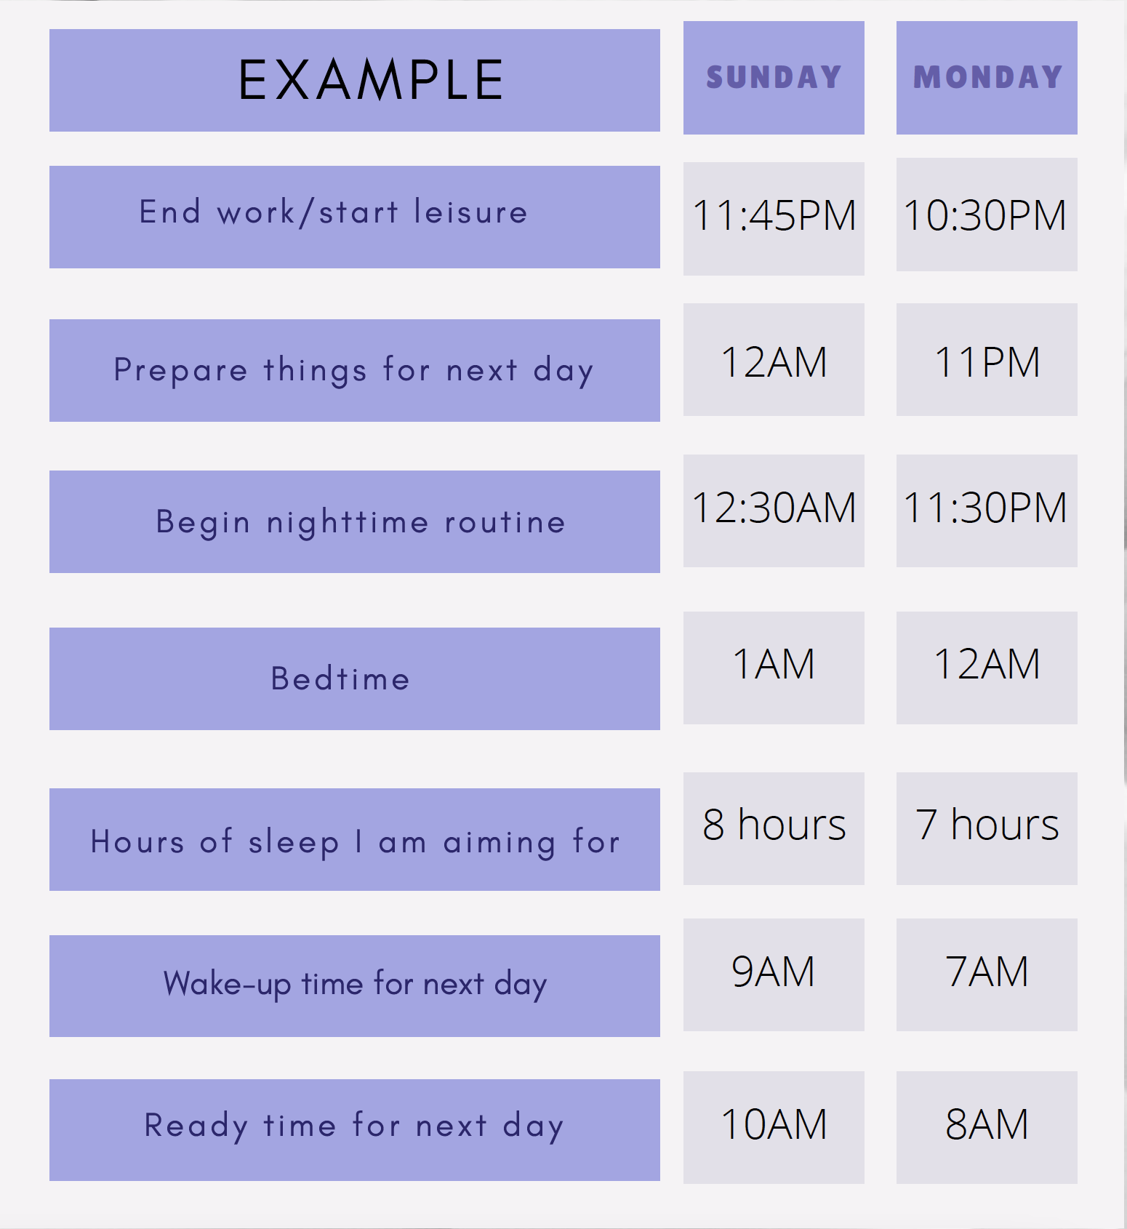
Planning for your Sleep Schedule (Ramar et al, 2021)
Notes:
You can find the Creating a Sleeping Schedule handout below and download it.
When planning for a sleep schedule, you want to plan backwards. This allows for you to make sure you are adequately preparing for the next day. By starting with what time you need to leave the next day, you can get an accurate idea of what your evening will look like. In the next few slides I will provide an example of how to create a sleep schedule. The sleep schedule as shown in this picture has 7 steps. We will go through these steps in the following slides by reviewing from the bottom and move up to the top.

Slide 4
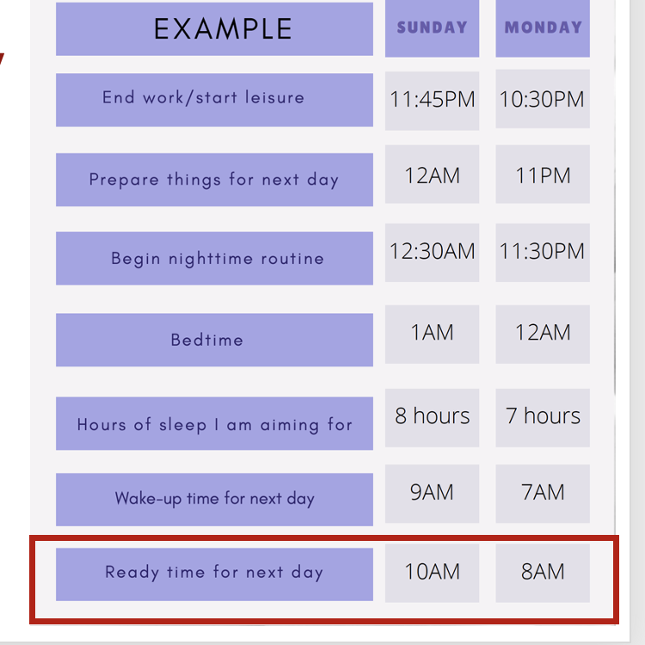
Ready Time For Next Day
Time you need to leave for the next day
Ramar et al. (2021)
Notes:
The first thing step in building a sleep schedule is to start at the bottom and figure out what time you need to be ready to head to campus or work the next day.
To figure out what time you need to be ready for the next day you will need to think about how much time you need to get to class or work. In this example, if you need to be on campus by 10:30AM and it takes you 20 minutes to walk, you can plan to leave at 10AM so you can arrive to class a bit early. In the next example, if you need to be on campus for a 8:30 AM class, leaving at 8am will give you time to get where you are going on time.

Slide 5
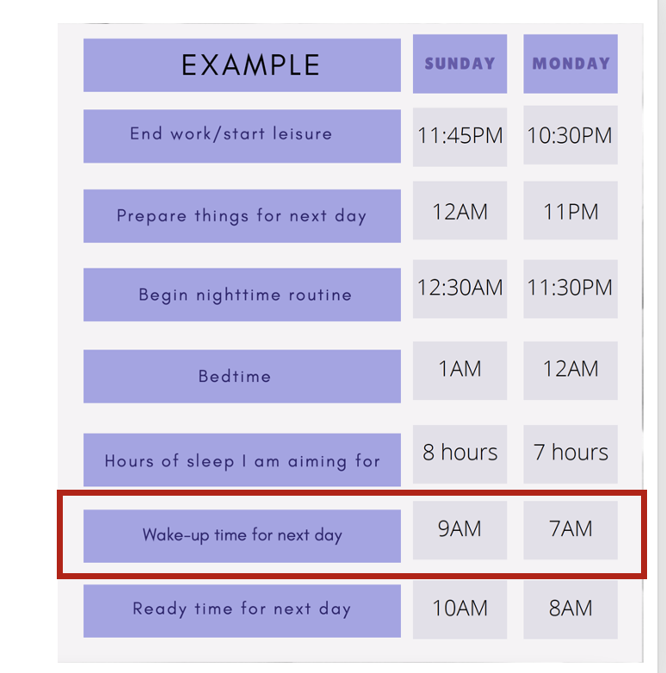
Wake-Up Up Time For Next Day
You will want to consider:
Shower time
Getting ready
Morning workout
Morning chores
Walking your pet
Set your alarm for this time
It is recommended not to snooze
Ramar et al. (2021)
Notes:
Continuing to work backwards, after determining what time you will need to be ready to leave, it is now time to determine what time you will want to wake up. Most students need somewhere between 30-60 minutes from the time they wake up until they are ready to leave.
When determining what time you need to wake up, think about:
Do you need to shower and get ready?
How long does it take you to get ready?
Do you work out in the morning?
Do you have any morning chores?
Do you need to walk your pet?
Do you need to drop off anyone at work or school?
There is another presentation on Creating a morning routine that may be of interest to you if you are looking for ideas on creating a routine in the morning.
Reminder, it is best to not hit snooze because it typically leaves you more tired. Because of this, your wakeup time should be the time you set your alarm for.
In the example on the slide if you need to be ready by 10 am and it takes you an hour to get ready your wakeup time would be 9 am. If you need to be at ready at 8 am, your wakeup time would be 7 am and you will have plenty of time to get ready.

Slide 6
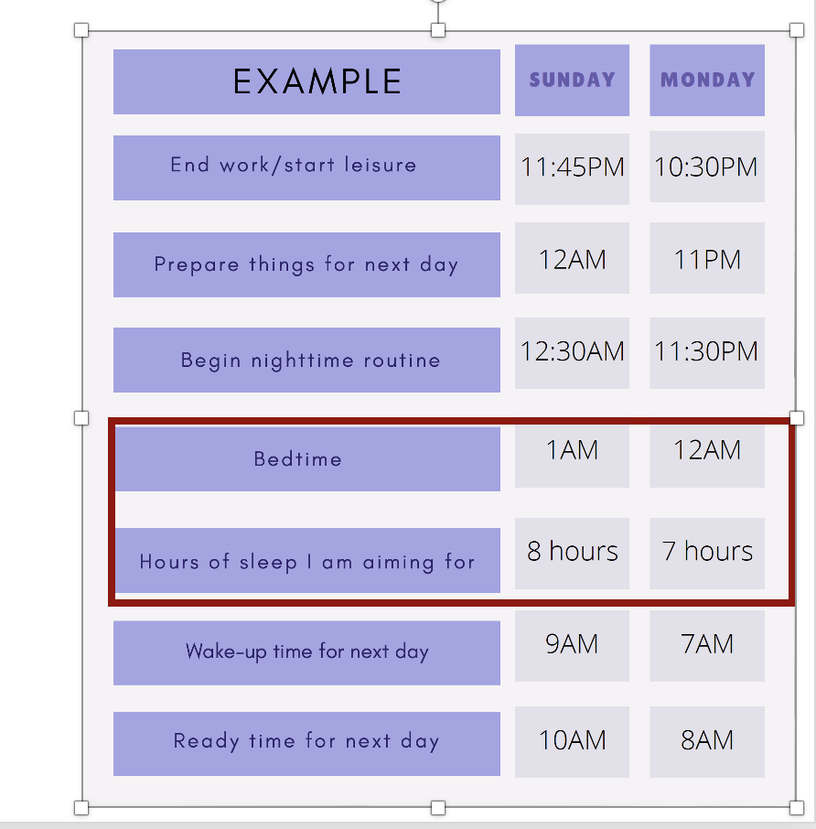
Hours of Sleep I Am Aiming For/Bedtime
7-8 hours per night
Avoid distractions
Hou et al. (2020)
Notes:
Next, you want to determine the amount of sleep that you are aiming to get. It is suggested to get at about 7-8 hours of sleep per night. Trying to go to bed in the same hour range will help offset being tired or groggy the following day. So you will take your waking time and subtract the hours of sleep you are aiming to get. That will also give you your bedtime.
In the example on this slide, if you plan to wake up at 9am and aim to sleep for 8 hours, then your bedtime would be 1am. If you plan to wake up at 7am and want to get 7 hours of sleep, your bedtime would be 12 am.
The big thing is to avoid distractions. When it is bedtime, it is lights out and not time to mindlessly scroll on your phone. As a reminder, your wake-up time will not include snooze time.

Slide 7
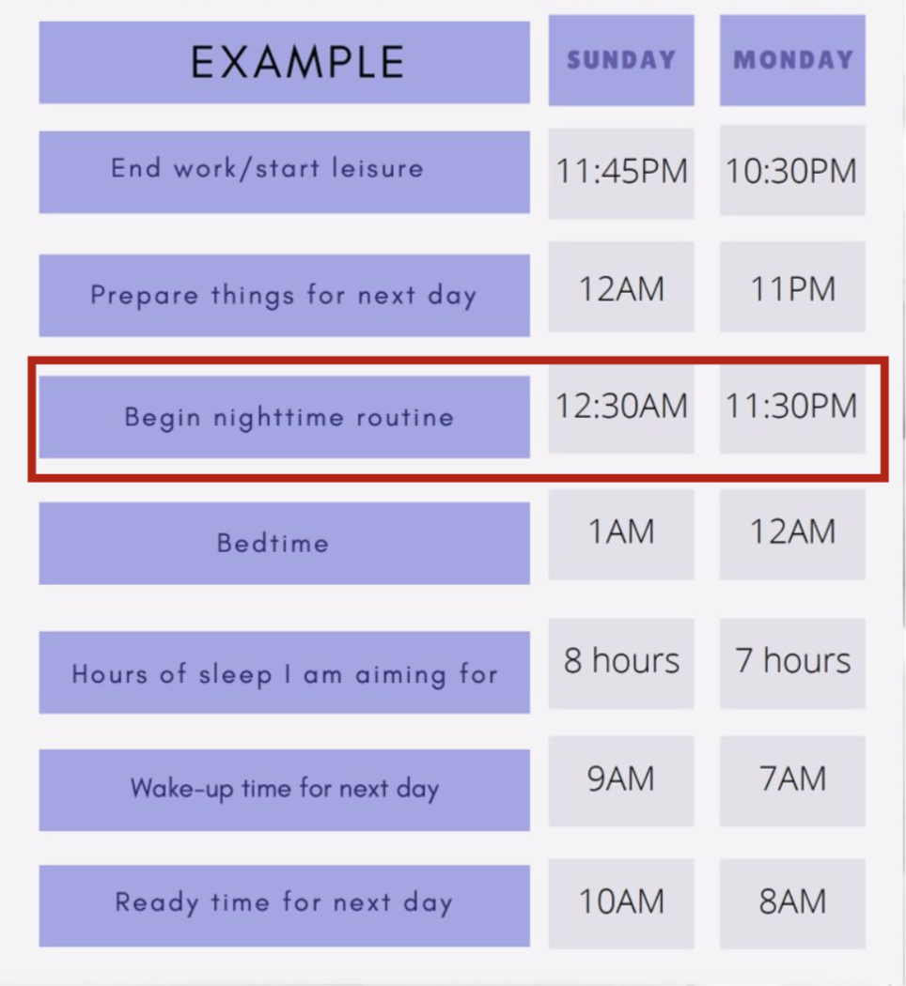
Begin Nighttime Routine
Preparing for bed
Winddown activity
Dental routine
Skincare routine
Hou et al. (2020)
Notes:
When you are preparing for bed, you will want to give yourself time to decompress for the day. If you are looking to work on your nighttime routine, there is another presentation on Creating an Evening routine which may be beneficial.
For a nighttime routine, you will want to include any winddown activities like stretching or meditation, taking a shower and/or reading a book. These activities should be calming. You should also include hygiene practices like brushing your teeth, washing your face, etc. You will want to estimate how long these activities will take and continue to plan backwards. For most people, this will take somewhere between 10 and 45 minutes depending on the tasks that need to be completed.
In this example, if your nighttime routine takes 30 minutes and your bedtime is 1am then you should begin your routine at 12:30am. If your bedtime is 12am , and your routine will take 30 minutes, then you should begin your nighttime routine at 11:30pm.

Slide 8
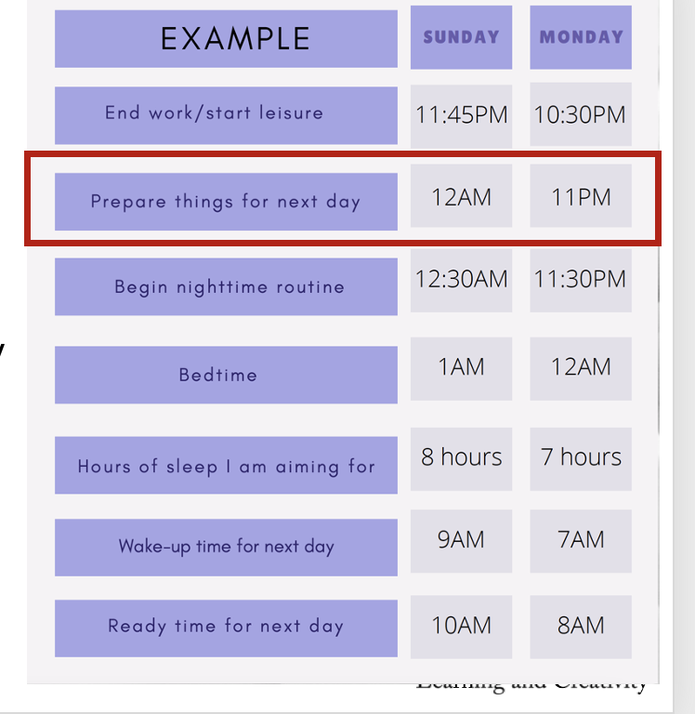
Prepare Thing For The Next Day
Charging your computer
Preparing your backpack
Lunch/snacks
Picking out clothes for the next day
Hou et al. (2020)
Notes:
Next, is determining how long it will take you to prepare your things for the next day. Allowing for time to do this the night before will make sure you are not in a rush the next day and forgetting things. These will include things like charging your computer, preparing your backpack, packing any lunch or snacks you need to take to campus, preparing breakfast, and/or selecting your outfit for the next day. It is important to consult the weather to see if an umbrella or a coat will be needed. You will need to estimate how long these things will take. For most folks, it is somewhere between 10 and 30 minutes depending on the activities.
In this example, if it takes 30 minutes to prepare things for the next day and you want to begin your bedtime routine at 12:30am then you should begin preparing your things for the next day at 12am. If you want to start your bedtime routine at 11:30pm then you should begin preparing your things for the next day at 11pm.

Slide 9
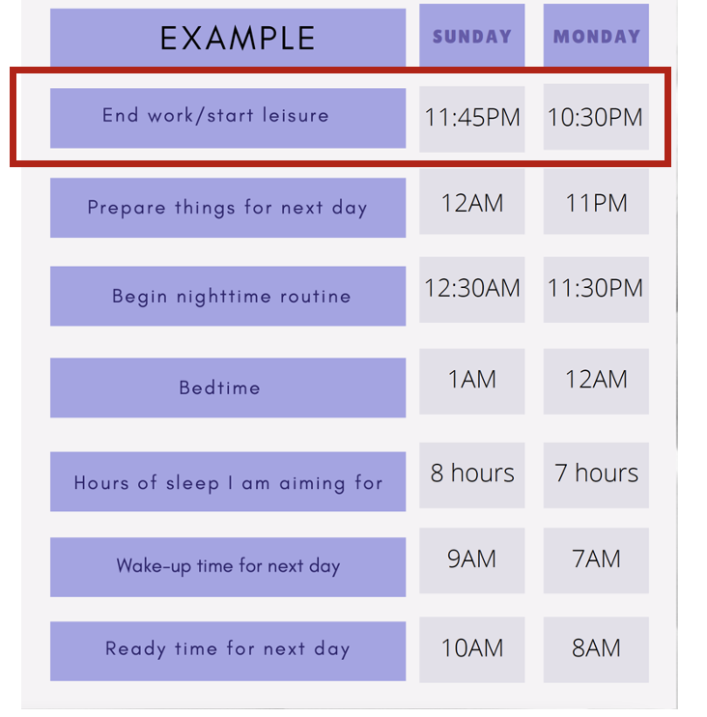
End Work/start leisure
Ending work
Starting leisure could include:
Relaxing beverage or snack
Watching a television show
Chatting with a loved one
Spending time with a pet
Cleaning
Hou et al. (2020)
Notes:
The final step is to plan the time you will stop work and begin your leisure routine. A leisure routine can be anywhere from 15 to 60 minutes depending on what you decide to do. Some suggestions of things to do include have a beverage like warm tea and maybe a light snack, watching a television show, chatting with a loved one, spending time with a pet or even cleaning.
In this example, you will want to end work and start leisure at 11:45 pm so that you have 15 minutes before preparing things for the next day at 12am. Or if you plan to start preparing things for the next day at 11 PM, you would want to stop working at 10:30 PM.

Slide 10
Your Sleep Schedule!
Build your own Sleep Schedule!
List the end of your work
Preparing for the next day
Nighttime Routine
Bedtime
Hours of Sleep You Need
Your set wakeup time
Your set ready time
Hou et al. (2020)
Notes:
Now it's your turn! You may notice that the handout has a different space for each day of the week because depending on your class and work schedule, you may need to make adjustments depending on the time you need to be on campus. You will start to plan from the bottom and work your way up. As you do this, you will want to make sure you are being realistic and that it is a routine that will you be able to follow.

Slide 11
References
Hou, W. K., Lai, F. T., Ben-Ezra, M., & Goodwin, R. (2020). Regularizing daily routines for mental health during and after the COVID-19 pandemic. Journal of Global Health, 10(2).
Ramar, K., Malhotra, R. K., Carden, K. A., Martin, J. L., Abbasi-Feinberg, F., Aurora, R. N., ... & Trotti, L. M. (2021). Sleep is essential to health: an American Academy of Sleep Medicine position statement. Journal of Clinical Sleep Medicine, 17(10), 2115-2119.
Notes:
Thank you for listening to the presentation. Feel free to stop by the Kortschak Center for drop-in hours if you would like assistance building a sleeping schedule.

