Slide 1
Creating a Morning/Evening Routine
Ashlyn Kirkpatrick
Notes:
Hi. I’m Ashlyn Kirkpatrick and I’m an Academic Coach at the Kortschak Center for Learning and Creativity. In this presentation, I will discuss why you should create a routine and how to create a routine

Slide 2
Why create a routine?
Reduced fatigue, overthinking, and stress levels
Make better big decisions
Increased productivity
Better sleep
Prioritize what is important to you
Hou et al., 2020; Piedmont, n.d.
Notes:
Routines are an important part of our day. But why should we create a routine? Let's review a few reasons:
Routines can help reduce fatigue, overthinking, and stress levels by creating more predictably and an increased sense of control
Routines can also help you make better big decisions because less brainpower is being wasted on smaller decisions
Routine can also help increase your productivity and improve your sleep quality
Routines can also help you prioritize what is important to you. If you want to spend more time with family, you can create routines that reflect this. If you want to prioritize your physical health, you can create routines that include exercise

Slide 3
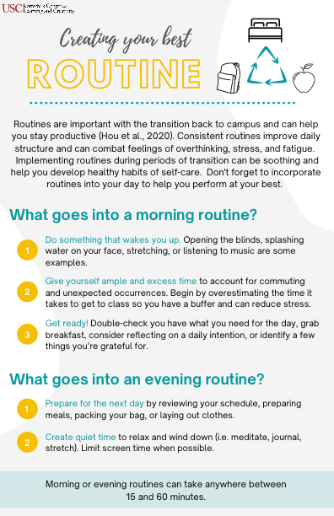
How to create a morning routine
Morning routine
Something to wake you up
Give yourself excess time
Get ready
Notes:
This “creating your best routine” handout is another resource to help you design your routines. You can download it from our website. We are going to review this handout.
Morning routines are important as they can assist in getting your day off to a great start.
Some suggestions for creating a morning routine include doing something to wake yourself up like stretching, splashing water on your face or listening to music
It is also helpful to give yourself excess time in your morning routine so you have a buffer and aren’t rushing to class or work
Finally, you might consider including time to make set your intentions for the day, get breakfast, and make sure you have everything you need for the day (laptop, chargers, etc)

Slide 4
How to create an evening routine
Evening routine
Prepare for the next day
Create quiet time
Length of routines may vary
Notes:
Evening routines can help you wind down after a long day and also prepare for a successful next day. A couple of suggestions for creating an evening routine can include preparing for the next day by packing your bag, preparing meals, and laying our clothes. Another popular option to include in your evening routine includes creating quiet time or time to wind down. This might include meditating, journaling, and/or limiting screen usage before bed
Remember everyone’s routines will look slightly different. There is no “perfect” routine. Routines may also vary in length. Most are about 15-60 minutes

Slide 5
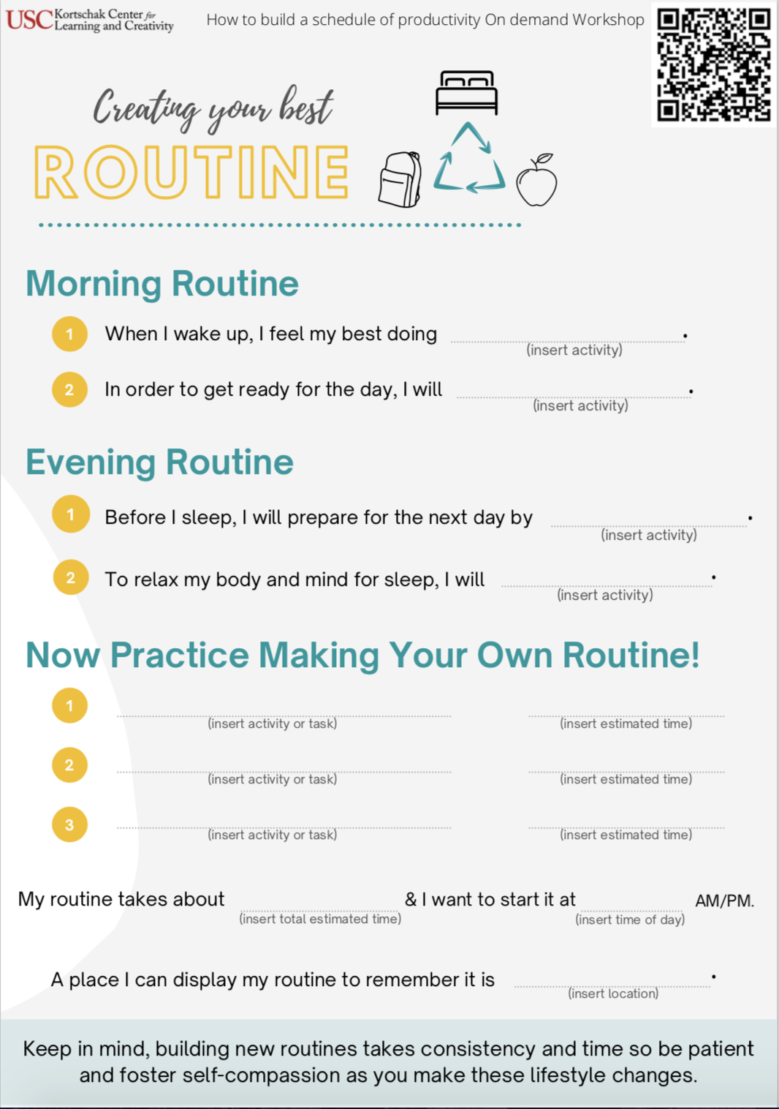
Creating your best routine
Morning routine
What do you feel your best doing
What will help you prepare for the day
Evening routine
Prepare for the next day
Ways to relax
Notes:
When creating a morning routine, you can think about what helps you feel your best and how you might be able to incorporate that into your morning routine. Also consider what helps you prepare for the day. You can use these prompts to help brainstorm what will be important for you to include in your routine.
Similarly, for your evening routine, you might consider ways that you can prepare for the next day, such as laying out your clothes or packing your bag the night before. It may also be helpful to include a way to relax or wind down from the day such as journaling or meditation.

Slide 6
Implementing your routine
Estimate time to complete
Where will you display your routine?
Practice self-compassion
Notes:
After you have considered different components for your routine, think about how long it will take you to complete each task. For example, if part of your routine includes packing your bag, will this take you 10 minutes or 15 minutes to complete? Once you have estimated how long it will take to complete each part of your routine, you will have a good estimate of how long it will take to complete your entire routine. This can also help you plan when to start your routine. For example, if you need to leave your dorm/apartment by 10am for class and your routine takes 45 minutes, you should probably start your morning routine no later than 9:15am.
Spend some time thinking about where you will display your routine. Will you have a digital or physical display of your routine? A habit tracker with things you want to do everyday and the days of the week can be a great way to visualize your progress and can be a form of reward for sticking with your habit
As you create a routine, give yourself compassion and grace. It takes time to build a routine and figure out what works for you

Slide 7
References
Hou, W. K., Lai, F., Ben-Ezra, M., & Goodwin, R. (2020). Regularizing daily routines for mental health during and after the COVID-19 pandemic. Journal of Global Health, 10(2). https://doi.org/10.7189/jogh.10.020315
Piedmont (n.d.). Why routines are good for your health. Piedmont Healthcare. https://www.piedmont.org/living-better/why-routines-are-good-for-your-health
Notes:
The ”creating your best routine” handout is available on the Kortschak Center website and will be available to download underneath this video. Thank you for watching!

