Slide 1
How to Create an Action Plan
Kortschak Center for Learning and Creativity
Notes:
Hellol! Welcome to the Kortschak Center for Learning and Creativity Tools and Resources page. My name is Zainab Nicholas and I serve as an Academic Coach. Today, I will be discussing how to create an action plan.

Slide 2
What is an action plan?
Method of Organization
Breakdown of task
Increase Efficacy
Increase Accountability
Self-regulation
Seli, H. & Dembo, M. (2021)
Notes:
Weekly action plans are a great organizational tool to help with breaking down tasks and assignments into manageable pieces. They allow for you to plan out your weekly tasks. Developing an action plan can help increase efficiency and accountability to meet goals and objectives through detailed action steps that determine what day they will be completed. Action plans assists in the development and accountability of self-regulation.

Slide 3
Step 1: List the Weekly Dates
Notes:
Let's go through the steps on how to create an action plan. An action plan usually takes about 10-20 minutes to complete so make sure to set aside enough time to complete it. There is a blank action plan in a word document form below on this webpage. Feel free to watch this video while you also complete your action plan.
Step 1 is to write the weekly date in the top right corner. You will want to write out the dates that you will be putting into the action plan. You notice in red on the slide that this calendar will review the Week of 11/6-11/12.

Slide 4
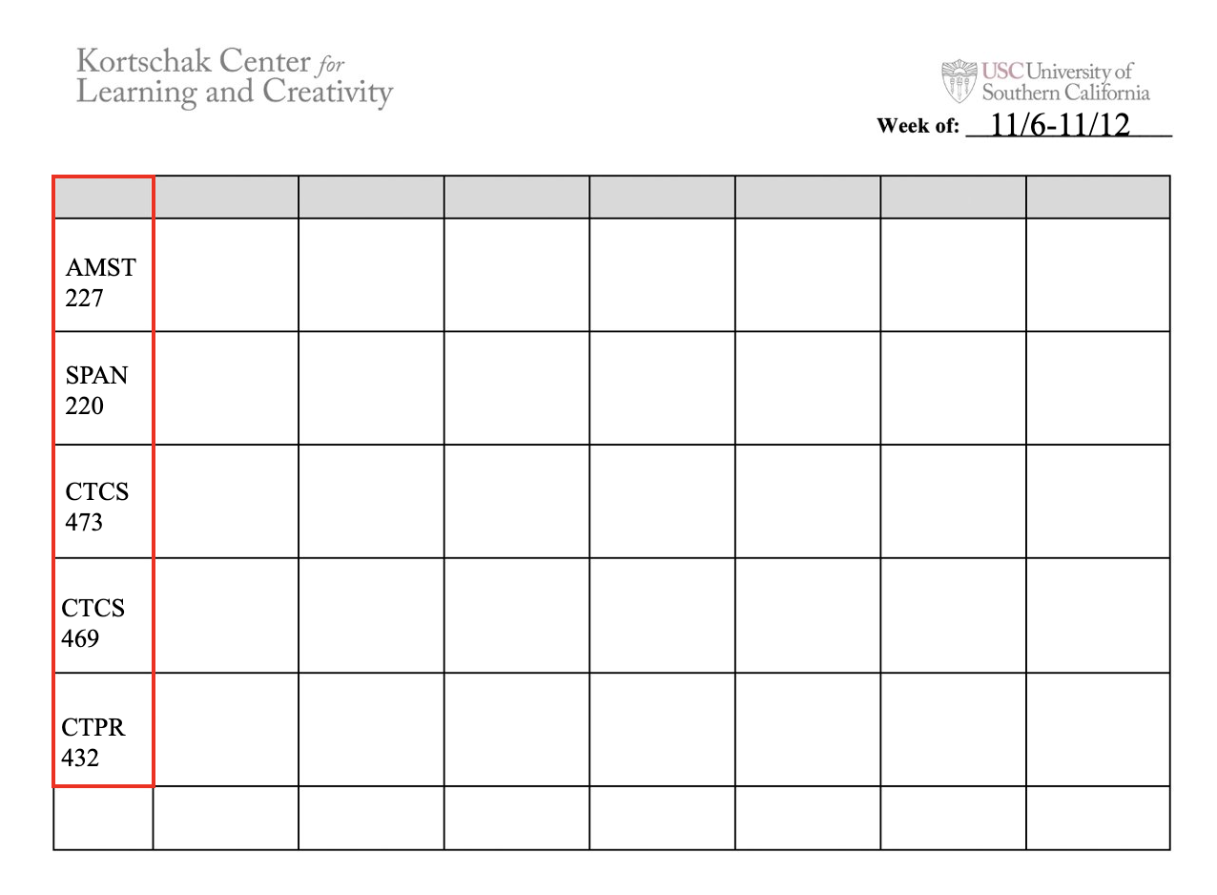
Step 2: List your Courses
Notes:
Step 2 is list your courses in abbreviation and number in the far-left column in the white spaces. You can also include work or any clubs you are in here as well. You notice in the red that this calendar will plan for five courses.

Slide 5
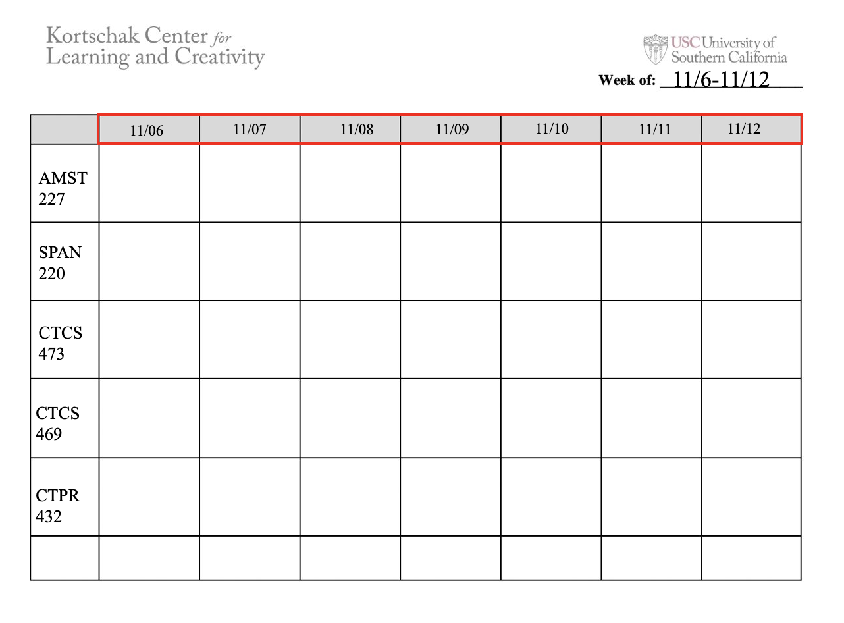
Step 3: List the Dates in Sequential Order
Notes:
Step 3 is to write the specific date in each gray column at the top going from left to right. Theses days should reflect the dates indicated in the week of.
You notice in the red the date added.

Slide 6
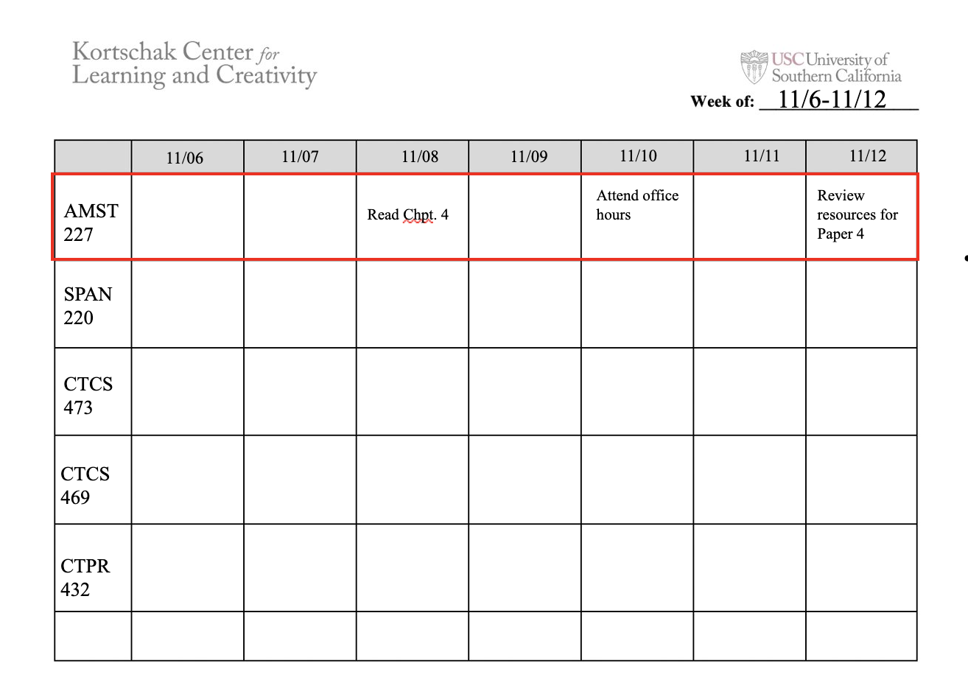
Step 4: Create Task List for your First Course
Notes:
For step four you will start with your first course located in the second horizontal line. This example shows in red for the AMST 227 class.
You will look at your syllabus, emails, notes, and blackboard to determine what needs to be added for this week. From there, you can break down assignments and add them to the day you plan on completing the task. If you do break down assignments, make sure it is manageable components.
In this example, you can see a reading, attending office hours and reviewing resources for a paper have been added.

Slide 7
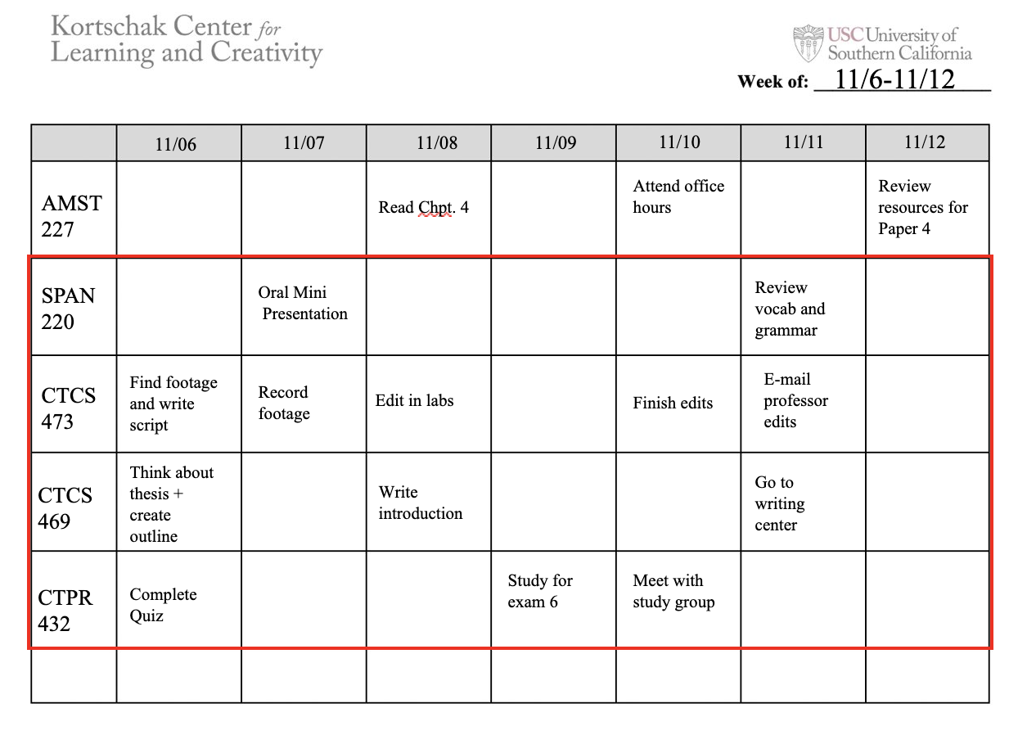
Step 5: Create Task for the Reminder of the Courses
Notes:
In step five you'll complete the task list for the remainder of your courses. Here these are in the red box for SPAN 220, CTCS 469, and CTPR 432. You will continue to write in items and breaking down tasks.

Slide 8
Step 6: Facilitation
Notes:
Now that you have completed your action plan you can focus on the upcoming days. Step 6 is the facilitation of the action plan. We are going to first look at the date 11/6 in the example on the slide.
It is important in the action to plan to look at each date and make sure that you have time to complete the task. If you have a busy day and won't have time to complete the task, then some tasks may need to move to a different day.
Another step you may want to take is to estimate how long it will take you to complete the task and start to assign it into your day and in your weekly schedule.

Slide 9
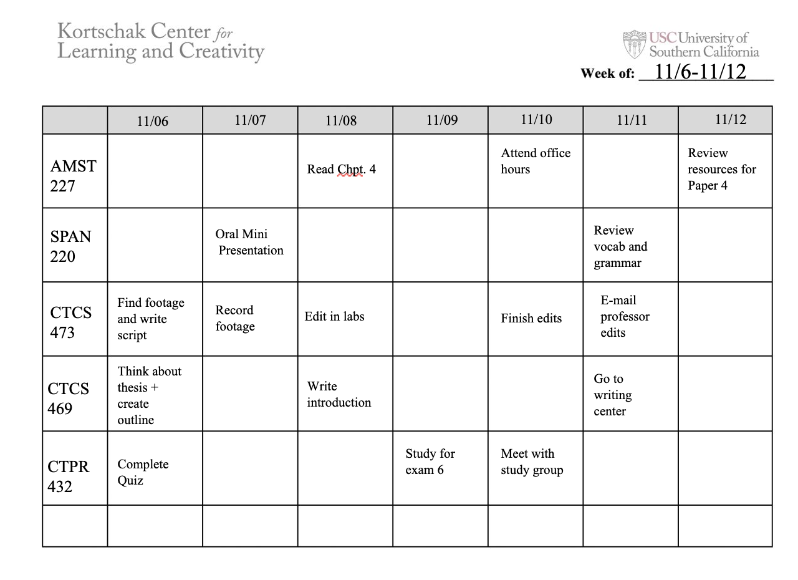
Step 7: Monitor and Evaluate
Notes:
Step seven is to monitor and evaluate your action plan. Just because you created the plan does not mean that it will actually turn out that way. Action plans often need updating and fine-tuning throughout the week, especially if unexpected things occur. Task-reflecting is important to an action plan because it increases productivity.
Once the week is complete, you can start over again for the next week. Make sure to incorporate strategies you have learned throughout the week into your next action plan.

Slide 10
REFERENCES
Seli, H. & Dembo, M. (2021). Motivation and learning strategies for college success : a focus on self-regulated learning (6th ed.). Routledge. https://doi.org/10.4324/9780203813836
Notes:
I hope watching this video was helpful. Please visit KCLC if you have any additional questions.

