Slide 1
ADHD and Mindfulness
Presented by: Shawn Aminirad
Notes:
Hello, my name is Shawn Aminirad, and I am an academic coach at the Kortschak Center for Learning and Creativity. Welcome to this workshop on ADHD and Mindfulness. This workshop will illustrate the benefits of mindfulness on the ADHD brain, although its benefits can extend to many different profiles, regardless of learning difference.

Slide 2
Learning Outcomes
Identify the benefits of mindfulness for students
Use mindfulness when studying to improve your ability to initiate a task, concentrate on the task, and then complete the task
Demonstrate the importance of goal setting and reflection in order to attain your goals
Notes:
Our learning outcomes today are to identify and explain the benefits of mindfulness for students.
Next we will review how to use mindfulness when studying to improve your ability to initiate a task, concentrate on the task, and then complete the task
Lastly, we will demonstrate the importance of goal setting and reflection in order to atttain your goals

Slide 3
What is Mindfulness?
Type of meditation
Focus on the moment, without judgment (Mayo Clinic, 2020)
Notes:
You may be wondering, “what is mindfulness?”
According to the Mayo Clinic, mindfulness is a type of meditation where the focus is on being “intensely aware of what you’re sensing and feeling in the moment, without interpretation or judgment.”

Slide 4
Mindfulness Benefits
Stress
Anxiety
Pain
Depression
Insomnia
High blood pressure (hypertension)
Improve attention
Decrease job burnout
Improve sleep
Improve diabetes control
(Mayo Clinic, 2020)
Notes:
Mounting evidence shows that mindfulness can provide benefits by reducing stress, anxiety, physical and emotional pain, depression, insomnia, and decrease high blood pressure (Mayo Clinic, 2020).
Generally, meditation can also improve attention, decrease burnout, improve sleep, and improve diabetes control (Mayo Clinic, 2020).

Slide 5
How and Where to Practice Mindfulness
Eating
Drawing
Breathing
Exercising
Sitting
And more!
Notes:
You may now be wondering, “how and where can I practice mindfulness,” or “I’ve tried mindfulness before, and I didn’t really like it.” What’s great about mindfulness is that it can be practiced in many different ways. Here, we have a list of different things you can do mindfully, so you can have the cognitive benefits of mindfulness, while also doing it in a unique way that appeals to you and fits into your schedule.

Slide 6
Mindfulness and ADHD
Research indicates that mindfulness can:
Improves attention and cognitive inhibition while reducing symptoms of anxiety and depression
(Zylowska, L., Ackerman, D. L., Yang, M. H., Futrell, J. L., Horton, N. L., Hale, T. S., Pataki, C., & Smalley, S. L., 2008)
Keep you on-task
(Bachmann, K., Lam, A. P., Sörös, P., Kanat, M., Hoxhaj, E., Matthies, S., Feige, B., Müller, H., Özyurt, J., Thiel, C. M., & Philipsen, A., 2018)
Reduce ADHD symptoms like difficulty beginning tasks, or completing them once started
(American Psychiatric Association, 2013)
Notes:
Research indicates that mindfulness, specifically in ADHD, can result in improved attention and cognitive inhibition while reducing symptoms of anxiety and depression (Zylowska et al., 2008).
It can also improve task performance and significantly reduce ADHD symptoms (Bachmann et al., 2018).
Some ADHD symptoms include difficulties beginning tasks, or completing tasks once started (American Psychiatric Association, 2013).

Slide 7
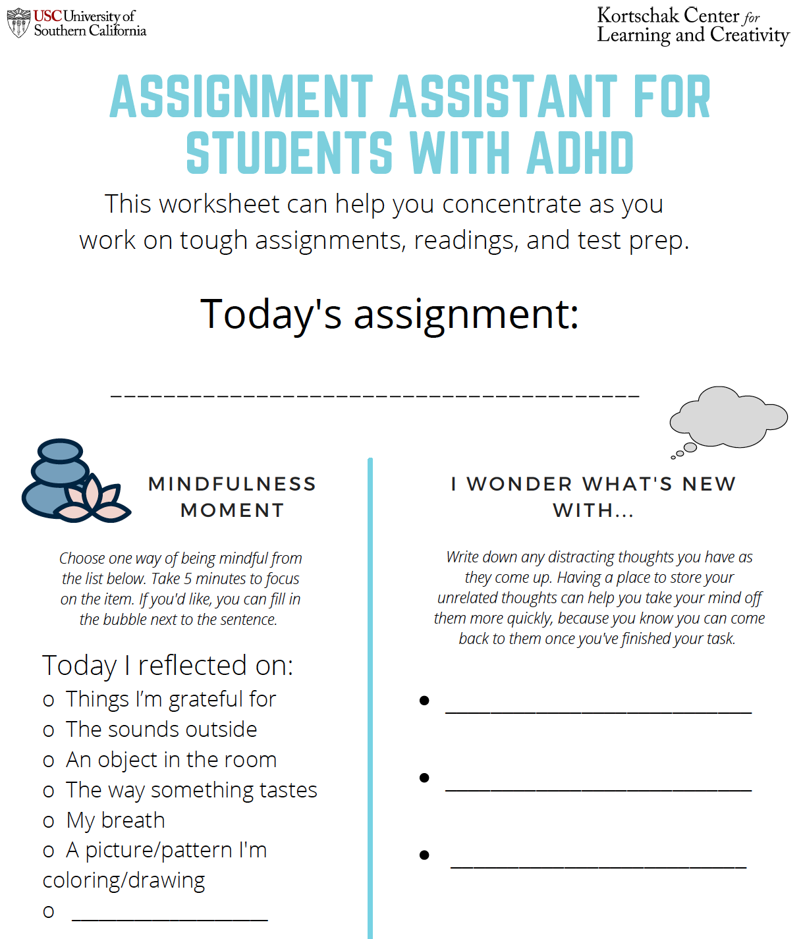
Worksheet Overview
Notes:
This worksheet titled, "Assignment Assistant for Students with ADHD" can help you concentrate as you work on tough assignments, readings, and test prep. It is designed for people with an Attention Deficit Hyperactivity Disorder diagnosis in mind, but can really be used by anyone who tends to become distracted when working on a single task for an extended period of time.
While it is meant to be printed and filled out with a pen or pencil, you may also screenshot it and fill it in using a basic drawing app, like Microsoft Paint or Preview.

Slide 8
Today’s Assignment Goal
Begin by writing the task you’re planning to focus on today
Consider smaller, more manageable steps as your assignment for the day
Notes:
The handout begins by asking you to specify what your task is. It can be, “read 24 pages” or “study for anthropology quiz,” or “complete problem set for economics,” or whatever you feel is relevant to your current situation. Having your goal written here can help you by marking exactly what the end point is.
For some people, they may prefer to have their goal broken down into smaller, more manageable parts. If that sounds like you, you’d want to complete that step first, so that the goal you see here is the immediate task at hand.

Slide 9
Mindfulness Moment
Take 5 mindful minutes before beginning Today’s Goal
Notes:
When we first begin an assignment, it’s important to begin with a mindful exercise. The worksheet makes this process explicit, and provides you with many options for mindful activities to get you started. Of course, if there is another mindful activity that you find helpful, you can absolutely do that for five minutes instead; what you see on the sheet are only suggestions.

Slide 10
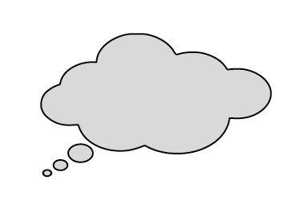
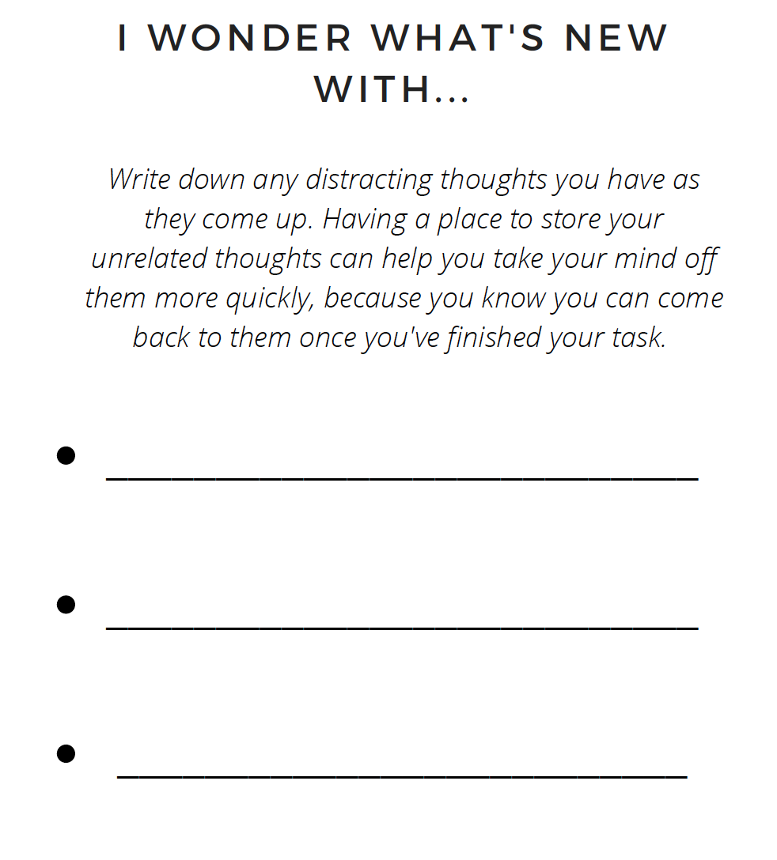
Brain Dump List
Can be helpful to vent, keep track of thoughts, or hold onto distractions (Mincu, 2019)
Notes:
This section allows you to write out thoughts that come to mind while working. Intrusive thoughts, for students with ADHD, are significantly more common than for those without. Having a space to vent those thoughts can help put your mind at ease, because you know that, as soon as your task is done, you can check in with that thing that you thought about. It’s a good way to acknowledge that your interests are important to you, and allows you to use those interests to motivate you further.

Slide 11
Restorative Drawing Space
Fill in a few bubbles with fun, creative imagery
Can help you think about a problem differently (Fabrega, 2016)
Notes:
The final section of the worksheet is a restorative drawing space. If you’re feeling overwhelmed, stuck, frustrated, or tired, one way to mindfully keep your mind on-task is to fill in a few bubbles with the same—or even a completely different—design. Doing this will stretch out the more creative parts of your brain, allowing you to view and solve a question or problem with renewed vigor.

Slide 12
Things and People that Helped Me Today
Promotes metacognition
Helps solidify positive habits
Builds resilience by emphasizing strong social connections (Dvorksy & Langberg, 2016)
Notes:
This part of the worksheet can be a little more challenging, because it demands a level of reflection. Take the word “things” to be as broad as you’d like, and think about anything that helped you accomplish your goal today. Was it this worksheet? The time of day? The fact that you had a fruit plate nearby? Did you use a specific strategy, like the Pomodoro Technique? Was that helpful? Did a parent, friend, significant other keep you on task? Did something happen that made you feel appreciated or grateful?
Reflecting on these things can build metacognition. Metacognition, which is essentially, thinking about how you think, is a vital tool for academic success. Having strong metacognitive skills essentially means that you know a lot about your personal learning profile (meaning, what is or isn't helpful), so you can capitalize on your strengths while working around your weaknesses.
It can also solidify positive habits by reflecting on the things that helped, so you can emphasize or reuse those later. Identifying supportive people can help to build resilience by emphasizing strong social connections. This is important because increasing resilience helps people be more committed and flexible when things don’t go according to plan.

Slide 13
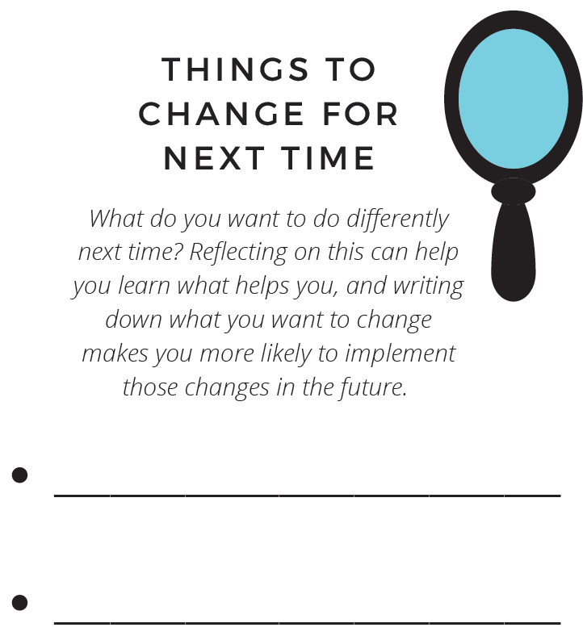
Things You Can Do Differently
Easier to stick to things if they’re written down (Greene, 2019)
Helps us understand ourselves
Notes:
In this section, you can write down the things, if anything, you’d like to change next time you do a task that is similar to this one. If you write down the things you want to change, you will be more likely to recall and act on those things later. Research shows that writing down goals makes you three times as likely to stick to them. Therefore, by writing down the things that you want to change when working next time, you will be more likely to actually implement those strategies (For example, reminding yourself to eat some fruit before studying or having a bottle of water nearby if you recognize that those things help you focus).
Writing down what we want to change helps us reflect on our learning profile and identify what works and what doesn’t.

Slide 14
Thank you!
Notes:
Thank you for watching this workshop. Remember you can download the handout from this page as well.

Slide 15
References
Abramovitch A, Schweiger A (2009). Unwanted intrusive and worrisome thoughts in adults with Attention Deficit\Hyperactivity Disorder. Psychiatry Res, 168(3): 230-3. doi: 10.1016/j.psychres.2008.06.004.
American Psychiatric Association (2013). Diagnostic and Statistical Manual of Mental Disorders. 5th edition. Arlington, VA., American Psychiatric Association.
Bachmann, K., Lam, A. P., Sörös, P., Kanat, M., Hoxhaj, E., Matthies, S., Feige, B., Müller, H., Özyurt, J., Thiel, C. M., & Philipsen, A. (2018). Effects of mindfulness and psychoeducation on working memory in adult ADHD: A randomised, controlled fMRI study. Behaviour research and therapy, 106, 47–56. https://doi.org/10.1016/j.brat.2018.05.002
Dvorsky, M. R., & Langberg, J. M. (2016). A Review of Factors that Promote Resilience in Youth with ADHD and ADHD Symptoms. Clinical child and family psychology review, 19(4), 368–391. https://doi.org/10.1007/s10567-016-0216-z
Fabrega, M. (2016, October 15). 7 benefits of doodling and how to get started. https://daringtolivefully.com/doodling-benefits
Greene, B. (2019, August 7). The Psychology Of Writing Down Goals. New Tech Northwest. https://www.newtechnorthwest.com/the-psychology-of-writing-down-goals/. New Tech.
Mayo Clinic. (September 2020). Mindfulness exercises. https://www.mayoclinic.org/healthy-lifestyle/consumer-health/in-depth/mindfulness-exercises/art-20046356
Mincu, B. (2019, April 1). ADHD Parking Lot for Pop-up Thoughts. Thrive with ADD. https://thrivewithadd.com/adhd-pop-up-thoughts/.
Zylowska, L., Ackerman, D. L., Yang, M. H., Futrell, J. L., Horton, N. L., Hale, T. S., Pataki, C., & Smalley, S. L. (2008). Mindfulness meditation training in adults and adolescents with ADHD: a feasibility study. Journal of attention disorders, 11(6), 737–746. https://doi.org/10.1177/1087054707308502

