Slide 1
ADHD and Anxiety
Kelliann Lively
Notes:
Hello! I am Kelliann Lively, an academic coach and Marriage and Family Therapist Intern at the Kortschak center and today we will be reviewing ADHD and Anxiety.

Slide 2
What is ADHD?
A condition affecting children and adults characterized by problems with:
Attention
Impulsivity
Overactivity
3 Subtypes
Inattentive
Hyperactive
Combined Type
(American Psychiatric Association, 2013)
Notes:
ADHD stands for attention deficit hyperactivity disorder.
It is a condition that affects children and adults.
It primarily affects attention, impulsivity, and overactivity.
There are 3 subtypes of ADHD which are inattentive, hyperactive, and combined type.
Some symptoms of inattentive type are: difficulty sustaining attention, struggling to complete tasks, forgetful of daily activities, and fails to pay attention to details
Some hyperactive type symptoms are: fidgets with hands or feet, feelings of restlessness, excessive talking, and difficulty engaging in leisure activities.
Combined type is when both inattention and hyperactivity are present.

Slide 3
What is anxiety?
Apprehension or fear about a future threat or a response to an immediate threat
Normal human response that can cause:
Restlessness
Fatigue
Difficulty concentrating
Irritability
Sleep disturbance
Can be positive by energizing and motivating people to accomplish tasks and goals
(American Psychiatric Association, 2013)
Notes:
Anxiety is an apprehension or fear about the future or a future threat or a response to an immediate threat.
It is a normal human response that people experience everyday. Some common symptoms of anxiety are restlessness, fatigue, difficulty concentrating, irritability, and sleep disturbances
Anxiety can be positive and helpful because it can provide energy and motivation that helps accomplish tasks and goals.

Slide 4
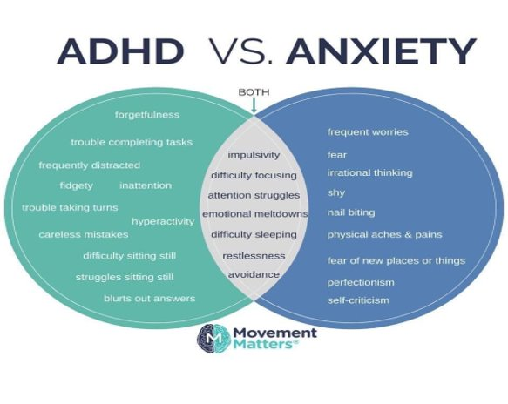
ADHD and Anxiety Overlap
https://www.facebook.com/thecontentedchild/posts/adhd-vs-anxiety/1544643812350648/
Notes:
While they are different and have different diagnostic criteria they can co occur together and also share similar symptoms.
Some of the symptoms that can occur that represent both are impulsivity, difficulty focusing, attention struggles, emotional meltdowns, difficulty sleeping, restlessness, and avoidance

Slide 5
How do they relate?
College students are at greater risk for having anxiety symptoms and anxiety disorder (O’Rourke, Bray, & Antstopoulos, 2020).
ADHD can cause students to feel overwhelmed, fall behind, more likely to experience negative situations and emotions, and have lower self-esteem.
Once anxious, ADHD symptoms increase and become worse
https://www.psych-nyc.com
Notes:
ADHD and Anxiety are two separate diagnoses so you might be wondering how they relate to one another.
ADHD can’t be discussed without bringing up anxiety because of the stressful nature of day-to-day life
Research shows that around 50% of adults with ADHD also have cooccurring anxiety or experience anxiety symptoms
Not all adults with ADHD will meet criteria for an anxiety disorder but will still experience occasional and situational anxiety in their daily lives.
Problems stemming from ADHD — such as tardiness, procrastination, and the prospect of social stigma — all lead to experience anxiety at many points in their lives.

Slide 6
How to Cope

Slide 7
Regulate Behaviors, Emotions, & Mindset
Write it out!
Use feelings and behaviors as information
Ask yourself:
What am I feeling?
What is the problem?
What was the trigger?
How can this be managed?
What is the best, worst, and most likely outcome of the situation?
https://www.bustle.com/p/11-journaling-tips-for-people-who-are-absolutely-terrible-at-keeping-a-journal-15514789
Notes:
To help yourself when your anxiety and ADHD become overwhelming, use what you are feeling and your behavior as information
Ask yourself these questions: what am I feeling, what is the problem, what was the trigger, how can this be managed, what is the best, worst, and most likely outcome of the situation.
Writing it out helps. By moving the issue out of your head and onto paper, you are allowing yourself to see what you can control and what you can’t control
An example of this would look like:
I am feeling my heart beat really fast, I am struggling to sit still
The problem is that I can’t focus on doing my assignment.
The trigger is the deadline for this assignment being in a few hours and I need to get it done.
This can be managed by deep breathing and redirecting my focus onto completing the assignment.
Best outcome: professor canceling the assignment
Worst: not doing the assignment and getting a zero.
Most likely: I complete the assignment and turn it in on time

Slide 8
Coping Mechanisms
Structure unstructured time to create a routine
Exercise and movement
Maintain healthy habits
Better exercise, sleep, and eating habits
Limiting anxiety inducing triggers like caffeine and other substances
Reducing stress overall
Notes:
Structure unstructured time. Creating routine is important, especially one that’s highly visible. That could be an appointment planner, a calendar on the wall, or a digital planner such as google calender. planners allow us to look hours, days, and weeks into the future, priming us for what we plan to do.
Exercise and movement: Movement can be its own form of meditation, allowing us to remove ourselves from work or home and reset. This can be anything from going on a walk or roller blading, dancing, jumping on a trampoline
Maintain healthy habits: Many individuals, ADHD or not, are experiencing chronic stress and general feelings of overwhelm with no one particular stressor. Maintaining healthy habits like better exercise, sleep, and eating habits as well as limiting anxiety inducing triggers such as caffeine and other substances and reducing stress

Slide 9
Additional Coping Mechanisms
Organize physical spaces
Define where work, leisure, sleep, study, and other activities will be done around your home
Example: cleaning off your desk leaving nothing, but your to-do list out and visible.
Decrease Sight Pollution
Reset and prepare your workspace for the following day
Lower the bar on expectations
Reframe tasks into do-able terms
Decatastrophize
Maintain perspective and practice gratitude
Defuse by accepting thoughts for what they are
Thoughts and NOT facts.
Notes:
Organize physical spaces: Define where work, leisure, sleep, study, and other activities will be done around the home to help with task activation and habit formation.
Decrease "sight pollution” by resetting and preparing your spaces for the next day. This can help with transitions and is done by closing notebooks and textbooks and organizing them, deleting tabs on your computer that are unneeded for the following days work, and putting away any materials that are unneeded the following day.
Lower the bar on expectations: reframe tasks into do-able terms. Being good enough is better than expecting to be perfect, and this mentality alone can get you unstuck and to a less anxious state.
Decatasrophize: Maintaining perspective and practicing gratitude. One way to modify thoughts is to disengage with the inflexible “should” mindset –– as in things “should” only work out one way and are no good if they don’t. We can “defuse” by accepting some negative thoughts for what they are – just thoughts and not facts.

Slide 10
References
American Psychiatric Association. (2013). Diagnostic and statistical manual of mental disorders (5th ed.).
O’Rourke, S. R., Bray, A. C., & Anastopoulos, A. D. (2020). Anxiety Symptoms and Disorders in College Students With ADHD. Journal of Attention Disorders, 24(12), 1764–1774.
Prevatt, F., Dehili, V., Taylor, N., & Marshall, D. (2015). Anxiety in College Students With ADHD: Relationship to Cognitive Functioning. Journal of Attention Disorders, 19(3), 222–230.
Ramsay, J. (2020, December 22). ADHD and Anxiety: Symptoms, Connections & Coping Mechanisms. Retrieved February 01, 2021, from https://www.additudemag.com/adhd-and-anxiety-symptoms-coping/
Notes:
Thank you for reviewing the presentation!

