Slide 1
General Study Skills
Annie Villanueva
Kortschak Center For Learning and Creativity
Notes:
Hi Everyone! My Name is Annie Villanueva I am an Academic Coach here in the Kortschak Center For Learning and Creativity and Welcome to the General Study Skills Workshop

Slide 2
Learning Objectives
Understand what we mean by general study skills and why they are important
Recognize the difference between Meaningful Learning Strategies and Rote Learning Strategies
Describe different approaches for learning different types of material
Notes:
In this Workshop the learning objective are:
Understand what we mean by general study skills and why they are important
Recognize the difference between Meaningful Learning Strategies and Rote Learning Strategies
Describe different approaches for learning different types of material

Slide 3
What are general study skills and why do they matter?
General study skills are the skills needed as a college student to help you succeed in all of your classes.
Learning different strategies for different types of course material is necessary because different classes will require different approaches so the ability to adjust is key.
Notes:
What are general study skills?
General study skills are skills that are needed as a college student to be able to succeed and do well in all of your classes. Learning different study strategies for different types of classes is necessary because every class in not the same and Learning to adjust to different content and methods of learning is key. For example you wont use the same study skills for an economics class for an English or psychology class.
Learning different study skills can help you decide what strategy to use for which class. Today we will be going over summarization, outlining, practice testing, flashcards, mind mapping and concept maps

Slide 4
Meaningful and Rote Learning Strategies
Rote Learning Strategies: repetition without gaining a deep understanding of the material (Seli & Dembo, 2020)
Re-reading notes
Cramming the night before
Meaningful Learning Strategies: make sense of the material and connect to prior knowledge
Elaboration
Adding detail, summarizing, creating examples and analogies
"Who, what, when, where, where and how"
Organization
Creating structure for the material by forming relationships and connections
Notes:
It is important to understand the difference between rote and meaningful learning strategies to know which types of strategies can help you be more successful while studying. Seli and Dembo (2020) discuss the difference between rote and meaningful strategies.
Rote Learning is a process of learning through repetition without gaining a deep understanding of the material.
This can look like copying material from a book or lecture slide, taking verbatim notes, underlining material, or cramming the night before. These are common practices but they are not successful.
Meaningful Learning is a process of learning whereby the student attempts to make sense of the information and connect it to prior knowledge.
This can look like studying a mixed problems set instead of getting used to one type of problem. This forces the brain to think of other ways to tackle the problem which creates a deeper understanding of the material.
Two Strategies that are Meaningful strategies are Elaboration and Organization learning Strategies.
Elaboration Strategies is the integration of meaningful knowledge into long term memory through adding detail, and summarizing, creating examples, and analogies.
Thinking about the who, what, when, where and how when you elaborate to create additional ways of recalling the information.
Organization Strategies is a learning strategy that creates structure for the material by forming internal relationships and connections within the body of information.
When new information is organized it is stored more effectively within your long-term memory and thus can be remembered more completely
Let's review meaningful learning strategies in greater detail

Slide 5
Summarization
An elaboration strategy that takes a section of reading and condenses to a short summary (Seli & Dembo, 2020)
Example:
Paragraph to read: Learning how to use and incorporate different learning strategies can be difficult. Especially, when we don’t know how to use new learning strategies, we can become lost and stuck on how to use them. However, we can break down different learning strategies. There are Rote and meaningful learning strategies. We want to incorporate as many meaningful learning strategies as we can to be able to put new information in long-term memory and retain the information better. The different meaningful learning strategies are elaboration and organizational learning strategies.
Summary Sentence: There are rote and meaningful learning strategies. It is better to use meaningful learning, which is an elaboration and organizational learning strategies, to be able to remember the information.
Notes:
Summarization is an Elaboration Strategy, it is a brief statement that identifies the major ideas in a section of a textbook, play, newspaper article, or story.
When creating a summary it is important to identify the main points and keep it objective and factual, think of it as a brief report.
This example on this slide shows how taking a reading selection can be transitioned into a short summary.

Slide 6
Outlining
Organize the material by identifying the relationship between main ideas and supporting details (Seli & Dembo, 2020)
Example:
Major Topic​
First Main Idea​
First Important detail ​
Second Important detail ​
Third Important detail ​
Second Main Idea​
First Important detail ​
Second Important detail ​
Third Important detail
Notes:
Outlining is a great organization strategy. Outlining organizes the material by identifying the relationship between main ideas and supporting details
To show the relationship between main ideas and supporting details we can use this format
First write down the major topic and break the topic down into main ideas, indenting to the right.
Next, add supporting details to those main ideas, indenting to the right again.
Then repeat once you wrote down all of the main ideas about the major topic
When looking at an outline you should be able to quickly see what is most important with short descriptions.

Slide 7
Practice Testing
Attempting problems that will reflect material on future quizzes or tests (Seli & Dembo, 2020)
Completing practice problems or questions at the end of the chapter
Completing practice test provided by a professor
Notes:
Practice testing is another great study skill
Practice testing enhances learning and retention by making sense of the material since it is a meaningful learning method.
Some examples of practice testing is completing practice problems or questions that are available throughout the chapter or the end of the chapter or book as well as practice test provided by a professor or TA.

Slide 8
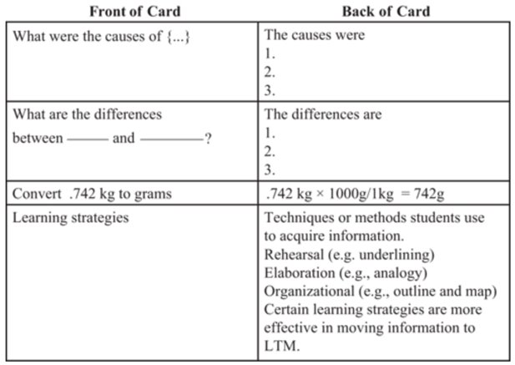
Flashcards
Self-testing strategy to rehearse recalling important information (Seli & Dembo, 2020)
Can include lower level answering Who, What, Where, Where
Can include higher level questions on solving problems, analyzing information, creating a solution
Can be made on index cards, paper or online (i.e. Quizlet)
Notes:
Flashcards or study cards are an effective self-testing strategy.
You can include lower level questions that answer the Who, What, When and where.
As well as Higher level questions such as solving problems, analyze information, evaluate the value of the information, or create a solution or plan.
These questions answer the Why, How, What if, The advantages and disadvantages, difference between, and what is your opinion of. It is important when creating flashcards to focus on one main point versus lots of points in one flashcard.
There are different ways to create flashcards such as using an index card, paper, or online using websites like Quizlet.

Slide 9
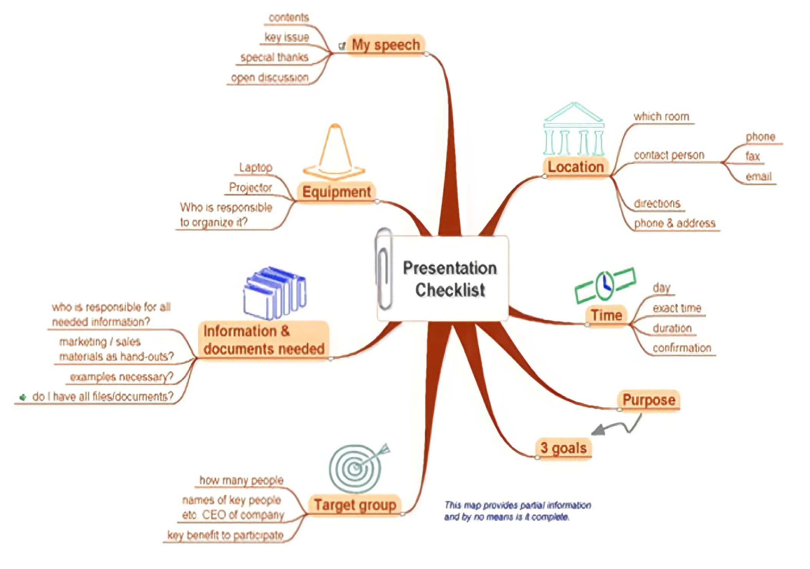
Mind Mapping (Davies, 2011)
Aim of mind maps is to find visual associations between ideas
To create:
first place image or topic in the center
Then main concepts surrounding the center, keep placing all ideas on page
Then begin connecting topics
Notes:
Mind mapping is defined as a visual non linear representation of ideas and their relationships to the center topic. Mind Maps consists of A network of connected and related concepts. Any idea can be connected in this network which requires spontaneous thinking when creating mind maps
The aim of mind maps is to FINDcreative associations between ideas and for many students it helps with memory retention because it is easier to remember a diagram than reading multiple paragraphs in a chapter.
To create a Mind Map first place an image or topic in the center, then being to write down the main concepts, words, phrases, or symbols surrounding the center topic. You can keep placing more topics until you feel like all your ideas are on the page. Then begin connecting it to the central topic by making the main topics a thicker line and a thinner line to the rest of the connecting ideas.
This example shows the PRESENTATION checklist that is needed.

Slide 10
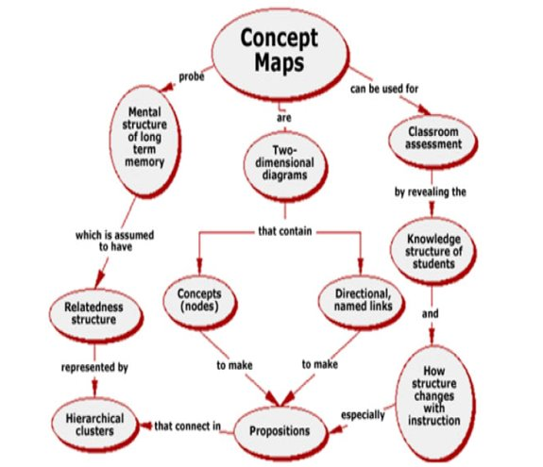
Concept maps (Davies, 2011)
Like mind mapping, concept maps is another diagram but more structured.
Concept Maps is a visual hierarchal "tree" structure that organizes and connects important concepts to one main topic at the top.
Notes:
Similar to Mind Mapping, Concept Maps is another diagram, but concept maps are more structured. Concept maps is a visual hierarchal "tree" structure that organizes and connects important concepts to one main topic at the top of the page. The aim of concept of concept maps is to outline a relationship between ideas
To create a Concept Map you must first choose a word that represents a focus question or main concept, then begin brainstorming ideas and concepts about this topic. Place the main word or phrase at the top of the page and then start placing your brainstormed ideas and connecting it with a crossing link and a linking word to describe the relationship to those concepts. There are many linking words such as "leads to", results from", or "made of" to represent the relationship.
This example is actually a concept map of how a concept map works.

Slide 11
References
Seli, H. & Dembo, M. H. (2020). Motivation and learning strategies for college success: A focus on self- regulated learning (6th ed.). New York: Routledge.
Davies, M. (2011). Concept mapping, mind mapping and argument mapping: what are the differences and do they matter? Higher Education, 62(3), 279–301. https://doi.org/10.1007/s10734-010-9387-6
Notes:
Thank you so much for reviewing this presentation. I hope you learned more about general study skills. And if you have any additional question please visit the kortshack center website at kortschakcenter.usc.edu. Thank you and have a great day!

