Slide 1
Thriving as a Trojan Online Building your Finals Toolkit
Caitlin O’Donnell, OTS
Notes:
Change names to those presenting
Welcome everyone
As everyone is joining, you can ask them to type their major &/or year (1st year, grad student, etc) into the chat box
Mention that this is going to/can be an interactive session to keep you engaged and help make you get the most out of the workshop

Slide 2
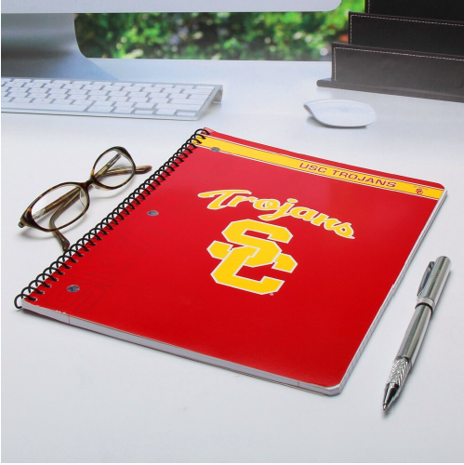
What are we going to cover today?
Preparing for finals in advance
Learning/Study strategies
Test taking strategies
Setting aside time for self-care
Notes:
In this session we are going to discover methods of preparing for your online finals, including tips on how to develop a study plan, ome learning strategies, refine your test-taking strategies, and maintain your overall mental health
These are some things we are going to cover today that can help you during this transition

Slide 3
Preparing for finals in advance
1 – 2 Weeks Before the Test
Become familiar with the test
Develop a study schedule and plan
Communicate with your Professor and/or TA
During the Week Before the Test
Stick to your study plan that you created
Minimize distractions
Set up a work & test taking space
Notes:
Become familiar with the test
What is the format of the test
What material will be covered
Develop a study schedule & plan
Estimate how much time each item will take
Break up tasks into manageable pieces & fit them into your schedule
Communicate with your professor &/or TA
Attend office hours to ask clarifying questions
If you have DSP accommodation, make sure to email your professor and DSP ahead of time to ensure test is set up
Stick to your study plan
Try to schedule short study periods for yourself
Remember to take breaks
Set up a work and test taking space
Find a quiet space to complete test
If needed use headphones or earplugs to reduce distractions
Avoid working on beds or couches
Minimize distractions
Clear off your workspace prior to the test
Have snacks and water available

Slide 4
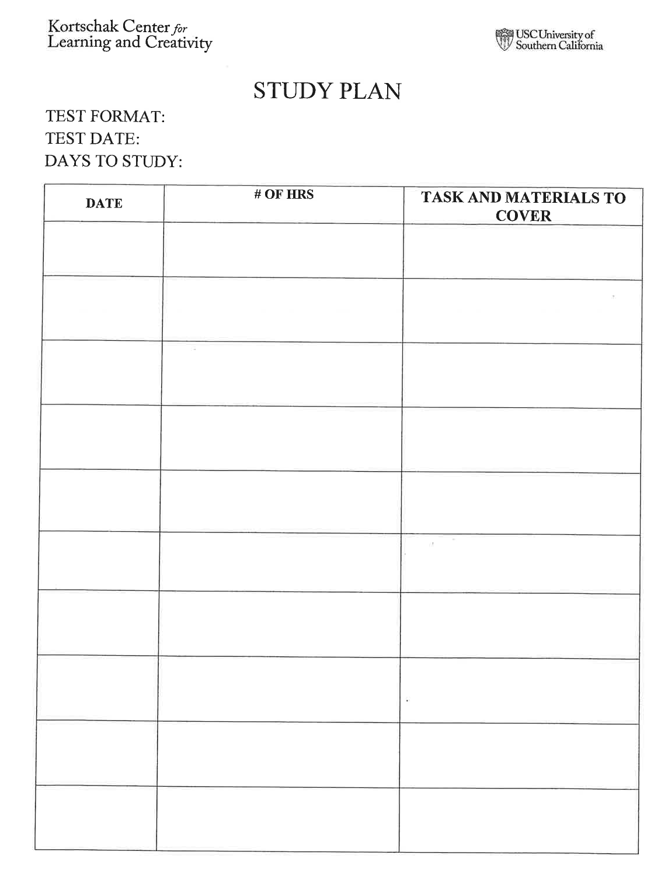
Create a Study Plan
Helps keep your studying on track
Break down large tasks into manageable pieces
Review material over various days to strengthen connections to your memory
Notes:
Try to ensure the tasks are action-oriented and specific to show HOW you’re going to study and WHAT you’re going to study.
Example:
AVOID- “study for bio”
SUBSTITUTE WITH- “review flashcards for ch. 1 & 2” or “create study guide for ½ of chapters”

Slide 5
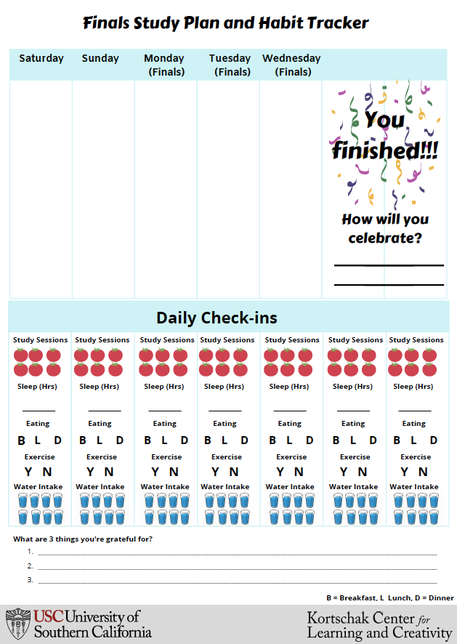
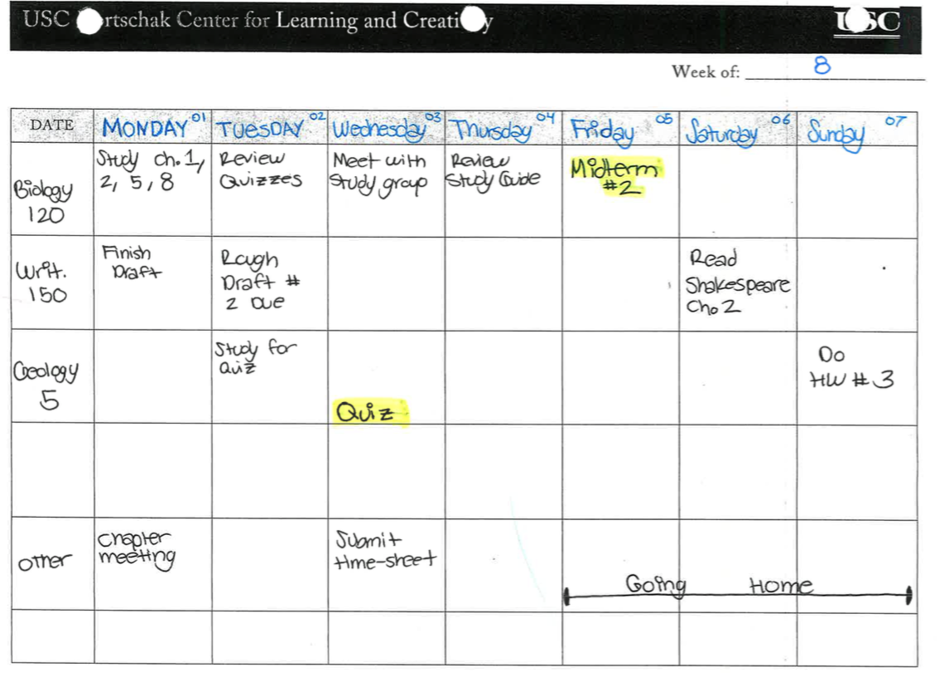
Other finals study planning tools
KCLC’s Weekly Action Plan
KCLC’s Finals Study Plan & Habit Tracker
https://kortschakcenter.usc.edu/tools-resources/

Slide 6
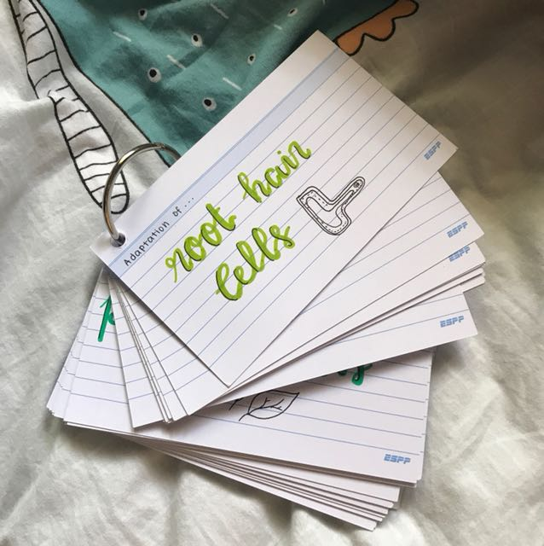
Learning/Study Strategies
Rehearsal Strategies
Mixed problem sets
Spaced/Distributed Practice
Elaboration Strategies
Mnemonics
Writing notes in your own words
Analogies
(Seli & Dembo, 2020)
Notes:
Helps identify gaps in knowledge, recalling information, and create connections with information
Rehearsal - Learning through practice and repetition
Mixed problem sets – instead of doing problems from Ch1, then Ch 2, then Ch 3 – try mixing all three chapters’ problems together
Allows you to develop a broader understanding of the material
Spaced/Distributed practice
Spacing out your learning this allows a break so that your brain can consolidate new long-term memory
Elaboration Strategies – link new knowledge to knowledge already stored in your long-term memory
mnemonics
Writing notes in your own words
analogies

Slide 7
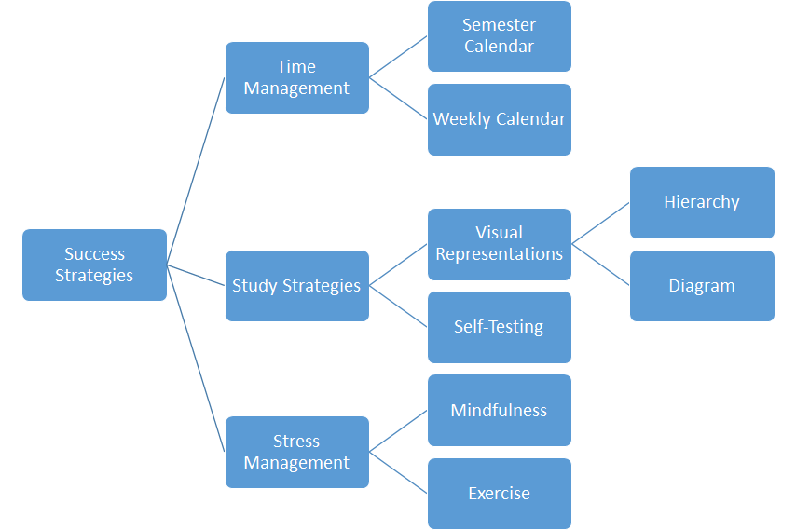
Learning/Study Strategies (cont.)
Organizational Strategies
Classifying information into groups
Creating outlines
Representation maps
Hierarchy
(Seli & Dembo, 2020)
Notes:
Helps organize information better so it can be recalled easier
Mind maps, hierarchy, use matrixes
using different learning strategies helps learn better.
visuals help us see connections, see what is missing, reduce clutter
For more learning strategies see KCLC’s On-Demand Workshop on Memory Retention Strategies

Slide 8
Other memory strategies
Sleep
Exercise
Self-Referencing
Write about it
Sing about it
(Brown, Roediger, & McDaniel, 2014), (Lipitz, Liu, & Gutchess, 2018), (Loprinzi et al., 2018), (Spencer, Walker, & Stickgold, 2017)
Notes:
Memory consolidation happens when we are awake and asleep
Adequate amount of sleep leads to better focus and concentration, both of which are necessary for memory
Studies have show exercise can help to improve memory
Relating information to yourself which makes it easier to remember and recall at a later time
Writing – direct connection from our hands to our brains,
This also may force you to slow down and concentrate more on each word
Singing
Sometimes even if you forget the words, the tune may help to remind you

Slide 9
Tackling the Big Test
Day Before the Test
Determine which questions you may want to tackle first and last
Figure out how much time you want to spend on each question &/or section
Get a good night’s sleep!
Day of the Test
Don’t forget to eat!
Log on to Zoom or testing site early
Press “Save” button after answering a question to avoid loosing work
Read questions out loud
Outline essay questions
Notes:
Sleep deprivation decreases your ability to focus and concentrate

Slide 10
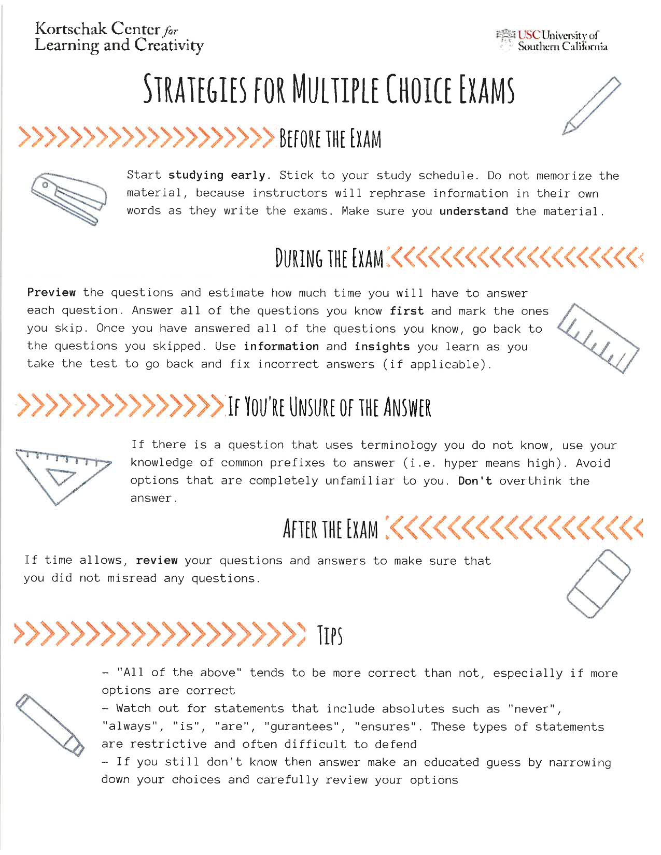
Strategies for Multiple Choice Exams
If possible, preview the questions
Answer all the questions you know first; mark the ones you don’t know to come back to later
If You’re Unsure of the Answer
Don’t overthink the answer
Use context clues
If time allows, review your answers and make sure you have answered each question
Notes:
Determine what questions you want to start on first and how much time you want to allocate
You can eliminate "all of the above" if you know know one of the answer choices is incorrect
Watch out for statements that include absolutes such as "never", "always", "is", "are", "guarantees", "ensures".
These types of statements are restrictive and often difficult to defend
If you still don't know then answer, make an educated guess by narrowing down your choices and carefully review your options

Slide 11
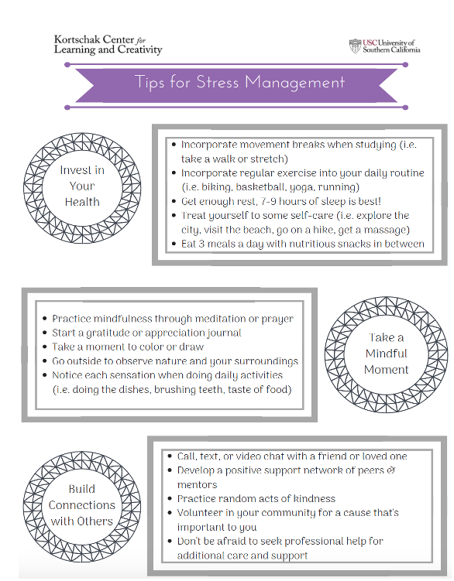
Setting aside time for self-care
Effective self-care reduces anxiety, raises mood, and can help make you more productive.
Eat health study snacks
Get plenty of sleep
Practice relaxation techniques
& more!
Notes:
Effective self-care reduces anxiety, raises mood, and can help make you more productive.
Some examples of self-care can look like:
Eat healthy study snacks
Practice relaxation techniques to reduce stress (i.e. deep breathing, meditation, yoga, etc.)
Make a gratitude list -
research has shown that gratitude can increase happiness, strengthen relationships, and improves mental health, stress management, & quality of sleep
Can let them know of the self-care handouts on the KCLC website

Slide 12
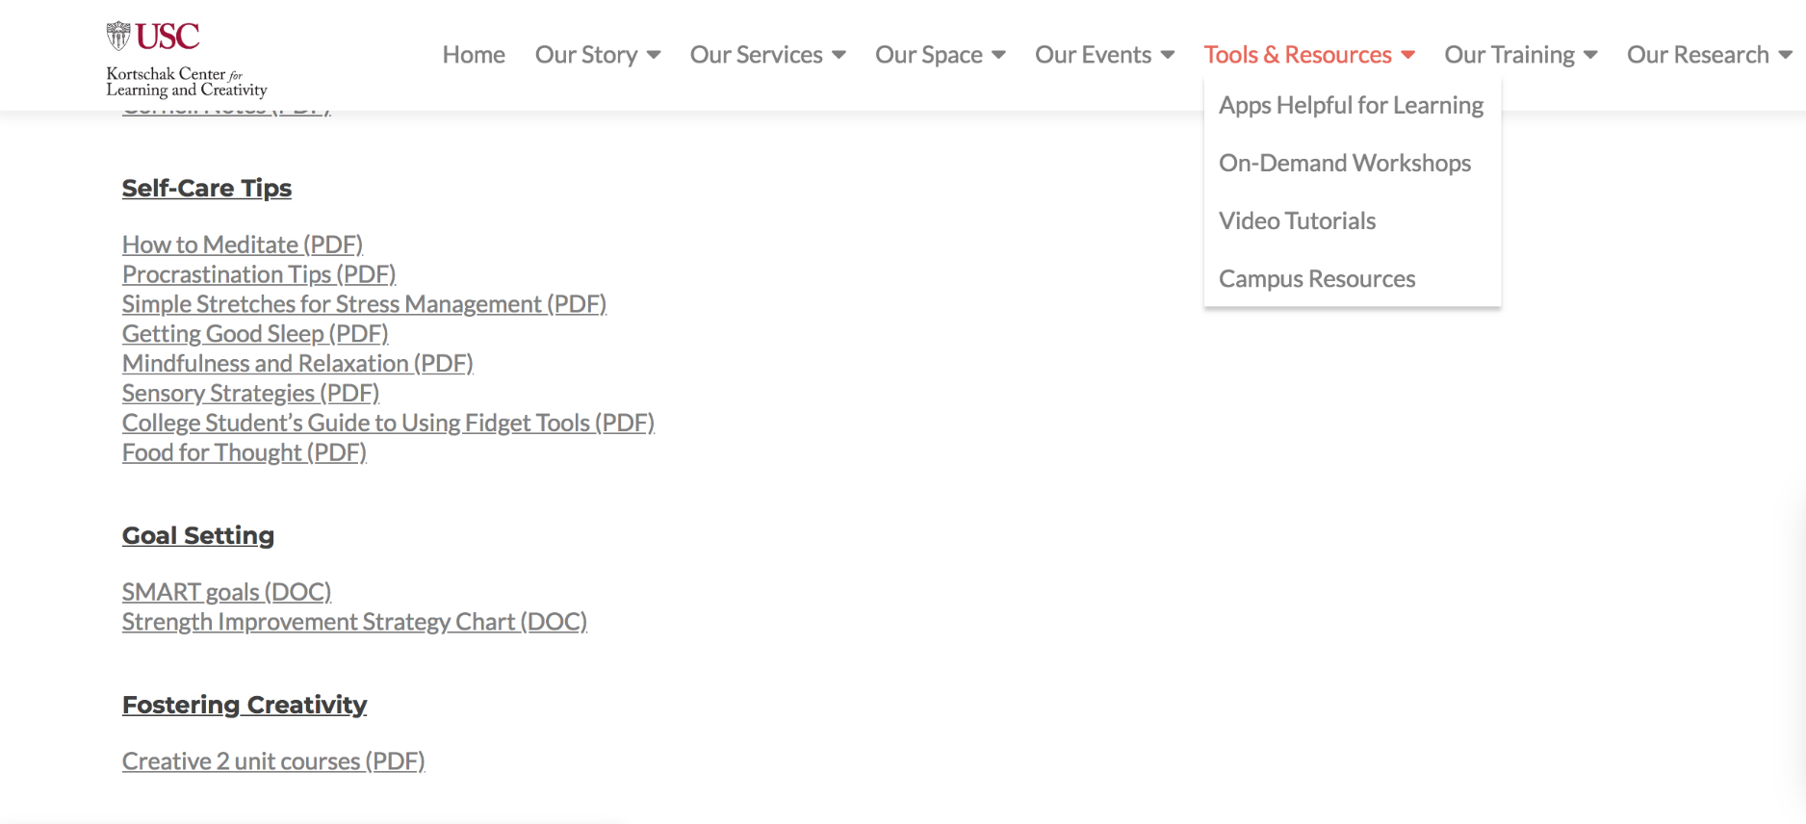
KCLC Online Tools and Resources
On-Demand Workshops
Handouts Online
https://kortschakcenter.usc.edu/
Notes:
Point out tools and resources that are available and point out a favorite or two

Slide 13
Thank you! Questions?

Slide 14
References
Brown, P., Roediger, H., and McDaniel, M. (2014). Make it stick. Massachusetts: The Belknap Press of Harvard University Press.
Lipitz, S., Liu, X. & Gutchess, A. (2018). Self-Referential Memory Encoding and Mind- Wandering in Younger and Older Adults. Open Psychology, 1(1), pp. 58-68. Retrieved 6 Mar. 2020, from doi:10.1515/psych-2018-0005
Loprinzi, P. D., Frith, E., Edwards, M. K., Sng, E., & Ashpole, N. (2018). The Effects of Exercise on Memory Function Among Young to Middle-Aged Adults: Systematic Review and Recommendations for Future Research. American Journal of Health Promotion, 32(3), 691–704. https://doi.org/10.1177/0890117117737409
Seli, H & Dembo, M (2020). Motivation and learning strategies for college success: A self-regulation approach (6th ed.). New York: Routledge.
Spencer R.M.C., Walker M.P., Stickgold R. (2017) Sleep and Memory Consolidation. In: Chokroverty S. (eds) Sleep Disorders Medicine. Springer, New York, NY

