Slide 1
Regulating our Moods
Miguel Angel Anzelmetti
Academic Coach
Kortschak Center for Learning and Creativity
Notes:
Have you ever felt so stressed that you were unable to focus? Or maybe you were feeling sad and weren’t motivated to complete your tasks? Maybe something happened and you were too upset to think about anything else?
Hi, my name is Miguel Anzelmetti, and this workshop will help you learn how to regulate your moods and emotions to be focused, calm, and complete your assignments.

Slide 2
Learning Outcomes
Understand why self-regulating is important
Identify cues that remind you to self-regulate
Identify strategies that help you self-regulate
Notes:
After this presentation you will understand why self-regulating is important, identify cues that remind you to self-regulate, and be able to identify strategies that will help you self-regulate your moods and emotions.

Slide 3
Why is Self-Regulation Important?
Self-regulation is self-control, impulse control, emotion management
Optimal state for productivity
Positive emotions predict to higher achievement
(Kuypers, 2013; Seli & Dembo, 2020)
Notes:
What is self-regulation? Think of self-regulation as self-control, controlling your impulses, and managing your emotions. Although we might experience stressors, emotions, or worry, the goal is to be self-regulated enough so that we are able to perform the best we can. Self-regulating doesn’t mean we will get rid of our emotions or fix our stressors, but rather that we will remain calm enough to function.
Why is self-regulation important? Positive emotions, such as happiness, joy, and hope, predict higher achievement and negative emotions, such as sadness, fear, and loneliness, predict lower achievement. A study that revealed that people who were depressed showed less activity in the parts of the brain responsible for memory. This means that if you’re trying to learn and memorize material, the brain will have a harder time storing information if you are experiencing negative emotions.
So in order to maximize our learning, we want to “weaken negative emotions and intensify positive emotions”

Slide 4
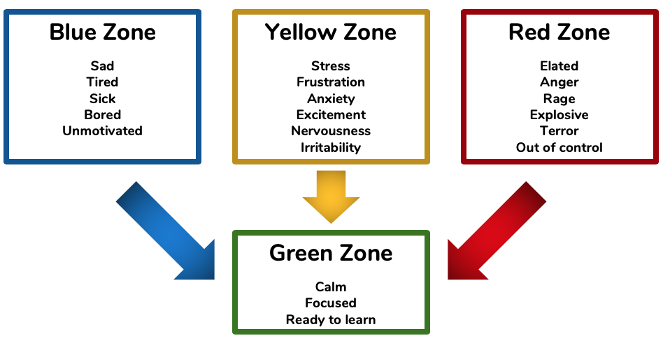
Zones of Regulation (Kuypers, 2013)
Notes:
Whenever you find yourself unable to focus or work, it might be helpful to categorize your mood or emotion into either a blue, yellow, or red zone.
The blue zone signifies low levels of alertness and emotions. Examples may include feeling sad, tired, or bored.
The yellow zone signifies heightened levels of alertness and emotions. Examples may include feeling stress, frustration, or nervousness.
The red zone signifies extremely heightened and intense levels of alertness and emotions. Examples may include anger, rage, or feeling out of control.
Once you have identified the zone you’re in, you can implement the appropriate strategies to move on to the green zone. The green zone signifies feeling calm and neutral levels of alertness and emotions. In this zone, you may feel focused, content, and ready to learn.

Slide 5
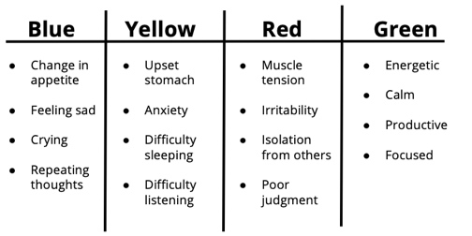
Know What Zone You’re In
Notes:
It’s important to know when we need to self-regulate so that we can do something about it. Check in with yourself to see what you experience in each zone. Each person will have a different experience in each zone and each zone will have different symptoms associated with it. Whenever you are in any zone, notice how your body is feeling, any emotions you are having, and any recurring thoughts. For example, maybe you notice in the blue zone your appetite changes, you feel sad, you cry, and have repeating thoughts. Or in the yellow zone, you have an upset stomach, anxiety, difficulty sleeping, and difficulty listening to others. In the red zone, maybe your muscles become tense, you are easily irritable, you isolate yourself from others, and you have poor judgment. In the green zone, you might feel energetic, calm, productive, and focused.
What do you experience in any of the zones? Take a moment to write down symptoms for the blue, yellow, and red zones as cues to implement your self-regulation techniques.
Worry https://pixar.fandom.com/wiki/Fear
Sad https://insideout.fandom.com/wiki/Sadness
Anger https://insideout.fandom.com/wiki/Anger
Riley https://www.npr.org/2015/06/19/415748439/pixars-inside-out-is-a-mind-opening-masterpiece

Slide 6
Moving from Blue Zone to Green Zone
Replace overgeneralizations with positive thoughts
Remember the positive aspects of each situation
Reframe the situation to become more interesting
Engage in a favorite activity
(Seli and Dembo, 2020)
Notes:
When you find that you’re in the blue zone, here are some strategies to move to the green zone. People in the blue zone tend to overgeneralize situations based on a single or a few incidents. For example, “I never understand my readings, I’m not smart enough.” This exaggerates the situation and might make you feel worse. By reframing your thoughts, you can begin to have a more realistic approach that is motivating. For example, “The more I practice reading and apply reading strategies, the more it will make sense.”
Another strategy is to remember the positives of a situation. Many times, in the blue zone, people just think about the negatives. By focusing on the positives, you can begin to remove yourself from a downward spiral. For example, instead of thinking “I’m feeling homesick, I don’t like LA.” Try thinking, “there is a lot to explore, I’ve enjoyed some experiences.”
If you’re ever bored, reframe your situation to make it more interesting. Examples of reframing are, “If I study now, I won’t feel stressed later and will have time to do fun things.” Or “If I pay attention, I will be more prepared for my exam.”
Also, take a break and do an activity that gives you life, that makes you feel joy. This could be playing basketball, dancing, running, or window shopping.
Gym https://www.shutterstock.com/search/gym+cartoon
Painting easel http://clipart-library.com/easel-cliparts.html
Painting https://www.amazon.com/Buyartforless-FRAMED-Landscape-Painting-Poster/dp/B07FYSB1K1

Slide 7
Moving from Yellow Zone to Green Zone
Replace catastrophizing thoughts with positive thoughts
Positively reframe situations
Use humor
Reading
(Amstadter, 2008; Rizzolo, Zipp, Stiskal, & Simpkins, 2009; Seli & Dembo, 2020)
Notes:
To move from the yellow zone to the green zone, try replacing catastrophizing thoughts. Many people in this zone tend to think of extreme situations when something negative occurs. Whenever you catch these thoughts, replace them with positive thoughts. For example, “I didn’t do well on this exam, I’ll never get into med school.” Try thinking, “Mistakes happen, it’s part of the process. Let me see what I can do differently to learn the material better.”
Also, try to reframe situations in a positive way. This can help in managing the way you perceive a problem so that feel differently towards it. An example could be, “Group work is so stressful, it’s so hard to work with my teammates.” And reframing it to, “This is a learning experience on dealing with people I don’t work well with, this will help me in the future because I’ll know how to work with difficult coworkers.” This takes practice, it’s catching these negative thoughts and changing your mindset.
Another great way to self-regulate when you’re feelings stressed or irritable is humor. 30 minute sessions of humor has been shown to reduce stress. Try hanging out with a funny friend or watch a funny video.
Also, try reading as a form of relaxation.
Bing bong https://insideout.fandom.com/wiki/Bing_Bong

Slide 8
Moving from Red Zone to Green Zone
Spend time alone
Remove yourself from the situation
Avoid statements that begin with, “should”
(Seli and Dembo, 2020)
Notes:
If you find yourself in the red zone, feeling extreme anger or terror, sometimes it’s helpful to spend some time alone to process what it going on. Removing yourself from the situation can also ease extremely heightened emotions.
Also, try avoiding statements that begin with “should”. When directing a “should” statement toward another person, you impose your beliefs on how you want that person to behave. This often results in anger, frustration, or resentment toward that other person.
An example could be changing the belief that “My friend should reach out more,” to “My friend shows they care differently than I do. I can’t change their behavior, but maybe I can let them know what my needs are.”
These are not the only strategies to help in regulating emotions. Think about what has helped you in the past? How do you see others self-regulating their emotions?
Disgust https://clipartstation.com/disgust-clipart-5/
Flame anger https://www.pinterest.com/pin/159737118014002765/?lp=true

Slide 9
Building Your Toolkit for Any Zone
Physical activity
Yoga, exercise, dance
Spend time with others
Talk to someone you trust
Relaxation exercises
Diaphragmatic breathing
Progressive muscle relaxation
Journal
Essential oil
Lavender, rosemary, orange
(Matthews, 2018; Rizzolo et al., 2009; McCallie, Blum, & Hood, 2006; Ulrich & Lutgendorf, 2002; Seli & Dembo, 2020)
Notes:
Here are some more techniques you can use in any zone to get back to help you feel regulated.
Physical activity can help regulate activity in the parts of the brain that induce stress. Try activities that you enjoy. It could be yoga, light stretches, running, or dancing.
Spend time with others to help get your mind off things and to get additional support.
Talking about how you’re feeling to someone you trust can help in processing your situation.
Breathing exercises are great to relax our body so that our mind can be relaxed. Take a minute to try it now. For diaphragmatic breathing. Take deep, long breaths. As you inhale, count to for. And as you exhale, count to 6.
Another exercise is progressive muscle relaxation. In this practice, you will tense a muscle group for 5 seconds, but not to the point of pain, and relax it for ten seconds. The four muscle groups are 1. Both hands and arms, 2. The face, neck, and shoulders, 3. The chest, back, and belly, and 4. Both legs. Focus on one muscle group at a time.
Journaling is helpful because you are able to express your feelings. It can help you feel a sense of control of your emotions. When you journal, focus on your emotions and the situation. It’s important not to dwell on your negative emotions, but that you express them and make sense of what is going on.
Using essential oils helps reduce stress hormones and has positive effects on the parts on the brain in charge of memories and emotions.
Try these strategies out! Find out what works for you and what doesn’t. Be creative with it.
Joy uphttps://dlpng.com/png/6350476
Joy read

Slide 10
References
Amstadter, A. (2008). Emotion regulation and anxiety disorders. Journal of Anxiety Disorders, 22(2), 211–221. doi:
10.1016/j.janxdis.2007.02.004
Kuypers, L. M. (2013). The Zones of Regulation: A Framework to Foster Self-Regulation. The American Occupational
Therapy Association, Inc., 36(4).
Matthews, J. (2018). Essential oils LOWER CORTISOLS AND HELP REDUCE STRESS. Alternative Medicine, (43), 24-25.
Retrieved from http://libproxy.usc.edu/login?url=https://search.proquest.com/docview/2262686452?accountid=14749
McCallie, M. S., Blum, C. M., & Hood, C. J. (2006). Progressive Muscle Relaxation. Journal of Human Behavior in the Social
Environment, 13(3), 51–66. doi: 10.1300/j137v13n03_04
Rizzolo, D., Zipp, G. P., Stiskal, D., & Simpkins, S. (2009). Stress Management Strategies For Students: The Immediate
Effects Of Yoga, Humor, And Reading On Stress. Journal of College Teaching & Learning (TLC), 6(8). doi: 10.19030/tlc.v6i8.1117
Seli, H. & Dembo, M.H. (2020). Motivation and learning strategies for college success: a focus on self-regulated learning.
New York: Routledge.
Ullrich, P. M., & Lutgendorf, S. K. (2002). Journaling about stressful events: Effects of cognitive processing and
emotional expression. Annals of Behavioral Medicine, 24(3), 244–250. doi: 10.1207/s15324796abm2403_10

