Slide 1
Loneliness in College
Cheng Yang Jeff Hsiao, MFTT
Notes:
Hey, my name is Cheng Yang Jeff Hsiao and I am a Marriage Family Therapist Trainee at the Rossier School of Education. I’m currently a 2nd year graduate student in the program and I wanted to talk about something that’s not typically addressed in school. Loneliness in college because it does happen.
So I hope I can shed some light on this topic and help you feel more prepared as you continue your USC journey.

Slide 2
Learning Objectives:
By the end of this presentation, you will:
Understand the definition of loneliness and the statistics within the US.
Identify the common myths surrounding loneliness and its effects.
Find ways to overcome the feeling of loneliness.
Notes:
So what are you going to learn from this presentation?
Here are the three learning objectives. By the end of this presentation, you will be able to (1) define loneliness and the statistics within the US (2) Identify the common myths surrounding loneliness and its effects based on research (3) We will talk about what the research says on how to reduce feeling of loneliness and what are some of the activities and resources available on campus.

Slide 3
What is Loneliness?
Loneliness is defined as a distressing feeling that accompanies the perception that one’s social needs are not being met by the quantity or especially the quality of one’s social relationships (Hawkley & Cacioppo, 2010).
Loneliness is a bodily function, like hunger.
Hunger makes you pay attention to your physical needs.
Loneliness makes you pay attention to your social needs.
Notes:
So to start off, what is loneliness?
The research defines it as a distressing feeling that accompanies the perception that one’s social needs are not being met by the quantity and ESPECIALLY the quality of one’s social relationships. This is from the two famous researchers on loneliness, Dr. Hawkley and Dr. Cacioppo.
The easiest way to understand is to use a simple analogy. Loneliness is a bodily function, almost like hunger. While hunger makes you pay attention to your physical needs, Loneliness makes you pay attention to your social needs.

Slide 4
In the US, 46% of the entire population feel lonely regularly
(Cigna U.S. Loneliness Index, 2018).
Notes:
Here’s a statistic that might surprise you.
In May 2018, Cigna surveyed 20,000 adults to understand the impact of loneliness in the United States. The survey revealed that most Americans are considered lonely, as measured by a score of 43 or higher on the UCLA Loneliness Scale, a 20-item questionnaire developed to assess subjective feelings of loneliness as well as social isolation.
They found that 46% of the entire population feel lonely regularly. That’s a lot of people.

Slide 5
Their relationships were not meaningful (43%)
They lack companionship (43%)
Isolated from others (43%)
No longer feel close to anyone (39%)
At least two in five surveyed sometimes or always feel:
Statistics retrieved from https://www.multivu.com/players/English/8294451-cigna-us-loneliness-survey/docs/IndexReport_1524069371598-173525450.pdf
Notes:
Here are more findings from the survey they did.
At least two in five people reported that they sometimes or always feel…
Their relationships were not meaningful.
They lacked companionship.
Feel isolated from other people.
No longer feel close anymore.
If you are interested in the survey and the details of their finding, the link is down below.

Slide 6
Common Myths
The more friends you have, the less lonely you’ll feel.
Loneliness is ALWAYS bad for you.
You can’t be lonely when you are with people.
FALSE. It’s the quality of the relationship that matters, not quantity.
FALSE. Feeling loneliness is a sign to help you re-evaluate your relationships.
FALSE. We've evolved to experience loneliness.
FALSE. Being lonely and being alone ARE NOT the same thing.
(Parker & Asher,, 1993)
FALSE.
(Hawkley & Cacioppo, 2010)
(Li & Kanazawa, 2016)
Notes:
So what are some of common myths regarding loneliness? It’s important to dispel them so we can better understand it.
MYTH 1 is that the more friends you have, the less lonely you’ll feel. Research shows that this is false. It’s actually the quality of the relationship that matters, not the quantity. It’s more about the connection you have with the other person rather than the number of people.
MYTH 2 is you can’t be lonely when you are with other people. This is false because being lonely and being alone are not the same thing. One person can enjoy reading in solitude while another person can feel lonely at a party, surrounded by other people.
MYTH 3 Loneliness is always bad for you. This is not necessarily true. Keep in mind, we all feel lonely sometimes and this is a normal part of being human. No feeling itself is 'bad' or 'good'. Rather, feelings can serve as messages to take a look what is happening in our lives. Loneliness can serve as a warning sign to re-evaluate our relationships and ask yourself - why am I feeling this way?. Loneliness may become a problem if it’s prolonged and not attended to. A good analogy is - if you are thirsty, then you look for water. If you are lonely, then you look for other people. From an evolutionary perspective, humans have stayed safe by living in cooperative groups for thousands of years, so it makes sense to have a survival mechanism which drives us to connect with others.

Slide 7
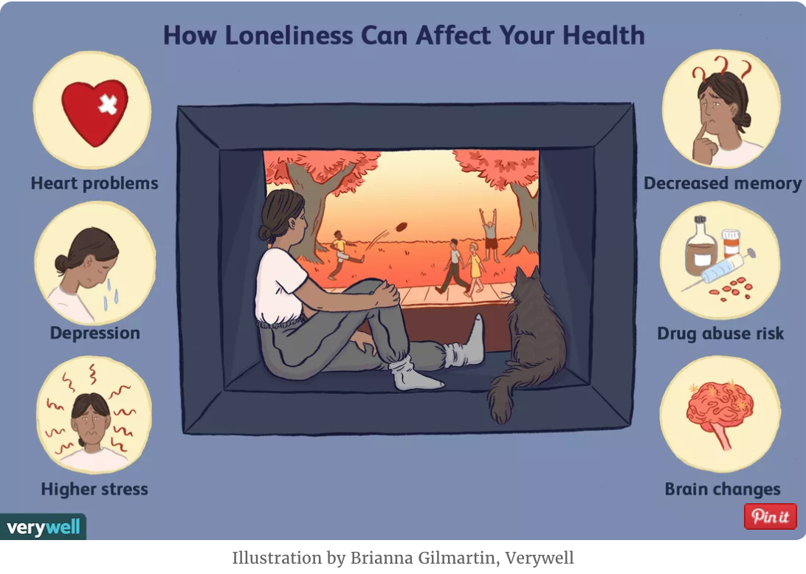
Effects of Loneliness
(Cacioppo, Hawkley, Crawford, 2002)
Notes:
So how does loneliness affect you? What are its effects?
Feelings of loneliness may pass, but sometimes they persist and start to interfere with our daily lives. It’s not always easy to talk about feeling lonely with someone, and if you already have a hard time reaching out to others, you might feel even more alone in the process.
While we all know that feeling lonely is not a pleasant feeling, there are physical and mental health consequences that may come from it. Keep in mind, loneliness symptoms can differ from person to person and it also depends on the situation as well.
Research has identified connections between loneliness and health problems, depression, stress, risk of drug abuse, and memory difficulties. Additionally, Cacioppo, one of the nation's leading scholars on loneliness, found in his 2007 study that loneliness may even impact your brain through the use of an fMRI. The study found that the ventral striatum - the brain region associated with reward - is much more activated in non-lonely people than lonely people when the participants view pictures of people in pleasant settings.
Living with mental or physical health issues can also increase the risk for loneliness. Health concerns can be isolating, since it can be difficult to explain how you feel to other people without being judged. There may also be the fear of the person not taking it seriously. Sometimes social activities demand too much emotional or physical energy, and you might end up canceling more plans than you keep.

Slide 8
What can we do about loneliness?
?
Notes:
So what can we actually do about it? What does the research say on not feeling so lonely? What are some resources that are available to us on campus?

Slide 9
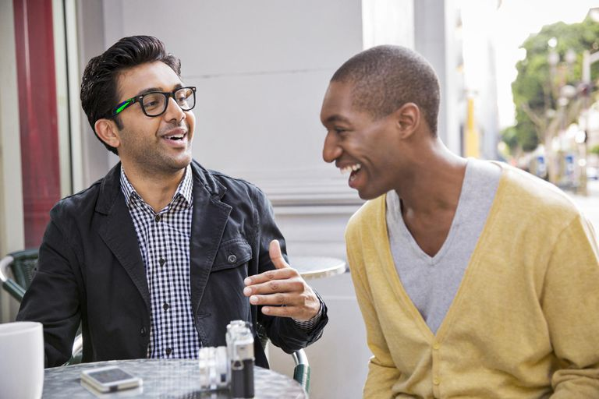
What The Research Says
(Rokach, 2001)
(Masi, Chen, Hawkley & Cacioppo, 2011).
Recognize and accept the loneliness (Rokach & Brock, 1998).
Do something you enjoy!
Connection. Connection. Connection.
Notes:
The first step is to recognize and accept loneliness. Everyone feels lonely from time to time. It’s a universal human experience and is a sign of wanting contact with people.
Doing something you enjoy presents great opportunities to meet new people and cultivate a friendship. It can also helps make you feel less lonely. You can do fulfilling and rewarding activities, I know for me that would be doing something creative. I enjoy writing and sharing my story online. You can also just relax and watch your favorite TV show or anime. You can even watch a funny video too. Even listening to music or reading a book could have more of a positive impact on loneliness. But make sure to include a range of activities in your life.
Some examples of this is planning out for this weekend, spending time outdoors, focusing on the positive things and treating yourself. I know for myself, I love eating and I ended up making a food blog. And I actually met other food bloggers online (who love food as much as I do) and became friends with them.
Another one is connection! Try to volunteer for a cause, reach out to old friends, invest in new connections with clubs and organization and even connect online. Find a few areas you’re interested in and try to get involved. Libraries and clubs are also a good place to find out about community and school events.
Stay in touch with loved ones. If you’ve just moved, try to talk to friends and family weekly. Apps like Skype, Snapchat, Discord and Facebook Messenger let you send video clips or communicate through video. It may not feel the same as in-person contact, but it can help you remember the people you love are still there for you.

Slide 10
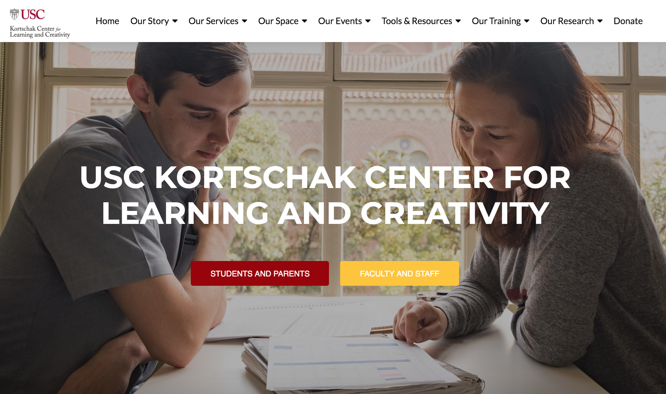
Recommended On-campus Resources
Link: https://studenthealth.usc.edu/
Link: https://kortschakcenter.usc.edu/
Counseling
Academic Coaching
Notes:
I want to provide you with some on-campus resources.
If you feel like the loneliness is interfering with your daily routine and becoming a major problem, reach out to the counseling center at USC.
In all cases, talking to a therapist can help you find ways to make changes. If you’re dealing with mental or physical health issues that isolate you or worsen feelings of loneliness, getting help for these issues can help by making it easier for you to reach out to others.
On the right is the Kortschak Center for Learning and Creativity, where you can come for a drop-in or academic coaching session. We can offer support around how loneliness may impact your academics.

Slide 11
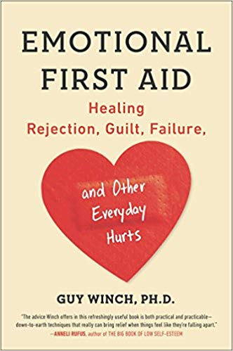
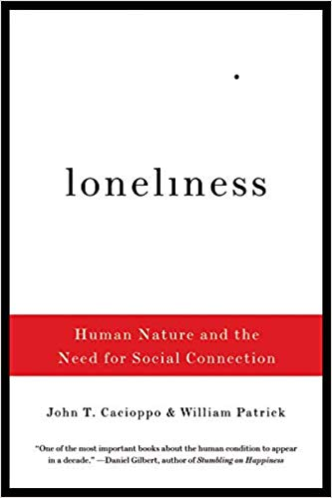
Recommended Books
Notes:
Now, I love providing books. This is extra and additional resource if you want.
But if you are interested in learning more about loneliness and ways to overcome it, here are two great books. The first one talks about the emotional side of loneliness and the second book explains it more from the evolutionary perspective on why we feel lonely.
These are really good reads that can help you better understand loneliness.

Slide 12
References
Cacioppo, J. T., Hawkley, L. C., Crawford, L. E., Ernst, J. M., Burleson, M. H., Kowalewski, R. B., ... & Berntson, G. G. (2002). Loneliness and health: Potential mechanisms. Psychosomatic medicine, 64(3), 407-417.
Cacioppo, J. T., & Decety, J. (2009). What are the brain mechanisms on which psychological processes are based?. Perspectives on
psychological science, 4(1), 10-18.
Hawkley, L. C., & Cacioppo, J. T. (2007). Aging and loneliness: Downhill quickly?. Current Directions in
Psychological Science, 16(4), 187-191.
Hawkley, L. C., & Cacioppo, J. T. (2010). Loneliness matters: A theoretical and empirical review of consequences and mechanisms. Annals of behavioral medicine, 40(2), 218-227.
Li, N. P., & Kanazawa, S. (2016). Country roads, take me home… to my friends: How intelligence, population
density, and friendship affect modern happiness. British Journal of Psychology, 107(4), 675-697.
Masi, C. M., Chen, H. Y., Hawkley, L. C., & Cacioppo, J. T. (2011). A meta-analysis of interventions to reduce loneliness. Personality and Social Psychology Review, 15(3), 219-266.
Parker, J. G., & Asher, S. R. (1993). Friendship and friendship quality in middle childhood: Links with peer group
acceptance and feelings of loneliness and social dissatisfaction. Developmental psychology, 29(4), 611.
Rokach, A., & Brock, H. (1998). Coping with loneliness. The Journal of Psychology, 132(1), 107-127.
Rokach, A. (2001). Strategies of coping with loneliness throughout the lifespan. Current Psychology, 20(1), 3-17.
Notes:
Hawkley, L. C., & Cacioppo, J. T. (2007). Aging and loneliness: Downhill quickly?. Current Directions in Psychological Science, 16(4), 187-191.

