Slide 1
“What’s in a Name?”: Helpful Approaches to Understanding Shakespeare
Kortschak Center for learning and creativity at the university of southern California
Presented by Jasmine Revels

Slide 2
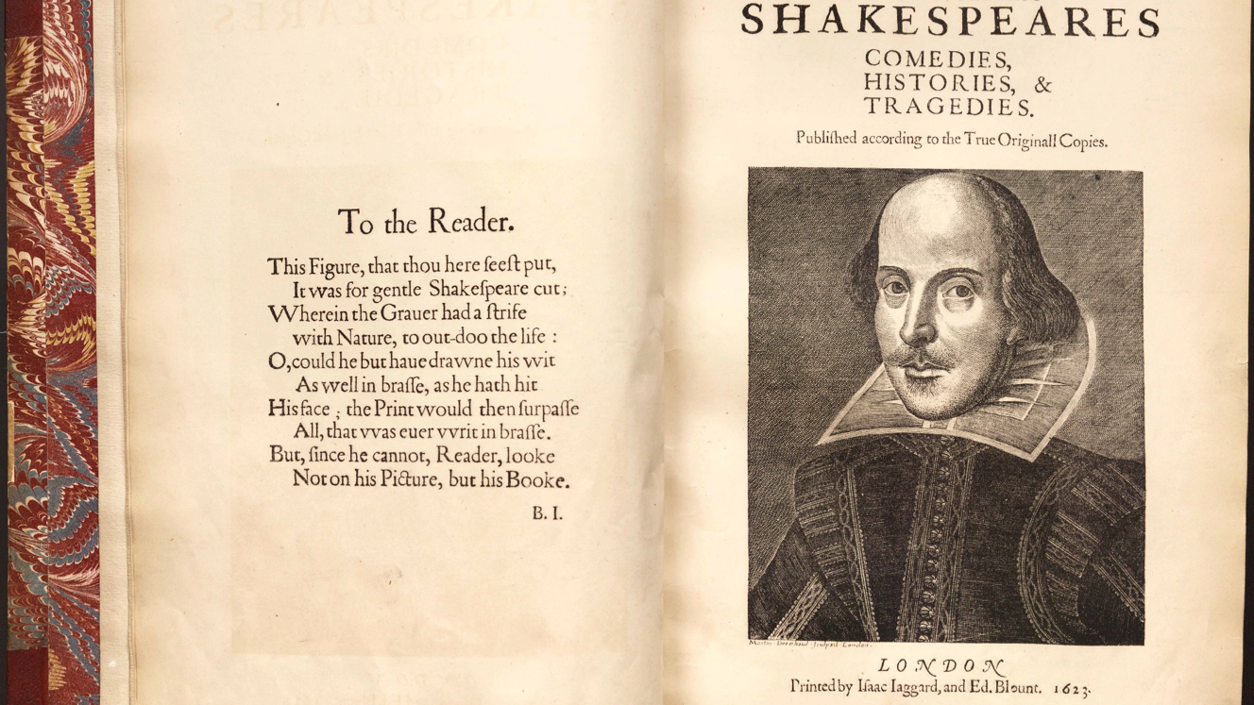
Learning Outcomes
By the end of this presentation, you should be able to…
Know the multiple forms in which Shakespeare is presented, besides in the traditional form of a play
Find multiple ways to understanding Shakespeare for your class (or for fun!)
Retrieved from Chrome images

Slide 3
The Difficulty of Shakespeare
Early Modern English (Shakespearean English) developed in the 16th century through the 18th century
Plots can be difficult to comprehend
Notes:
It is very common for students and people of all ages to have difficulty reading and understanding a Shakespearean play and/or poem. The most common and obvious reason why people find trouble understanding Shakespeare is the language, known as Early Modern English, which developed starting in the 16th century, ending in the 18th century. Because the language is difficult to comprehend, the plot can be hard to understand as well.

Slide 4
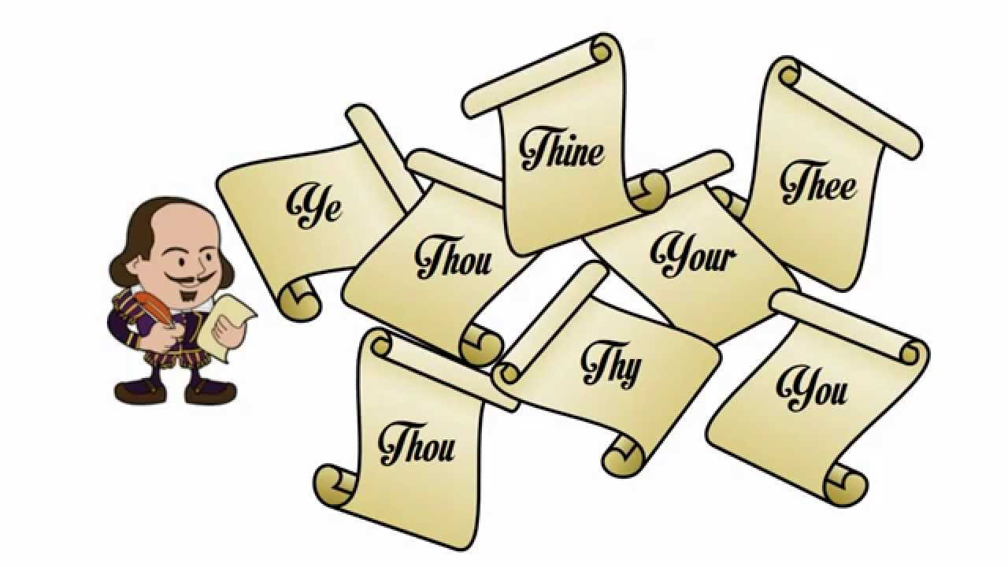
Familiarization with Terms
Early Modern English | Contemporary English
Thine | Your
Thy | Your
Thee | You
Thou | You
Ye | You (Plural)
Retrieved from Chrome images
Notes:
To begin to understand the basics of Shakespeare, one should familiarize oneself with the common terms or translations found in his plays, sonnets, and poems. Typical terms that would need modern translation are “thy” and “thine,” which translates to “your,” “thou” and “thee,” which translates to “you,” and “ye.” These translate to “you” plural.

Slide 5
Shakespeare in Other Forms
Performance
Modern text translations
Film adaptations
Retrieved from Chrome images
Notes:
It is impossible for non-experts to fully understand the language and historical references in Shakespearean works in just a matter of days and/or weeks. However, Shakespeare comes in many other forms, besides his original plays. To help combat any possible confusion with Shakespeare’s plots, couple the plays with dramatic performances, modern text translations, and/or film adaptations.

Slide 6
Performance (Felske, 2005 and Shoemaker, 2013)
Live plays, i.e. Independent Shakespeare Company in Los Angeles
Retrieved from Chrome Images
Notes:
Research has shown that one of the most, if not the most, effective ways of understanding Shakespeare’s works is by performance. Acting out the play in which one is reading not only helps with reading comprehension of the text, but it also helps readers make connections between the play’s characters and modern-day events, and may help readers appreciate the text. For those uninterested in acting out the play, watching a live performance of the play may also help with reading comprehension. The Independent Shakespeare Company in Los Angeles puts on free Shakespeare plays every year.

Slide 7
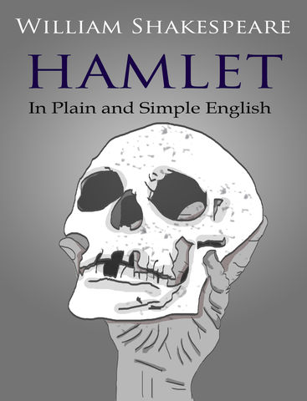
Modern Text Translations (Felske, 2005)
Photos retrieved from Chrome Images
Notes:
There are modern text translations of Shakespeare’s plays. If you decide to use a modern translation for a better understanding of the text, it is recommended you read it along with the original text. This will help strengthen and improve your comprehension of the material, and not doing so may hinder your comprehension. Modern translations can be bought through Amazon.

Slide 8
Film (Shoemaker, 2013)
Baz Luhrmann’s Romeo and Juliet
O
She’s the Man
10 Things I Hate About You
Photos retrieved from Chrome images
Notes:
There are films that are true to the original text, as well as modern adaptations, such as 10 Things I hate About You, which is a modern adaptation of Shakespeare’s The Taming of the Shrew, and She’s the Man, which is a modern adaptation of Shakespeare’s Twelfth Night. If you are currently reading Shakespeare and would like to watch an available modern adaptation, couple it with an accurate adaptation for better understanding of the content.

Slide 9
References
Felske, C. (2005). Beyond the Page: Students as Actor-Readers. The English Journal, 95(1), 58-63.
doi:10.2307/30047399
Shoemaker, B. (2013). To read or not to read: Five approaches to teaching shakespeare. English
Journal, 102(4), 111-114.
Notes:
Reading works by William Shakespeare is not easy, however these tips can be very useful for your learning experience. Whether you’re reading Much Ado About Nothing, Hamlet, or classic Romeo and Juliet, have fun and enjoy!

