Slide 1
How to Get the Most out of Your Syllabus
Laura Ashlock, MFTT
University of Southern California
Kortschak Center for Learning and Creativity
Notes:
Hello everyone, my name is Laura and I am an academic coach at USC’s Kortschak Center for Learning and Creativity. I hope that this workshop helps you identify the purpose of your course syllabus, as well as understand why it is important, and how to utilize your syllabus effectively throughout the semester!

Slide 2
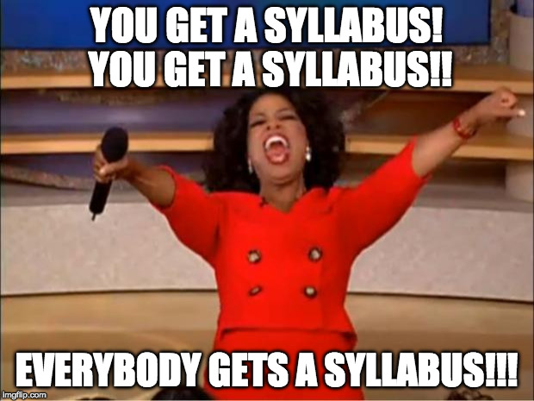
What is a syllabus?
Syllabus (plural: syllabi): A document “detailing assignments, procedures, and requirements for the course” (Thompson, 2007).
Almost every course will have a syllabus, often provided on the first day of class and/or electronically
Image retrieved from: https://imgflip.com/i/19aj6n
Notes:
Let’s begin by defining what exactly a syllabus is. Thompson (2007) defines the syllabus as a document “detailing assignments, procedures, and requirements for the course.” A syllabus is typically one of the first things that your professor will give you when you begin a course. Sometimes you get it on the first day of class, other times it may be uploaded online before class even begins. The reason that many classes begin with a “syllabus day” isn’t just to ease you into the course or provide a time to zone out during class- it’s because the syllabus is actually very important!

Slide 3
Why do I need it?
Three Elements
The syllabus is a contract
The syllabus is a permanent record
The syllabus is a learning tool
(Parkes & Harris, 2002)
Image retrieved from: https://www.dvusd.org/Page/58562
Notes:
The syllabus has 3 important purposes- it is a contract, permanent record, and most importantly, a learning tool. Now we’re going to explore each of these uses of the syllabus and how it can help you be a better student.

Slide 4
The Syllabus as a Contract
University
Professor
You
Most syllabi include information about:
Expected learning outcomes
Basic course information
Required readings
Course format and content
Grading
Technology
Student responsibilities
(Eberly, Newton, & Wiggins, 2001; Parkes & Harris, 2002)
Notes:
A syllabus is considered a contract between you, your professor, and the university. It means your professor has agreed to cover specific learning objectives that are in line with the mission and values of both the university and your specific academic program. It also means that you agree to follow the policies and schedule that are laid out in the syllabus. For example, most syllabi will include important information about policies regarding plagiarism, attendance, grading, technology in class, and more. Making sure that you understand your syllabus and each of your professors’ policies will ensure that you don’t miss important rules, deadlines, or details about the class.

Slide 5
The syllabus as a Permanent Record
Always download and save your syllabus
(i.e. Google Drive)
Record of material, textbooks, readings, and learning objectives for the course.
May be useful for graduate applications or transfer credit.
Image retrieved from: https://www.merriam-webster.com/words-at-play/the-difference-between-officious-and-official
(Parkes & Harris, 2002)
Notes:
Another reason your syllabus is so detailed is that it serves as a permanent record of everything that you covered, required texts or readings, and the skills you should have gained by the end of the class. It is very useful to download your syllabus and save it somewhere that you can easily access it when needed (for example, on your Google drive)
Saving your syllabi may also come in handy if you plan to apply to graduate school or engage in other academic endeavors, or if you ever need to use your course for transfer credit. Having a syllabus as proof that you have already covered certain material or taken the course may end up saving you time and money in the future!

Slide 6
The syllabus as a Learning Tool
Tips for using the syllabus to your advantage:
Write down important dates
Note contact information
Calculate grade breakdown
Utilize rubrics
(Parkes & Harris, 2002)
Image retrieved from: https://www.merriam-webster.com/words-at-play/the-difference-between-officious-and-official
Notes:
Remember, your syllabus was written to help YOU. You can utilize the information in your syllabi to set yourself up for success each semester. Here are some helpful tips:
Dates: At the beginning of the semester, record important deadlines and dates from your syllabi on your calendar. This way, you can plan ahead, especially for weeks when you have deadlines in multiple classes. You can download a semester calendar from our website if you’re looking for a place to record these dates.
Contact Information: Professors and TAs list their contact information and office hours for a reason- so that you will use them! Take advantage of these resources. Reach out to your professor or TA, ask questions, and go in and meet with your professor or TA personally. Building a relationship with them and showing that you care will help you in the long run because professors and TAs can provide help with difficult concepts, mentorship in their particular field, or even letters of recommendation.
Grade Breakdown: The syllabus will likely include a breakdown of class assignments, participation points, and tests and let you know what percentage of your grade each is worth. By knowing these percentages, you can allocate your study time more effectively and put focus on the items that are worth a large percentage of your grade. It is also important to know how much attendance and participation are worth, and what the penalty is for late assignments.
Rubrics: Often, professors include rubrics or other guidelines for projects and assignments as an appendix to the syllabus. Don’t forget to review these and pull them back out when it comes time to do your assignment. Reviewing the rubric will help you earn the maximum number of points by making sure you’re turning in what your professor has asked for!

Slide 7
Retrieved from: https://giphy.com/gifs/yes-yeah-yass-1fXcl6MEoOQvbOw3ZS
Notes:
I hope these tips have helped you better understand what a syllabus is, why it is important, and how to use it to your advantage! Making sure you know exactly what is required of you in each class can set you up for success and help you avoid being surprised by a deadline or requirement! Thanks for watching and best of luck!

Slide 8
References
Eberly, M. B., Newton, S. E., & Wiggins, R. A.
(2001). The syllabus as a tool for student-centered learning. The Journal of General Education,50(1),
56-74. doi:10.1353/jge.2001.0003
Parkes, J., & Harris, M. B. (2002). The purposes of a syllabus. College Teaching,50(2), 55-61.
doi:10.1080/87567550209595875
Thompson, B. (2007). The syllabus as a communication document: Constructing and presenting the
syllabus. Communication Education,56(1),
54-71. doi:10.1080/03634520601011575

