Slide 1
Know Your Power:
How to feel confident during your next presentation or interview
Zack Pinto
Kortschak Center Academic Coach
Notes:
Hello, My name is Zack Pinto and I am an academic coach at the USC Kortschak Center for Learning and Creativity. This workshop is titled Know Your Power and you will be learning how to feel confident and comfortable during your next presentation or interview.

Slide 2
Learning Objectives
Students will be able to create strategies to feel more confident and comfortable when giving presentations.
Students will be prepared to answer questions and remain poised during interviews.
Notes:
At the conclusion of this workshop you will be able to create strategies to feel more confident and comfortable when giving a presentation in class, and be prepared to answer questions and remain poised during interviews.

Slide 3
You are not alone
About 10% of people are terrified of public speaking
  Studies show that people fear public speaking more than death
About 80% of people get anxious and have trouble sleeping the night before they have to present or interview
Notes:
The first thing to remember is that you are not alone with your fear or anxiety related to public speaking. Studies show that about 10% of people are terrified of public speaking and about 80% of people get anxious and have trouble sleeping the night before they have a presentation or interview. Studies have also documented that people fear public speaking more than death.

Slide 4
Nonverbal communication
A popular belief is that nonverbal communication is the majority of our communication
  It affects how others see you
  It affects how you see yourself
The mind changes the body and the body changes the mind
  Example: Chewing on a pen horizontally, makes you smile and naturally makes you happier
Notes:
A popular belief is that nonverbal communication is the majority of our communication. Nonverbal communication is the element of communication aside from spoken word including gestures, facial expressions, and overall body language. Nonverbal communication affects how others see you and even how you see yourself. This idea is related to the concept of how the mind changes the body and how the body changes the mind. For example: if you chew on a pen or pencil horizontally, it makes you automatically smile and naturally makes you happier.

Slide 5
Preparation strategies
Record yourself
  Listen for words such as “um” or “like”
  Make sure you are speaking at an even pace
Film yourself or practice in front of a mirror or another person
  Make sure you have good posture and that you are not fidgeting
Notes:
Now we will discuss preparation strategies for presenting and interviewing. One of the first strategies you can do is record yourself speaking. After the recording, listen for words such as “um” or ”like” and make sure you are speaking at an even pace. Words should be enunciated clearly. You can also film yourself, practice in front of a mirror, or even another person. This will help to ensure that you have proper posture while not fidgeting or swaying and while sitting or standing up straight.

Slide 6
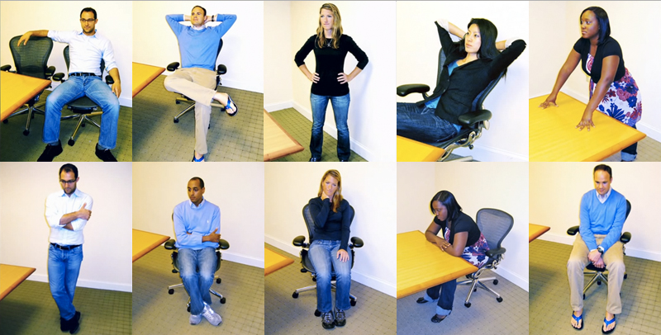
power poses
High power poses:
Low power poses:
Notes:
These are examples of power poses. The top row shows high power poses that you should practice right before your interview or presentation to start feeling powerful. The bottom row depicts low power poses that show reduced confidence.

Slide 7
Feeling Powerful
Being aware of power dynamics is crucial while interviewing
  It is more common for women to reduce their stance than men
  Make sure to stay confident in an interview regardless
Power poses:
  Increase risk tolerance
  Increase testosterone and decrease cortisol
  Help to “fake it until we make it,” but really fake it until we become it
Do not power pose while presenting or interviewing
Notes:
During an interview, it is important to be aware of the power dynamics between you and the interviewer. It is more common for women than men to reduce their stance due to the perceived power dynamics. Make sure to stay confident and feel powerful during your interview regardless. Power poses are shown to increase risk tolerance, increase testosterone for confidence, decrease cortisol to lower stress, and help us to not only fake it until we make it, but really fake it until we become it. Also, it is important to remember not to power pose while presenting or interviewing.

Slide 8
the presentation
Stand in a supported position with your arms by your side or use them naturally
Scan the room and make eye contact with your peers
  Keeping eye contact can make the presentation seem more like a conversation
Speak at a steady pace and make sure to breathe!
Use visuals if you want some of the attention taken off of you
Notes:
When presenting, these are some key tips to remember. It is important to stand in a supported position with your arms by your side or use them naturally. Scan the room and make eye contact with your peers; Keeping eye contact can make the presentation seem more like a conversation with the person you are looking at rather than speaking to a large room. Make sure to speak at a steady pace and most importantly make sure to breathe! You can also use visuals to take some of the attention off of you while you are presenting.

Slide 9
The interview
Walk in, make eye contact, greet your interviewer(s), and give a firm handshake
Make sure to sit upright in a comfortable and supported position
If you tend to fidget try to keep your hands flat or hold them together on your lap
Make sure to sit still with both feet on the ground if your chair is able to swivel.
Notes:
Now these are tips for a successful interview. First when you walk in, make sure to make eye contact when you greet your interviewers. Giving a firm handshake is always a great start to an interview. When seated make sure to sit upright in a comfortable and supported position. If you tend to fidget, try to keep your hands flat on your lap or gently clasp them on your lap or on top of a table. Lastly when seated, make sure to sit still and plant both feet on the ground if your chair is able to swivel to reduce movement.

Slide 10
The interview (Cont.)
Do not feel pressured to answer questions right away
  Take a moment to breathe, restate the question in your answer, and then deliver your response.
  Pauses feel a lot longer in your head than they do to the person interviewing you
Make sure to have general answers prepared for commonly asked interview questions
No matter how you feel the interview went, make sure to end it by shaking the interviewers hand with a smile
Notes:
These are more tips to remember during your next interview. Do not feel pressured to answer questions right away. You can take a moment to breathe, restate the question in your answer, and then deliver your response. Remember that pauses feel a lot longer in your head than they do to the person interviewing you. Also, make sure to have general answers prepared for commonly asked interview questions, you can find multiple lists of these online. And no matter how you feel the interview went, make sure to end it by shaking the interviewers hand with a smile.

Slide 11
References
Carney, D. R., Cuddy, A. J., & Yap, A. J. (2010). Power posing: Brief nonverbal displays affect neuroendocrine levels and risk tolerance. Psychological science, 21(10), 1363-1368.
Cuddy, A.J. (2012). Your body language may shape who you are [Video file]. Retrieved from https://www.ted.com/talks/amy_cuddy_your_body_language_ shapes_who_you_are
Cuddy, A. J., Wilmuth, C. A., Yap, A. J., & Carney, D. R. (2015). Preparatory power posing affects nonverbal presence and job interview performance. Journal of Applied Psychology, 100(4), 1286.
Morgan, N. (2011, August 11). Why we fear public speaking and how to overcome it. Retrieved January 24, 2018, from https://www.forbes.com/sites/nickmorgan/2011/03/30/why-we-fear-public-speaking-and-how-to-overcome-it/#6801e9a460b2
All images were taken by Google Images
Notes:
These are the sources for this presentation and thank you for listening to this workshop. Now you are equipped with tips to feel powerful in your next presentation or interview.

