Slide 1

How to Break Down Readings
Kortschak Center for Learning and Creativity
University of Southern California
Valeria Plascencia
Notes:
Hello and thank you for tuning into the How to Break Down Readings Workshop. My name is Valeria Plascencia and I am an Academic Coach at the Kortschak Center for Learning and Creativity.

Slide 2
Learning Outcomes
Identify a strategy to decrease stress levels.
Create a weekly action plan.
Plan ahead reading assignments.
Notes:
Learning outcomes for this workshop are that you will be able to identify a strategy to decrease your stress levels, you will also be able to create a weekly action plan and lastly you will be able to plan ahead reading assignments.

Slide 3
Overview and Importance
You will learn how to break up readings that are assigned using a weekly action plan.
Decrease Stress Levels
Increase focus
Improves organization
Notes:
During this Workshop you will learn how to break up your readings that are assigned using a weekly action plan some of the benefits of dividing up your readings is that it improves organization, it will decrease your stress levels and increases focus for your course material.

Slide 4
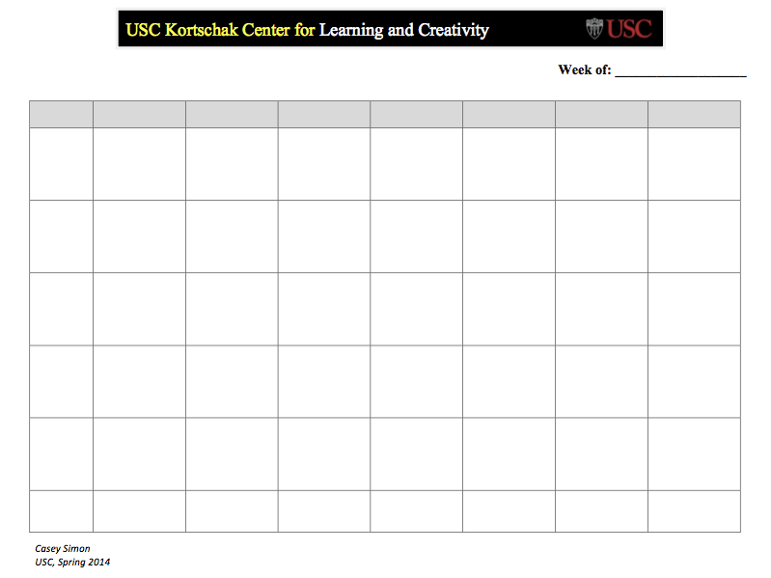
Welcome
Welcome to the Breaking Down Readings Workshop.
Please take the time to download the “Blank Weekly Action Plan” worksheet.
Notes:
Today we will be going over how to break down your readings using a Weekly Action Plan Worksheet. Please take the time to download a blank Weekly Action Plan Worksheet. If you would like to physically write on your Weekly Action Plan instead of typing, take the time to print it out. You will also need a separate sheet of paper or a blank document opened to take note of assigned readings you have for the week.

Slide 5
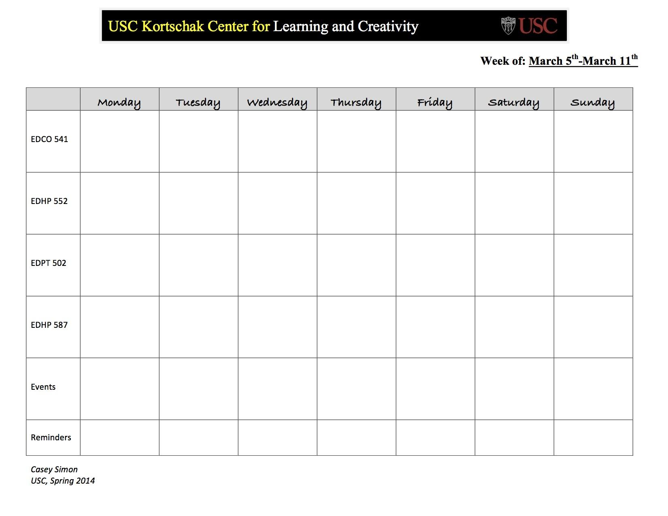
Step 1
Fill in the days of the week, your classes, events and reminders on your weekly action plan.
Notes:
You will begin by filling out the days of the weeks on the first row, then you will fill out your classes on the first column. You can add events or reminders you might have for that specific week. You can begin your action plan on any day of the week that you'd like, it doesn't have to start on Monday, whatever works best for you.

Slide 6
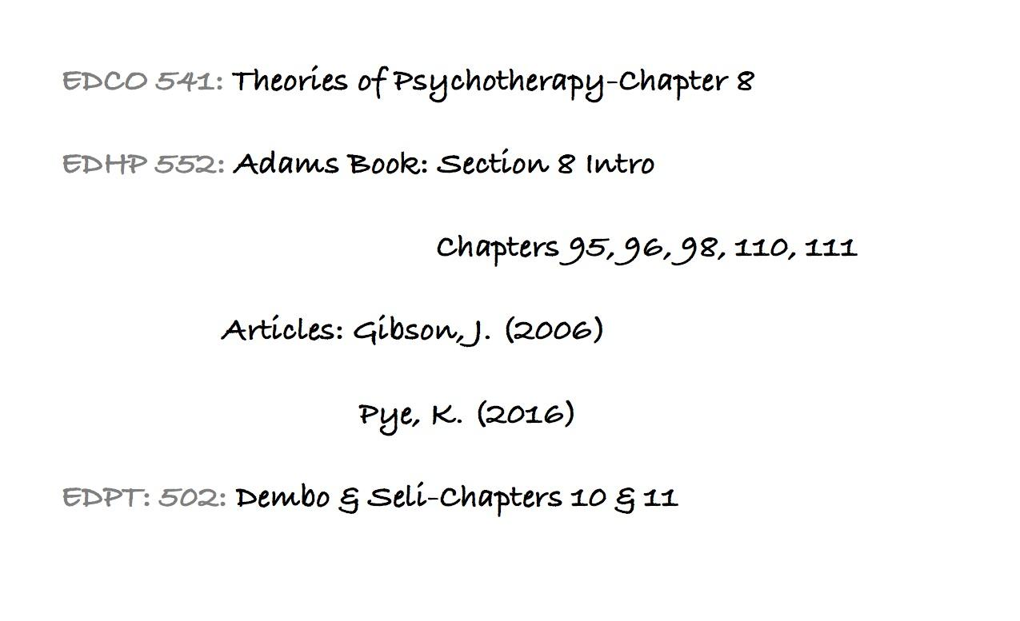
Step 2
Look through your class syllabus and take note of the readings you have assigned for the week.
Notes:
Next you will look through your class syllabus or planner where ever you have your readings written down that you have assigned for the week. Write down either the name of the book or the name of the article maybe the chapter you may have for that specific class. You may do this on the back of your weekly action plan if you printed it or on a blank document. This is an example of how It might look like.

Slide 7
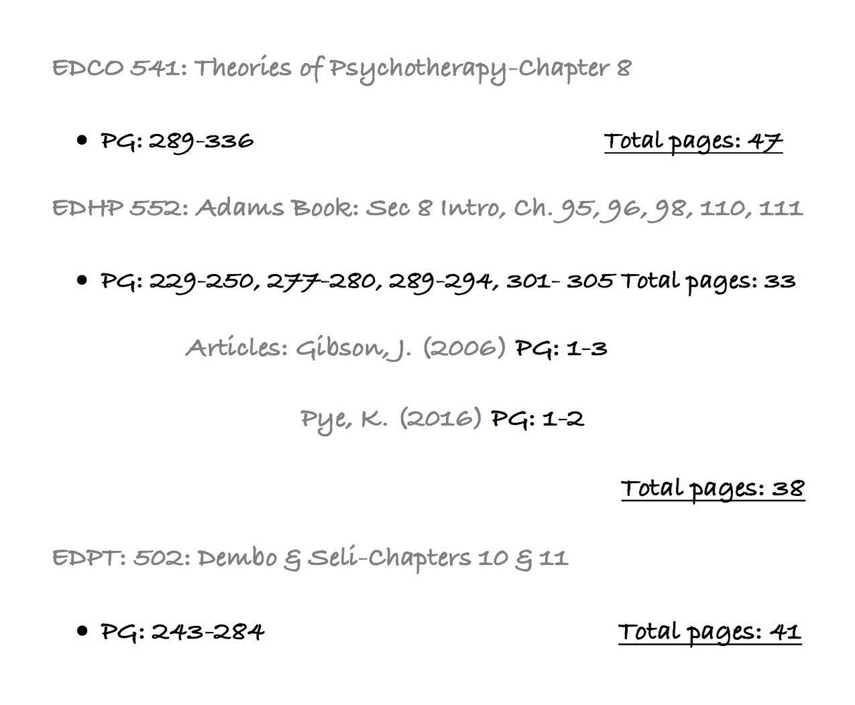
Step 3
Identify the number of total pages you have for each assigned reading for that week.
Notes:
The next step is for you to identify the the page numbers and the total number of pages you have for each reading assigned. Write down the total number of pages next to the chapter or article that you will be reading for that class. You may use the example here to guide you when identifying your readings. Also don't forget to keep in mind the density of your readings depending on your specific classes, two pages in one class maybe different than two pages from another class.

Slide 8
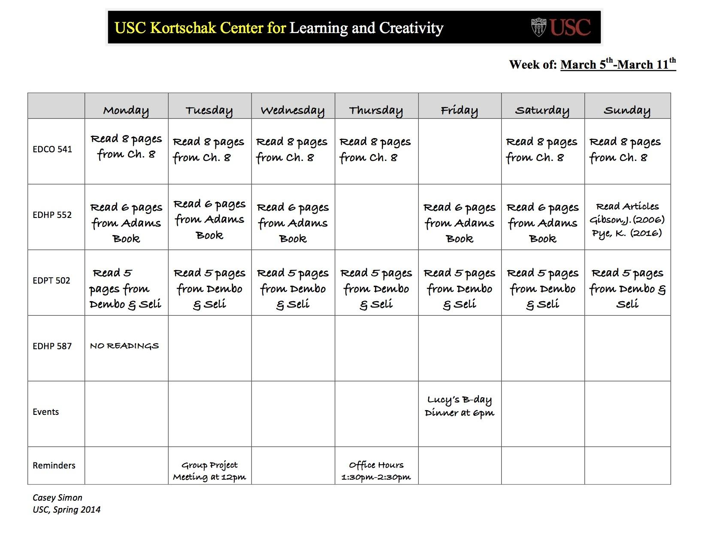
Step 4
Divide the number of pages by the number of days you would like to work on.
Notes:
Now the next step you will need to bring out your action plan. You will add any event or commitments you have for the week. then you will divide the number of pages by the number of days you would like to work on that specific reading. Keep in mind if you have any events or commitments on a specific day so you can do less reading on those days.

Slide 9
Notes:
You should keep your action plan somewhere that you will see it regularly throughout your week. You can also take a photo of it and keep it on your phone to refer back to it as much as you may need throughout the week. You may also use a weekly action plan to break down math homework or writing an essay. Thank you for participating in the How to Break Down Readings Workshop.

