Slide 1
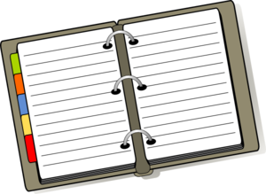
How to Organize a binder/folder
The Kortschak Center for Learning and Creativity
Presented by: Marc Roaquin
Notes:
This workshop will help you in creating a well organized binder for school.
To understand organization, you must learn the definition of “organize”, which is the formation of a coherent unity or functioning whole.

Slide 2
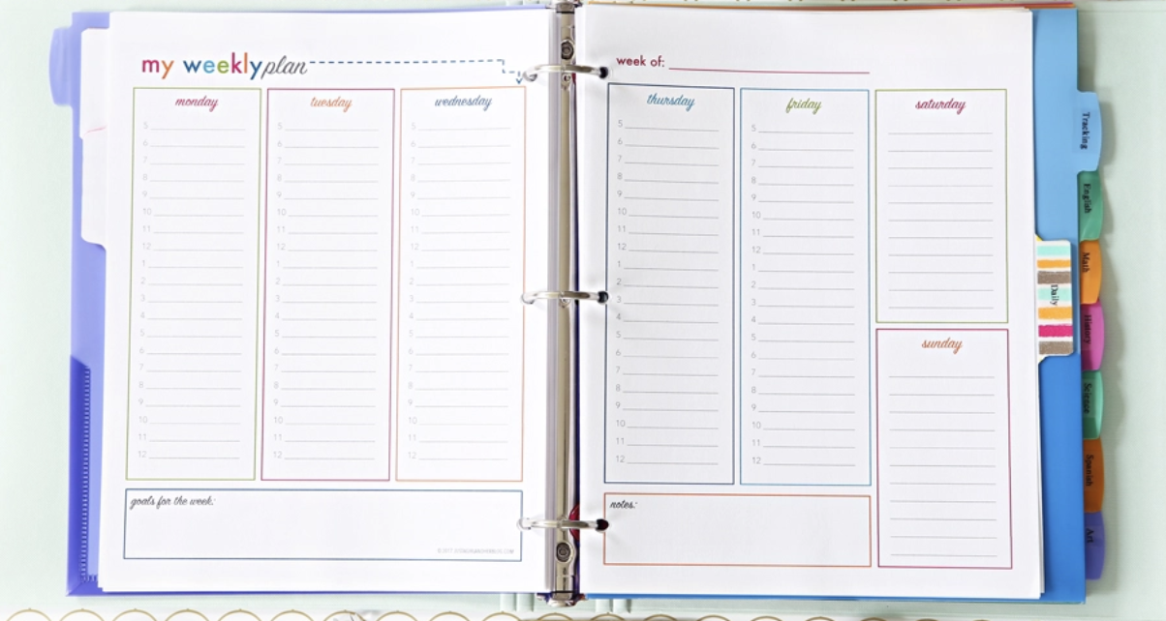
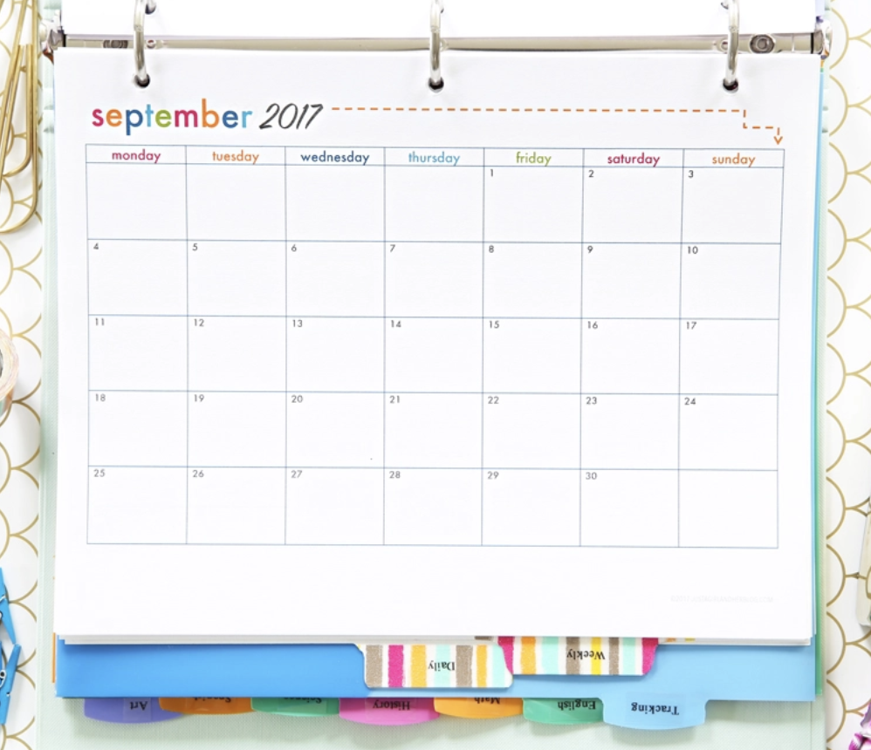
Learning Objectives
By the end of this presentation you should be able to:
Understand the importance behind organizing your binder
Assess how you stay organized
Develop your own way of organizing your binder.
Retrieved from: Google Images
Notes:
The learning objective: This presentation will show you the value in organizing your binder, analyze how to stay organized, and create efficient strategies towards organization.

Slide 3
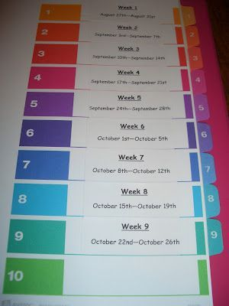
ORGANIZATION MATTERS
Everything has a spot
Having a binder(s) helps you be accountable
You are able to track progress
Retrieved from: Google Images
Notes:
Why does organization matter
Everything has a spot: with a binder, you know exactly where to find all those important documents, school assignments, dates, calendars, etc.
Having a binder(s) helps you be accountable: Everything is written down and organized, which mean there is no hiding from it.
You are able to track progress: time budgeting, accountability, and school binders. There is a clear starting point and being organized shows you how far you have come.

Slide 4
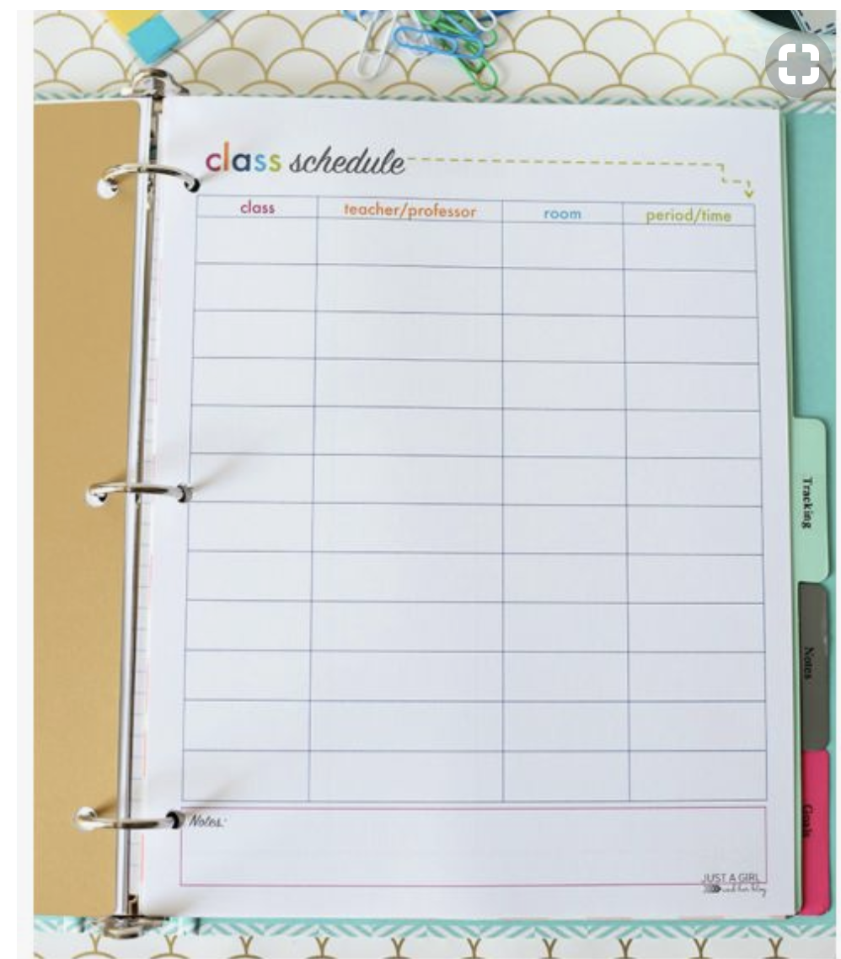
Importance of Organization
Organizational strategies are useful in remembering class material (Dembo & Seli, 2016).
Categories provide useful retrieval cues in many situations (Dembo & Seli, 2016).
You can organize your binder/folder based on categories (ex. Biology, Math, or English)
A body of new information learned is stored more effectively and remembered more when it is organized (Ormrod, 2011).
Retrieved from: Google Images
Notes:
Importance of Organization
- According to Dembo & Seli, organization is useful in remembering class materials.
In many situations, having designated categories within your binder reinforces retrieval cues.
A way in which you can organize your binders can be by subjects (math, biology, English)
A benefit of organization is that new information can be stored more easily than a cluttered mess.

Slide 5
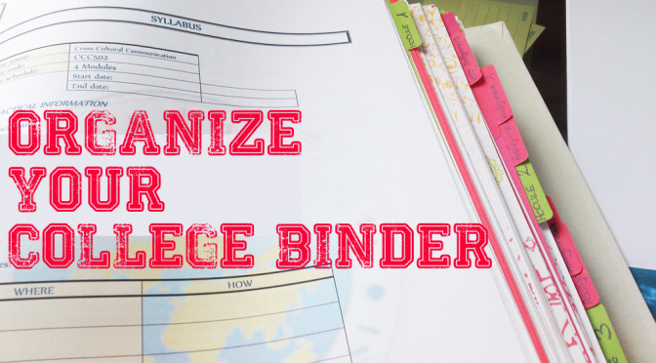
Organizing the binder/folder
        Designate one binder/folder for each course.
        Label each tab accordingly.
        Put dividers into your binders.
Retrieved from: Google Images
Notes:
Organizing the binder/folder
Here are the 7 steps in organizing your binder:
Designate one binder or folder for each course
Label each tab in the binder accordingly
Put divider into your binders

Slide 6
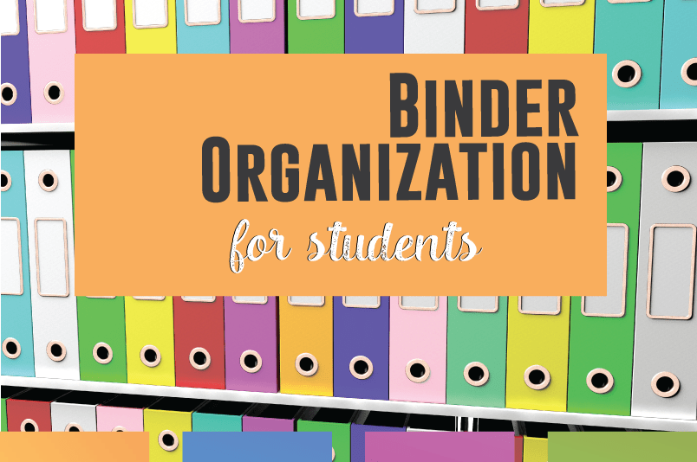
Organizing cont.
Decide what each section will be based on (e.g. course, subject, homework, etc.)
Date each document received and place them in the appropriate section of the binder.
Keep binders in a set place and label each spine.
Invest in a 3 hole puncher.
Retrieved from: Google images
Notes:
4. Decide what divider will be based on (will it be homework, projects, courses)
5. Date each piece of documents you receive and place it in the appropriate divider
6. Have a designated location for each binder and label the spine
7. Invest in a 3 hole puncher so that the sheets can be collected in a categorized manner in the binder.

Slide 7
References
Dembo, M. H., & Seli, H. (2016). Motivation and learning strategies for college success: A self- regulation approach (5th ed.). New York: Routledge.
Google images
Lawson, A. (2017, July 25). Printable Student Binder (blog) Retrieved from https://justagirlandherblog.com/printable-student-binder/
Merriam-Webster. (n.d.). Definition of organize. Retrieved March 28, 2018, from https://www.merriam- webster.com/dictionary/organize
Ormrod, J. E. (2011). Human learning (6th ed.). Englewood Cliffs, NJ: Prentice Hall.
Notes:
Conclusion: Hopefully that through this workshop, you are now better equipped with organizing your very own binder for class.

