Slide 1
#GOALS BREAKING DOWN PROJECTS & FINALS
Kortschak Center for Learning & Creativity
Arlin Gonzalez
Notes:
Hello and thank you for tuning into our Setting Goals workshop. My name is Arlin Gonzalez, I am an Academic Coach at the Kortschak Center for Learning & Creativity and today we will be going over how you can meet your personal academic goals by using the five important steps of goal setting, while breaking down projects and finals.

Slide 2
LEARNING OBJECTIVES
Understand the goal setting process
Apply the goal setting process to the planning of your personal projects, papers, and finals
Assess the pros & cons of your goal setting plan
Develop a goal setting process/plan appropriate for your project/final specific goals
Notes:
By the end of this workshop students will be able to understand the goal setting process, apply the goal setting process to the planning of personal projects, papers, and finals, assess the pros & cons of their goal setting plans, and develop a goal setting process that is appropriate for their own project and final goals.

Slide 3
WORKSHEET LINKS
SMART Goal Worksheet
Project Plan
Action Plan
Notes:
Before we get started, take some time to download the following worksheets so you can follow along with the presentation.

Slide 4
(Google.com)
Notes:
Research has shown that when one sets a goal, we are more likely to accomplish the task (Dembo & Seli, 2016). Not only do goals help improve performance they also help with motivation (Dembo & Seli, 2016). However, it is important to note what kind of goals we are setting. Often times we encounter the mistake of setting goals, that are either too big or too broad, that in the long run don’t aid our efficiency or drive to complete them.

Slide 5
THE GOAL SETTING PROCESS
Notes:
The goal setting process is an important learning strategy that helps students and people in general find meaning in their every day lives while achieving their goals and ambitions, and simultaneously helps set positive expectations for success (Dembo & Seli, 2016). The goal setting process is broken down into 5 steps.

Slide 6
1. IDENTIFY & DEFINE
THINK
IDENTIFY
DEFINE
USING S.M.A.R.T.
(Dembo & Seli, 2016, p.107-109)
(Google.com)
Notes:
The first step in the goal setting process is identifying and defining a goal. A good way to start is by asking ourselves what we would like to accomplish? Or what needs to get done? For example pass our calculus exam or finish writing our final English paper. Once that is done it is important to define our goal, this can be done by breaking down our main goal and verifying that it’s S.M.A.R.T. (Specific, Measureable, Attainable, Relevant, & Time Bound). For example I want to complete two practice tests 3 days before the exam or I want to complete my final English paper a week before it is due. Refer back to the SMART Goals worksheet you downloaded so you can create your own goals.

Slide 7
2. GENERATE & EVALUATE ALTERNATIVE PLANS
HOW?
REFLECT
STRENGTHS VS. WEAKNESSES
CONSIDER ALTERNATIVES
(Dembo & Seli, 2016, p.110-111)
(Google.com)
Notes:
In step 2, we generate and evaluate alternative plans. We take the time to ask ourselves, How? How is it that we plan to accomplish our goal? And we reflect on past experiences? For example, I have a tendency to become frustrated and give up if I study calculus by myself, so I should consider studying a group of friends, or I usually have a hard time developing my thesis statements when writing a paper so I will schedule an appointment with writing services so they can help guide me. Using the same SMART Goals worksheet from before, turn it over to the back and fill out the pros and cons box to identify possible obstacles you foresee and how you plan to overcome them when working on your new goal.

Slide 8
3. MAKE AN ACTION PLAN
DEVELOP A PLAN
LIST TASKS
USE INTERMEDIATE GOALS
SET DEADLINES
“IF-THEN PLAN”
(Dembo & Seli, 2016, p.111)
(Dembo & Seli, 2016, p.112)
Notes:
During the third step of the goal setting process we can start to further develop our goals by making an action plan. Now that we have outlined our goal and reflected on what works best for us we can start to take action by listing the tasks we need to get done. A good way to list our tasks is by using intermediate goals as a way to be specific and identify exact tasks. It is also important to set deadlines so that we can hold ourselves accountable and note our progress. Creating an “if-then plan”, is also a good strategy to have when creating an action plan, so in the case that something happens you are prepared and know what to do and how to accommodate your goals according to circumstances. For example establishing a deadline of completing your research paper 3 days in advance so you have enough time to set up an appointment with a writing center center tutor to revise it for you, and having an allowing an extra day or two in case there are no open slots available. Table 4.2 gives an example of how you can break down your goal into intermediate goals. During this step you can use the Project Plan or Action Plan worksheets you downloaded, or simply create a checklist of the intermediate goals they have to accomplish to help you keep track of your plan.

Slide 9
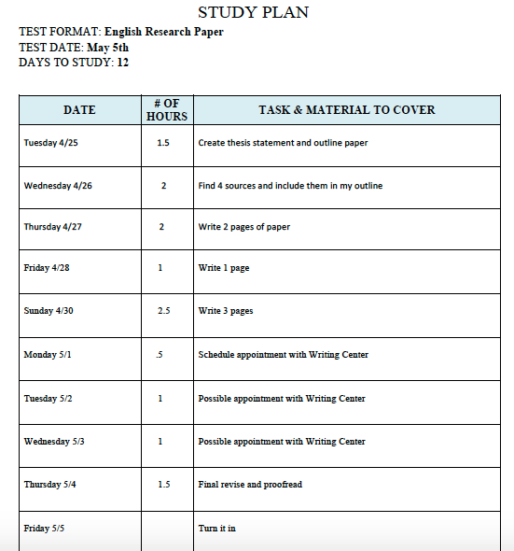
4. IMPLEMENT THE PLAN
ACTION!
CHECK PROGRESS
MAKE CHANGES
(Dembo & Seli, 2016, p.112)
Notes:
In step 4, we are ready to take action. After handling all the planning and sorting out what needs to get done, you can now get to work and start accomplishing each task. Be sure to check your progress as you go and note how things are going. You might notice that you forgot to include a specific task, and that’s okay. Making changes to your plans are encouraged especially as you learn how to navigate the process of goal setting. The more familiar you become with the process the less modifications you will need to adjust your plan.

Slide 10
5. EVALUATE YOUR PROGRESS
(Dembo & Seli, 2016, p.112)
(Google.com)
Notes:
In step 5 you can step back and evaluate your progress. Ask yourself, How well did your plan work out? How many tasks did you complete? Were there any tasks that gave you trouble, and if so why? What problems came up? Were you able to accomplish your goal? What new strategies can you implement next time to avoid this? Through reflecting and evaluation you can determine what new approaches you can use to help reach your goals in the future, and overall become more aware of what works and doesn’t work for you.

Slide 11
THANK YOU!
Notes:
Congratulations! You have successfully gotten through the 5 steps needed in order to break down your project or study plan.
Thank you for watching, we hope that after this video you feel more confident in your ability to prepare and plan for your future projects and exams.

