Slide 1
Meditation: “Om” Your Way To Academic Success
Micki Smith
Kortschak Center Academic Coach
(Top Image: http://greatist.com/meditation;
Bottom Image: http://www.learningmeditation.com/RotationImages/RESTORE_000014185704Resized.jpg)

Slide 2
Learning Outcomes
Understanding of Benefits
Techniques and Tools
(Source: Google Images)

Slide 3
First, Ask Yourself…
Does school ever stress you out?
Do you experience other stressors?
How do you cope with this stress?
Healthy habits
Unhealthy habits
(Image: http://www.justintarte.com/2011/12/top-10-questions-to-ask-yourself-in.html)

Slide 4
What Is It?
Meditation: “the action or practice of meditating”
Meditate: “to think deeply or focus one’s mind for a period of time, in silence or with the aid of chanting, for religious or spiritual purposes, or as a method of relaxation”
(https://www.merriam-webster.com;
Image: http://meditationiseasy.com/blog/meditation-techniques/chakra-meditation)

Slide 5
Some Common Myths
I can’t meditate because…
I can’t sit still.
I don’t have time.
I don’t know if I’m doing it right.
I’m not supposed to have any thoughts while meditating.
It is only for stressed out people.
It has to be religious or spiritual.
(http://www.huffingtonpost.com/2015/03/08/meditation-myths_n_6804780.html;
Image: http://www.brightfocus.org/glaucoma/article/five-common-myths-about-glaucoma)

Slide 6
Meditation has been found to…
Reduce stress
Improve concentration
Encourage a healthy lifestyle
Increase self-awareness
Increase happiness
Increase acceptance
Slow Aging
Benefit cardiovascular and immune health
(http://www.huffingtonpost.com/2014/09/19/meditation-benefits_n_5842870.html; Image: http://www.someecards.com/usercards/viewcard/MjAxMy00M2VkNmU0ZTYyMTUxOGYw)

Slide 7
For STUDENTS, meditation may…
Increase IQ levels
Decrease academic stress
Improve academic achievement
Lead to better focus
Enhance brain integrity and efficiency
Reduce depression and anxiety
Reduce destructive addiction (drugs and alcohol)
Decrease absenteeism and leads to better behavior
Lower risk of cardiovascular diseases
Increase happiness and confidence!
(http://tmhome.com/benefits/10-benefits-of-meditation-for-students/;
Image: https://commencement.usc.edu/)

Slide 8
That’s great and all, but how do I do it???
(Top Image: http://siegefitness.blogspot.com/2012/03/muscle-confusion-i-am-so-confused.html;
Bottom Image: http://soberingthoughts.info/pages/b/baby-confused/)

Slide 9
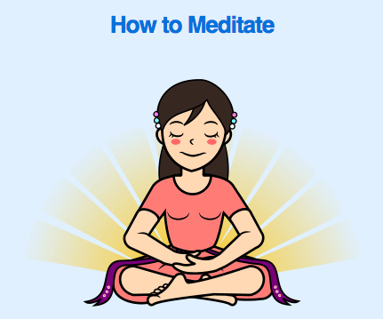
Choose a conducive environment
Nice quiet place where you won’t be disturbed
Find a position that is comfortable for you
Breathe slowly and deeply
Close your eyes if comfortable or direct your soft, unfocused gaze downwards
Inhale through your nose and out through your mouth
Be aware
Focus attention on breathing, and be mindful of each breath going in through your nose and out through your mouth
If your mind wanders, do not be disheartened! Notice it and bring your attention back to breathing
(https://theconsciouslife.com/how-to-meditate-a-guide-for-beginners.htm)

Slide 10
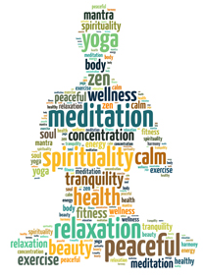
What Kind Should I Do?
Transcendental Meditation
Heart Rhythm Meditation
Kundalini
Guided Visualization
Qi Gong
Zazen
Mindfulness
(https://visualmeditation.co/7-types-of-meditation/;
Image: http://itsusync.com/best-meditation-music-with-binaural-beats)

Slide 11
Some of the Best Apps for Meditation
iPhone
Android
Buddhify – $4.99
Calm – Free
Headspace – Free
MINDBODY Connect – Free
Mindfulness App – $1.99
Omvana – Free
Smiling Mind – Free
Take A Break - Free
Buddhify – $2.99
Calm – Free
Headspace – Free
MINDBODY Connect – Free
Mindfulness App – $1.99
Omvana – Free
Smiling Mind – Free
Take A Break - Free
(http://www.healthline.com/health/mental-health/top-meditation-iphone-android-apps)

